Slide 1
2.3 Carbohydrates and lipids
Essential idea: Compounds of carbon, hydrogen and oxygen are used to supply and store energy.
When you are building and drawing molecules it is essential to remember that it's the bonds between the atoms where energy is stored. Organic molecules are often complex and hence contain any bonds. The background image is a molecular model that shows a small part of a cellulose molecule.

Slide 2
Understandings, Applications and Skills
 | Statement | Guidance
2.3.U1 | Monosaccharide monomers are linked together by condensation reactions to form disaccharides and polysaccharide polymers. | Sucrose, lactose and maltose should be included as examples of disaccharides produced by combining monosaccharides. The structure of starch should include amylose and amylopectin.
2.3.U2 | Fatty acids can be saturated, monounsaturated or polyunsaturated. | Named examples of fatty acids are not required.
2.3.U3 | Unsaturated fatty acids can be cis or trans isomers.
2.3.U4 | Triglycerides are formed by condensation from three fatty acids and one glycerol.
2.3.A1 | Structure and function of cellulose and starch in plants and glycogen in humans.
2.3.A2 | Scientific evidence for health risks of trans fats and saturated fatty acids.
2.3.A3 | Lipids are more suitable for long-term energy storage in humans than carbohydrates.
2.3.A4 | Evaluation of evidence and the methods used to obtain the evidence for health claims made about lipids.
2.3.S1 | Use of molecular visualization software to compare cellulose, starch and glycogen.
2.3.S2 | Determination of body mass index by calculation or use of a nomogram.

Slide 3
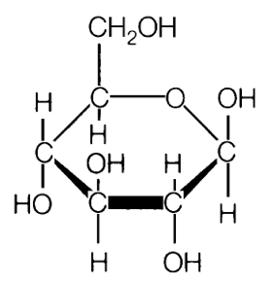
2.3.U1 Monosaccharide monomers are linked together by condensation reactions to form disaccharides and polysaccharide polymers.
Monosaccharide #1
Glucose has the formula C₆H₁₂O₆
It forms a hexagonal ring (hexose)
Glucose is the form of sugar that fuels respiration
Glucose forms the base unit for many polymers
5 of the carbons form corners on the ring with the 6th corner taken by oxygen
http://commons.wikimedia.org/wiki/File:Glucose_crystal.jpg

Slide 4
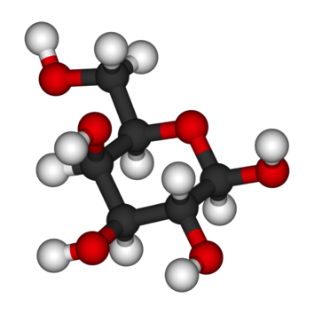
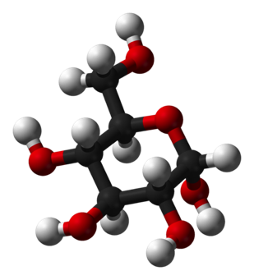
2.3.U1 Monosaccharide monomers are linked together by condensation reactions to form disaccharides and polysaccharide polymers.
Monosaccharide #2
Galactose is also a hexose sugar
It has the same formula C₆H₁₂O₆
but is less sweet
Spot the difference
Most commonly found in milk, but also found in cereals
Galactose
Glucose
http://commons.wikimedia.org/wiki/File:Galactose-3D-balls.png
http://commons.wikimedia.org/wiki/File:Alpha-D-glucose-3D-balls.png

Slide 5
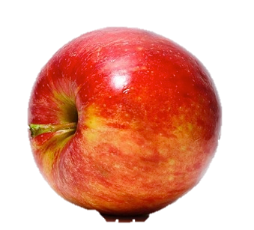
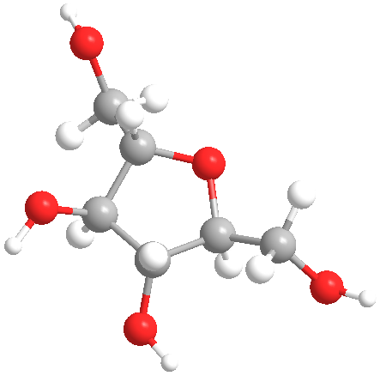
2.3.U1 Monosaccharide monomers are linked together by condensation reactions to form disaccharides and polysaccharide polymers.
Monosaccharide #3
Fructose is another pentose sugar
Commonly found in fruits and honey
It is the sweetest naturally occurring carbohydrate
http://www.flickr.com/photos/max_westby/4045923/
http://commons.wikimedia.org/wiki/File:Red_Apple.jpg
http://commons.wikimedia.org/wiki/File:3dfructose.png

Slide 6
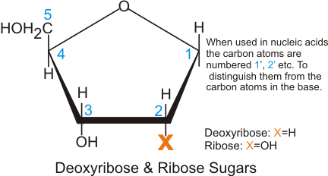
2.3.U1 Monosaccharide monomers are linked together by condensation reactions to form disaccharides and polysaccharide polymers.
Monosaccharide #4
Ribose is a pentose sugar, it has a pentagonal ring
It forms the backbone of RNA
Deoxyribose differs as shown in the diagram, and forms the backbone of DNA
N.B. the above monosaccharides are included for continuity from statement “2.1.S2 Identification of biochemicals such as sugars, lipids or amino acids from molecular diagrams.”. They are not referred to in the formation of the following disaccharides and polysaccharides.
Original owner of image unknown

Slide 7
2.3.U1 Monosaccharide monomers are linked together by condensation reactions to form disaccharides and polysaccharide polymers.

Slide 8
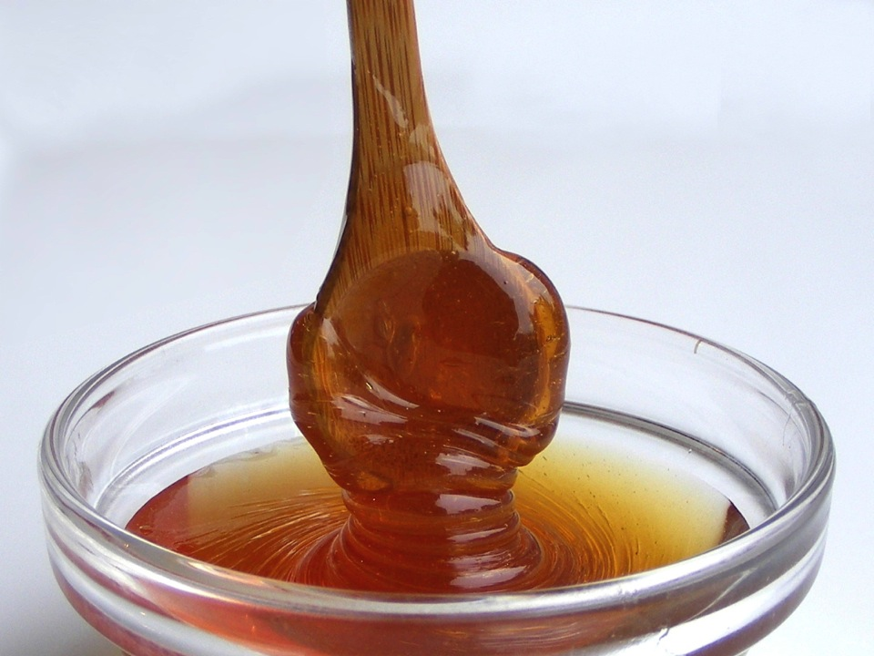
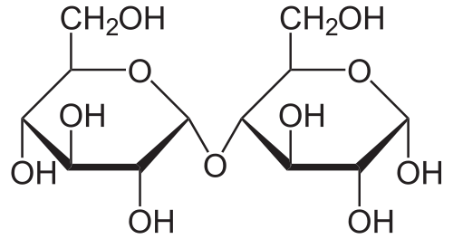
2.3.U1 Monosaccharide monomers are linked together by condensation reactions to form disaccharides and polysaccharide polymers.
Disaccharide #1
Maltose (C₁₂H₂₂O₁₁) is a dimer of glucose
Gosh! Isn’t it sweet?! The two glucose molecules are holding hands.
http://commons.wikimedia.org/wiki/File:Maltose_syrup.jpg
http://commons.wikimedia.org/wiki/File:Maltose_Haworth.svg

Slide 9
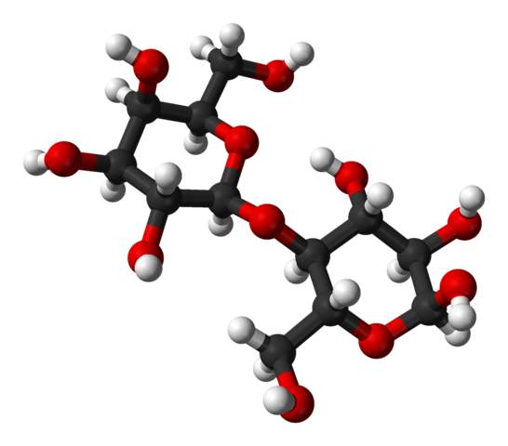
2.3.U1 Monosaccharide monomers are linked together by condensation reactions to form disaccharides and polysaccharide polymers.
Disaccharide #2
_{(Literally “two sugars”)}
Lactose (C₁₂H₂₂O₁₁) is most commonly found in milk
The two subunits that make up lactose are glucose and galactose, our friends from a couple of slides ago.
http://www.flickr.com/photos/vermininc/2764742483/
http://commons.wikimedia.org/wiki/File:Alpha-lactose-from-xtal-3D-balls.png

Slide 10
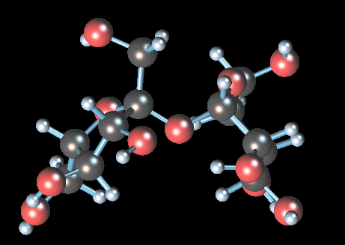
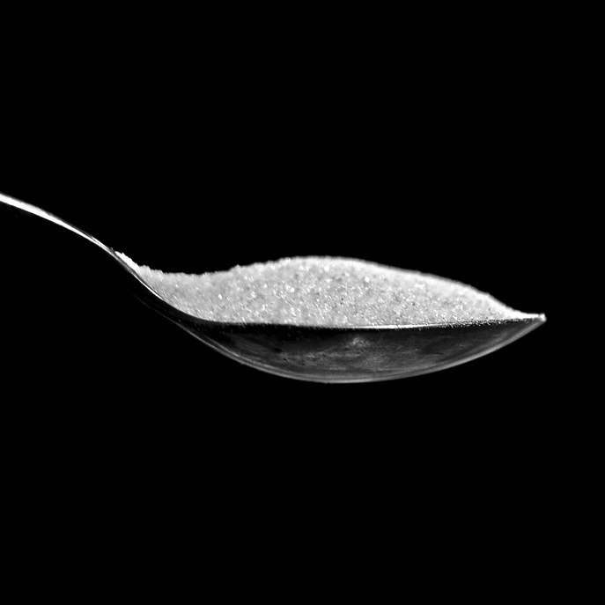
2.3.U1 Monosaccharide monomers are linked together by condensation reactions to form disaccharides and polysaccharide polymers.
Disaccharide #3
Sucrose (C₁₂H₂₂O₁₁) is also known as table sugar
The two subunits that make up sucrose are glucose and fructose.
The two monosaccharides that make it up are
glucose and fructose
http://commons.wikimedia.org/wiki/File:Sucrose.gif
http://www.flickr.com/photos/carowallis1/4388310394/

Slide 11
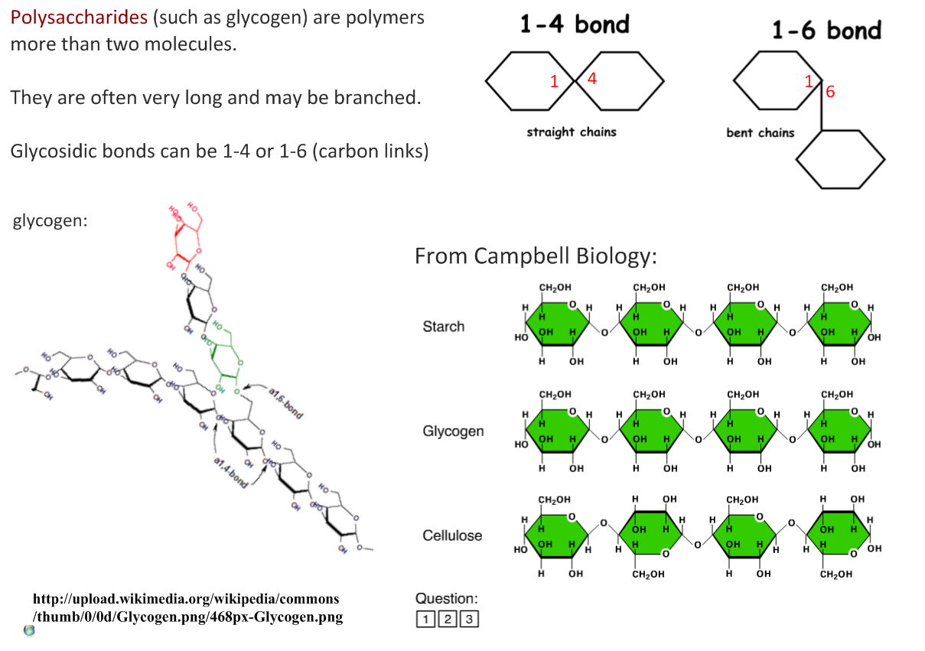
2.3.U1 Monosaccharide monomers are linked together by condensation reactions to form disaccharides and polysaccharide polymers.

Slide 12
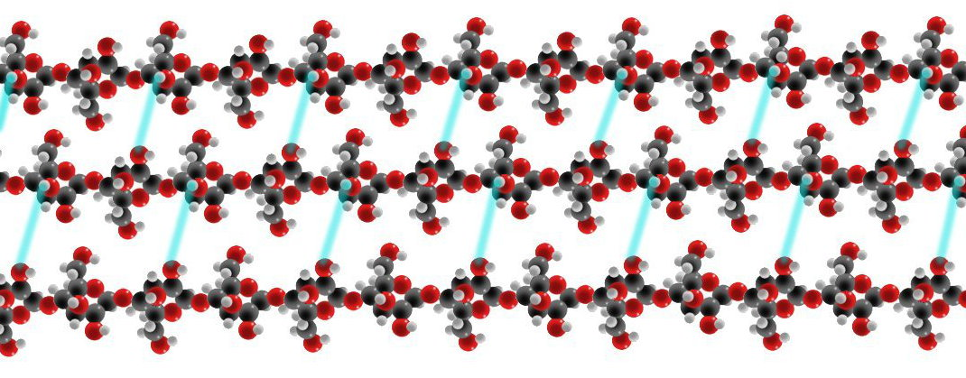
2.3.A1 Structure and function of cellulose and starch in plants and glycogen in humans.
Polysaccharide #1
Cellulose is made by linking together β-glucose molecules.
Condensation reactions link carbon atom 1 to carbon atom 4 on the next β-glucose.
The glucose subunits in the chain are oriented alternately upwards and downwards.
The consequence of this is that the cellulose molecule is a straight chain, rather than curved.
Cellulose
Cellulose molecules are unbranched chains of β-glucose.
Hydrogen bonds link the the molecules together.
The linked molecules form bundles called cellulose microfibrils.
They have very high tensile strength.
The tensile strength of cellulose (the basis of cell walls) prevents plant cells from bursting, even under very high (water) pressure.
http://en.wikipedia.org/wiki/File:Cellulose_spacefilling_model.jpg

Slide 13
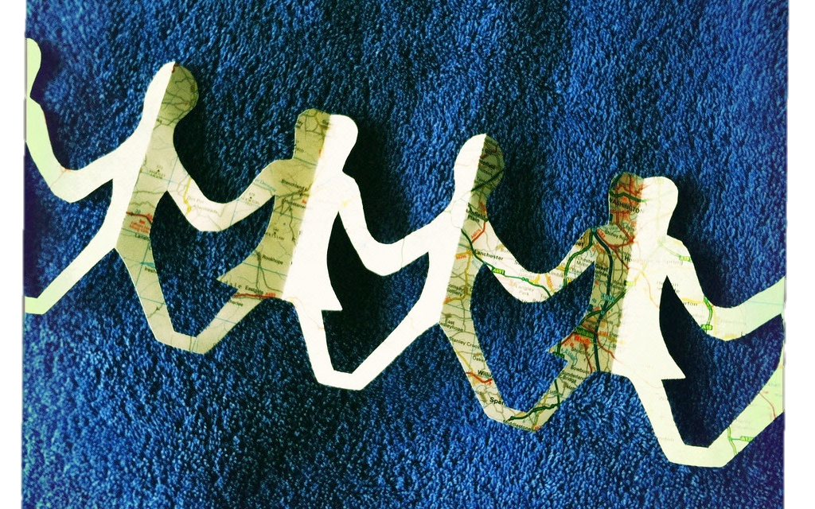
2.3.A1 Structure and function of cellulose and starch in plants and glycogen in humans.
Polysaccharide #2
Amylose and Amylopectin are both forms of starch and made from repeating glucose units
Starch is made by linking together α-glucose molecules
Condensation reactions link carbon atom 1 to carbon atom 4 on the next α-glucose
all the glucose molecules in starch can be orientated in the same way
The consequence of this is that the starch molecule is curved, rather than straight.
Size of the molecule is not fixed
http://www.flickr.com/photos/caroslines/5534432762/
http://commons.wikimedia.org/wiki/File:Amylose3.svg

Slide 14
2.3.A1 Structure and function of cellulose and starch in plants and glycogen in humans.
Polysaccharide #2
In amylose the chain of α-glucose molecules is un-branched and forms a helix.
Typically amylose is made up of 300-3,000 glucose units
In amylopectin the chain is branched, so has a more globular shape.
Due it’s branched nature amylopectin can be much larger consisting of 2,000-200,000 units
Starch is only made by plant cells.
Molecules of both types of starch are hydrophilic but are too large to be soluble in water.
Starch does not affect the osmotic balance of cells, i.e. cause too much water to enter them
It is easy to add or remove extra glucose molecules to starch
Therefore starch is useful in cells for glucose, and consequently energy, storage.
In seeds and storage organs such as potato cells glucose held as starch.
Starch is made as a temporary store in leaf cells when glucose is being made faster by photosynthesis than it can be exported to other parts of the plant.
http://www.flickr.com/photos/caroslines/5534432762/

Slide 15
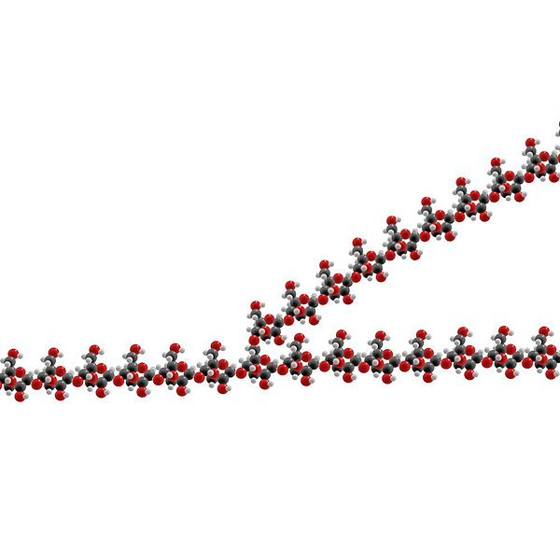
2.3.A1 Structure and function of cellulose and starch in plants and glycogen in humans.
Polysaccharide #3
Glycogen (C₆H₁₀O₅)_{n} is a polymer made from repeating glucose subunits
The molecule varies in size, typically it consists of 30,000 units
Glycogen is not just a simple chain, it branches many times
Condensation reactions link carbon atom 1 - 4 on the next α-glucose. Branches occur where a condensation reaction instead links carbon atom 1 – 6.
As a result the molecule is compact
Glycogen is made by animals and also some fungi.
It is stored in the liver and some muscles in humans.
It is used in cells where large stores of dissolved glucose would cause osmotic problems.
Glycogen does not affect the osmotic balance of cells, i.e. cause too much water to enter them
It is easy to add or remove extra glucose molecules to starch
Therefore glycogen is useful in cells for glucose, and consequently energy, storage.
http://en.wikipedia.org/wiki/File:Glycogen_spacefilling_model.jpg

Slide 16
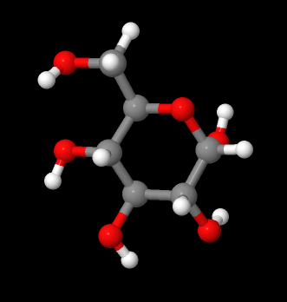
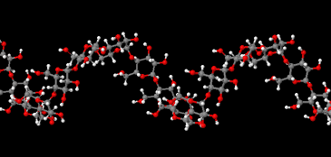
2.3.S1 Use of molecular visualization software to compare cellulose, starch and glycogen.
The easiest way to use jmol is to use the ready made models from on the biotopics website
Click on the models or the logo below to access them
Play with the models, move them, zoom in and out
Test yourself by answering the questions below:
Select the the glucose molecule and identify the colours used to represent carbon, hydrogen and oxygen atoms
Using the models identify and describe the differences between glucose, sucrose and fructose (hint: descriptions will be clearest if you refer to the numbered carbon atoms, see 2.3.U1)
Look at the amylose model and zoom out from it. Describe the overall shape of the molecule.
http://www.biotopics.co.uk/jsmol/glucose.html

Slide 17
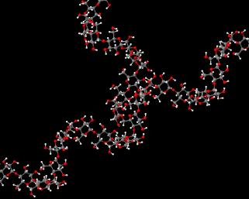
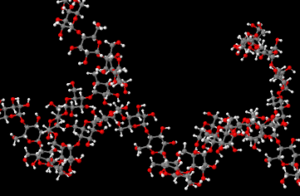
2.3.S1 Use of molecular visualization software to compare cellulose, starch and glycogen.
Zoom in on the amylose molecule. Each glucose sub-unit is bonded to how many other sub-units? Which carbons atoms used to form the glycosidic bonds? Are there any exceptions to these rules?
Select the amylopectin model and zoom in on the branch point. This glucose sub-unit is bonded how many others and which carbon atoms are used for bonded compared with the un-branched amylose molecule?
Using a similar approach to that above investigate the structure of glycogen and find the similarities and differences between it and both amylose and amylopectin.

Slide 18
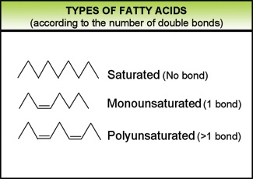
2.1.S2 Identification of biochemicals such as sugars, lipids or amino acids from molecular diagrams.
General structural formula for a fatty* acid
O
H₃C (CH₂)_{n} C
OH
Chain (or ring) of carbon and hydrogen atoms
Carboxylic group
*I prefer “big boned”
http://www.eufic.org/article/pt/nutricao/gorduras/expid/23/

Slide 19
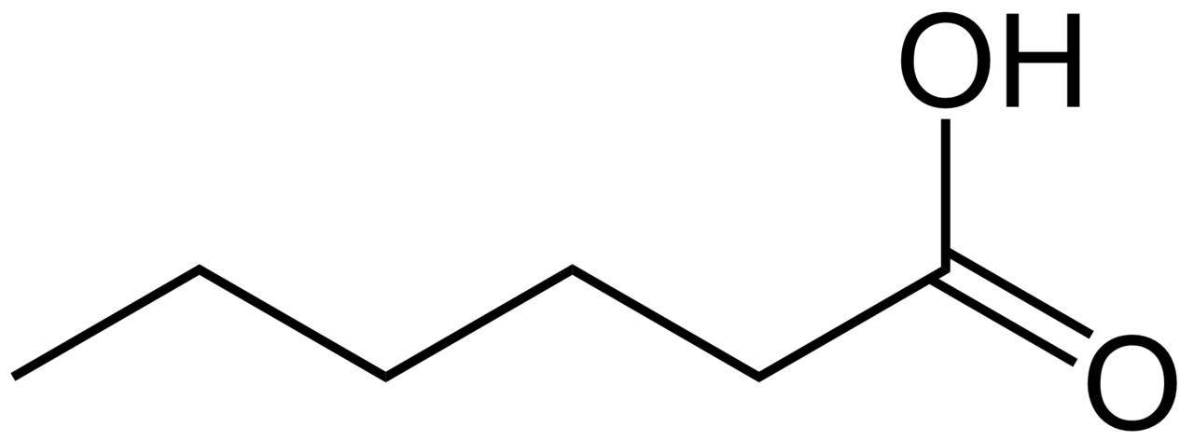
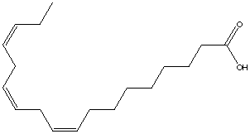
2.3.U2 Fatty acids can be saturated, monounsaturated or polyunsaturated.
Saturated, monounsaturated or polyunsaturated?
Q1 Oleic Acid
Q2 Caproic Acid
Q3 α-Linolenic Acid

Slide 20
2.3.U2 Fatty acids can be saturated, monounsaturated or polyunsaturated.
Saturated, monounsaturated or polyunsaturated?
Q1 Oleic Acid 1 double bond therefore monounsaturated
Q2 Caproic Acid no double bonds therefore monounsaturated
Q3 α-Linolenic Acid 3 double bonds therefore monounsaturated
n.b. the term saturated refers to whether more hydrogen can be added to the fatty acid. A double bond can be replaced if two hydrogen atoms are added. If there are no double bonds a fatty acid is said to be saturated as no more hydrogen atoms can be added.
https://commons.wikimedia.org/wiki/Fatty_acids#Polyunsaturated_fatty_acids_2

Slide 21
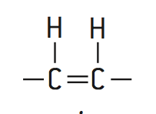
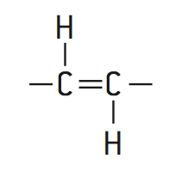
2.3.U3 Unsaturated fatty acids can be cis or trans isomers.
Cis-isomers | Trans-isomers
Very common in nature | Rare in nature – usually artificially produced to produce solid fats, e.g. margarine from vegetable oils.
the hydrogen atoms are on the same side of the two carbon atoms | the hydrogen atoms are on the same side of the two carbon atoms
The double bond causes a bend in the fatty acid chain | The double bond does not causes a bend in the fatty acid chain
Therefore cis-isomers are only loosely packed | Trans-isomers can be closely packed
Triglycerides formed from cis-isomers have melting points – they usually liquid at room temperature | Triglycerides formed from trans-isomers have melting points – they usually solid at room temperature

Slide 22
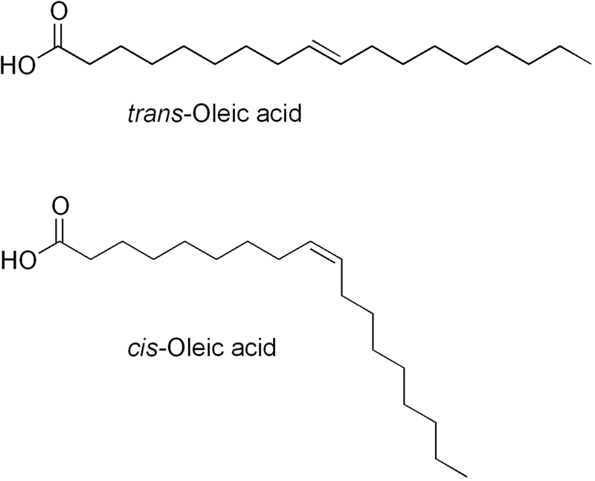
2.3.U3 Unsaturated fatty acids can be cis or trans isomers.
Q1 trans or cis isomers?
???
???

Slide 23
2.3.U3 Unsaturated fatty acids can be cis or trans isomers.
Q1 trans or cis isomers?

Slide 24
2.3.U3 Unsaturated fatty acids can be cis or trans isomers.
Q2 trans or cis isomer of α-Linolenic Acid?
All 3 double bonds are cis, each one causes a bend in the fatty acid chain.

Slide 25
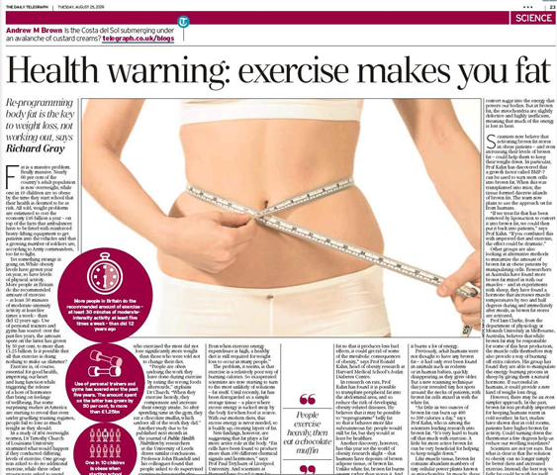
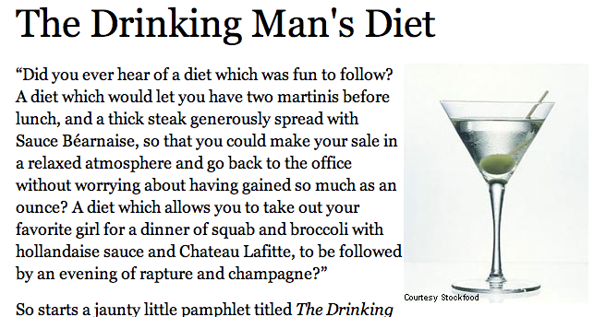
2.3.A4 Evaluation of evidence and the methods used to obtain the evidence for health claims made about lipids.
Which health claims are valid?
http://www.foxnews.com/health/2013/02/18/raspberry-ketone-be-wary-this-diet-trend/
http://www.forbes.com/2004/04/21/cz_af_0421feat.html
http://www.badscience.net/2009/08/health-warning-exercise-makes-you-fat/

Slide 26
2.3.A4 Evaluation of evidence and the methods used to obtain the evidence for health claims made about lipids.
Evidence for health claims comes from research. Some of this research is more scientifically valid than others.
Key questions to consider for the strengths are:
Is there a (negative or positive) correlation between intake of the lipid being investigated and rate of the disease or the health benefit?
If instead mean values are being compared how different are they? Has this difference been assessed statistically?
How widely spread is the data? This can be assessed by the spread of data points or the relative size of error bars. The more widely spread the data the smaller the significance can be placed on the correlation and/or the conclusion.
n.b. it is easiest to consider strengths by looking at effectively drawn graphs.
Evaluation = Make an appraisal by weighing up the strengths and limitations
Key questions to consider for the limitations are:
Was the measure of the health a valid one? e.g. cholesterol levels in blood are more informative than body mass index
How large was the sample size? Larger samples are more reliable.
Does the sample reflect the population as a whole or just a particular sex, age, state of health, lifestyle or ethnic background?
Was the data gathered from human or animal trials? If only done of animals how applicable are the findings?
Were all the important control variables, e.g. level of activity, effectively controlled?
Were the levels and frequency of the lipids (or substance studied) intake realistic?
How rigorous were the methods used to gather data? e.g. If only a survey was used how truthful were the respondents?

Slide 27
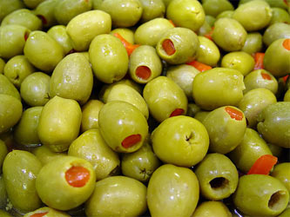
2.3.A2 Scientific evidence for health risks of trans fats and saturated fatty acids.
There have been many claims about the effects of different types of fat on human health. The main concern is coronary heart disease (CHD). In this disease the coronary arteries become partially blocked by fatty deposits, leading to blood clot formation and heart attacks.
A positive correlation has been found between saturated fatty acid intake and rates of CHD in many studies.
Correlation ≠ causation. Another factor, e.g. dietary fibre could be responsible.
There are populations that do not fit the correlation such as the Maasai of Kenya. They have a diet that is rich in meat, fat, blood and milk. They therefore have a high consumption of saturated fats, yet CHD is almost unknown among the Maasai.
Diets rich in olive oil, which contains cis-monounsaturated fatty acids, are traditionally eaten in countries around the Mediterranean. The populations of these countries typically have low rates of CHD and it has been claimed that this is due to the intake of cis-monounsaturated fatty acids.
Genetic factors in these populations could be responsible.
Other aspects of the diet could explain the CHD rates.
There is also a positive correlation between amounts of trans-fat consumed and rates of CHD.
Other risk factors have been tested, to see if they can account for the correlation, but none did. Trans-fats therefore probably do cause CHD.
In patients who had died from CHD, fatty deposits in the diseased arteries have been found to contain high concentrations of trans-fats, which gives more evidence of a causal link.
http://oliveoilsindia.com/green-olives/green-olives.jpg

Slide 28
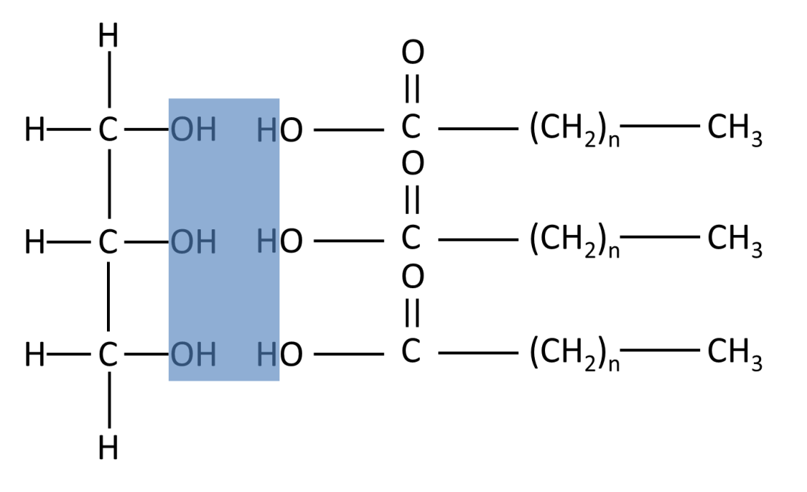
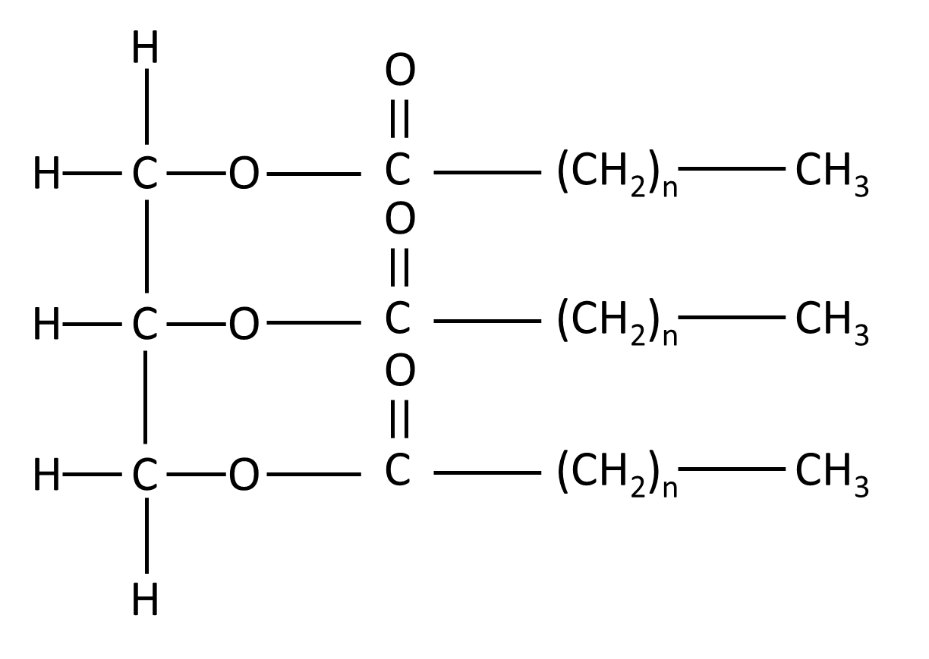
2.3.U4 Triglycerides are formed by condensation from three fatty acids and one glycerol.
Condensation reaction between glycerol and fatty acids
Glycerol
Three Fatty Acids
Triglyceride
Lipids are glycerol combined with 1, 2 or 3 fatty acids, therefore triglycerides are lipids
3H₂O
n.b. hydrolysis is the reverse of this process, catalysed by lipase
Covalent bonds called ester bonds are formed between the fatty acids and glycerol molecules.

Slide 29
2.3.A3 Lipids are more suitable for long-term energy storage in humans than carbohydrates.
Functions of lipids:
Structure: Phospholipids are a main component of cell membranes
Hormonal signalling: Steroids are involved in hormonal signalling (e.g. estrogen, progesterone, testosterone)
Insulation: Fats in animals can serve as heat insulators while sphingolipids in the myelin sheath (of neurons) can serve as electrical insulators
Protection: Triglycerides may form a tissue layer around many key internal organs and provide protection against physical injury
Storage of energy: Triglycerides can be used as a long-term energy storage source
Lipids are normally used for long-term energy storage whereas carbohydrates are used for short-term energy storage
The lipids that are used are fats. They are stored in specialized groups of cells called adipose tissue. Adipose tissue is located immediately beneath the skin and also around some organs including the kidneys.
http://www.flickr.com/photos/johnnystiletto/5411371373/

Slide 30
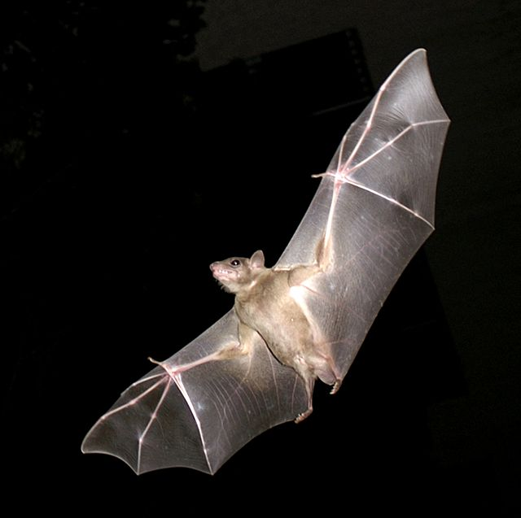
2.3.A3 Lipids are more suitable for long-term energy storage in humans than carbohydrates.
Reasons for using lipids for long-term energy storage:
The amount of energy released in cell respiration per gram of lipids is double that for carbohydrates (and protein)
Lipids add 1/6 as much to body mass as carbohydrates: fats are stored as pure droplets whereas when 1g glycogen is stored it is associated with 2g of water. This is especially critical for active animals as energy stores have to be carried.
(energy in) 1g lipids
Mass used for storage =
(energy in) 2g carbohydrate + 4g associated water
= 1 / 6
https://commons.wikimedia.org/wiki/Bat#mediaviewer/File:PikiWiki_Israel_11327_Wildlife_and_Plants_of_Israel-Bat-003.jpg

Slide 31
2.3.A3 Lipids are more suitable for long-term energy storage in humans than carbohydrates.
Why is glycogen is needed at all?
This is because glycogen can be broken down to glucose rapidly
and then transported easily by the blood to where it is needed
Fats in adipose tissue cannot be mobilized as rapidly
Glucose can be used either in anaerobic or aerobic cell respiration whereas fats and fatty acids can only be used in aerobic respiration

Slide 32
2.3.A3 Lipids are more suitable for long-term energy storage in humans than carbohydrates.
Glycogen is the medium-term energy storage molecule in animals. It is stored in the liver and muscles. The energy stored in glycogen is more readily available than the energy stored in fat.
Glucose in the bloodstream is for immediate use and will either be used in respiration to yield ATP or converted to glycogen or fat
Wallet
easy to get to,
would be too big if you put in all your money
An analogy:
Put it in your
(Glycogen)
You are
paid in cash
Deposit in the
(Glucose)
Bank
(Fat)
Can put lots of money here, more of a hassle to get it back out
Spend it!
(Respiration)

Slide 33
2.3.S2 Determination of body mass index by calculation or use of a nomogram.
In some parts of the world food supplies are insufficient or are unevenly distributed and many people as a result are underweight.
In other parts of the world a likelier cause of being underweight is anorexia nervosa. This is a psychological condition that involves voluntary starvation and loss of body mass.
Obesity is an increasing problem
in some countries. Obesity increases the risk of conditions such as coronary heart disease and type II diabetes. It reduces life expectancy significantly and is increasing the overall costs of health care in countries where rates of obesity are rising.
Body Mass Index (BMI) is used as a screening tool to identify possible weight problems, however, BMI is not a diagnostic tool. To determine if excess weight is a health risk further assessments are needed such as:
skinfold thickness measurements
evaluations of diet
physical activity
and family history
The table below can be used to assess an adult’s status
BMI | Status
Below 18.5 | Underweight
18.5 – 24.9 | Normal
25.0 – 29.9 | Overweight
30.0 and Above | Obese

Slide 34
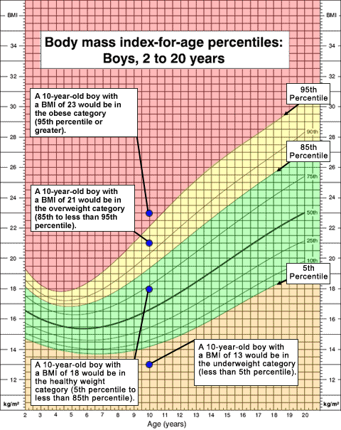
2.3.S2 Determination of body mass index by calculation or use of a nomogram.
BMI is calculated the same way for both adults and children. The calculation is based on the following formulas:
BMI = mass in kilograms
(height in metres)²
n.b. units for BMI are kg m⁻²
Example:
Mass = 68 kg, Height = 165 cm (1.65 m)
BMI = 68 ÷ (1.65)² = 24.98 kg m⁻²
In this example the adult would be (borderline) overweight - see the table on the previous slide
Charts such as the one to the right can also be used to assess BMI.

Slide 35
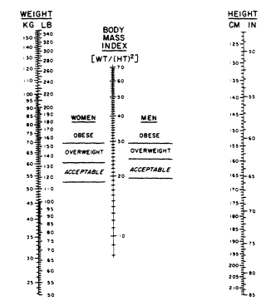
2.3.S2 Determination of body mass index by calculation or use of a nomogram.
An alternative to calculating the BMI is a nomogram. Simply use a ruler to draw a line from the body mass (weight) to the height of a person. Where it intersects the BMI line the person’s status can be derived.
http://www.nap.edu/books/0309039940/xhtml/img00027.gif

Slide 36
2.3.S2 Determination of body mass index by calculation or use of a nomogram.
State the body mass index of a man who has a mass of 75 kg and a height of 1.45 metres. (1)
Deduce the body mass status of this man. (1)
Outline the relationship between height and BMI for a fixed body mass. (1)

Slide 37
2.3.S2 Determination of body mass index by calculation or use of a nomogram.
State the body mass index of a man who has a mass of 75 kg and a height of 1.45 metres. (1)
Deduce the body mass status of this man. (1)
Outline the relationship between height and BMI for a fixed body mass. (1)
BMI = mass in kilograms ÷ (height in metres)²
= 75 kg ÷ (1.45 m)²
= 75 kg ÷ 2.10 m²
= 35.7 kg m⁻²
35.7 kg m⁻² is above 30.0 (see table below) therefore the person would be classified obese.
BMI | Status
Below 18.5 | Underweight
18.5 – 24.9 | Normal
25.0 – 29.9 | Overweight
30.0 and Above | Obese
The taller a person the smaller the BMI;
(negative correlation, but not a linear relationship)

Slide 38
2.3.S2 Determination of body mass index by calculation or use of a nomogram.
A woman has a height of 150 cm and a BMI of 40. Calculate the minimum amount of body mass she must lose to reach normal body mass status. Show all of your working. (3)
Suggest two ways in which the woman could reduce her body mass. (2)

Slide 39
2.3.S2 Determination of body mass index by calculation or use of a nomogram.
A woman has a height of 150 cm and a BMI of 40. Calculate the minimum amount of body mass she must lose to reach normal body mass status. Show all of your working. (3)
Suggest two ways in which the woman could reduce her body mass. (2)
BMI = mass in kilograms ÷ (height in metres)²
therefore
mass in kilograms = BMI ÷ (height in metres)²
Actual body mass = BMI ÷ (height in metres)²
= 40 kg m⁻² x (1.50 m)²
= 90 kg
Normal BMI is a maximum of 24.9 kg m⁻²
Normal body mass = 24.9 kg m⁻² x (1.5 m)²
= 56 kg
To reach normal status the woman needs to lose 90 kg – 56 kg = 34 kg
Reduce her nutritional intake / diet / reduce the intake of lipids;
Exercise / increase activity levels;

Slide 40
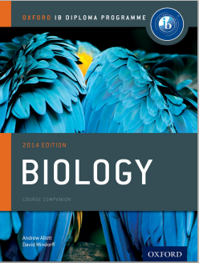
Bibliography / Acknowledgments
Jason de Nys

