Slide 1
Tissues

Slide 2
4 Basic Tissue Types
Muscle Tissue
Movement
Moving body parts, such as the muscles of arms, legs
Moving substances throughout the body, such as the muscles that make up the blood vessels
Striated (Skeletal) Muscle
Visceral (Smooth) Muscle
Cardiac Muscle

Slide 3
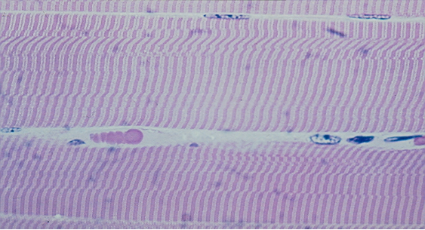
Striated (Skeletal) Muscle
Unbranched, multi-nucleated fibers bound together in bundles
Voluntary muscle, allows for movement
Found: along the bones

Slide 4
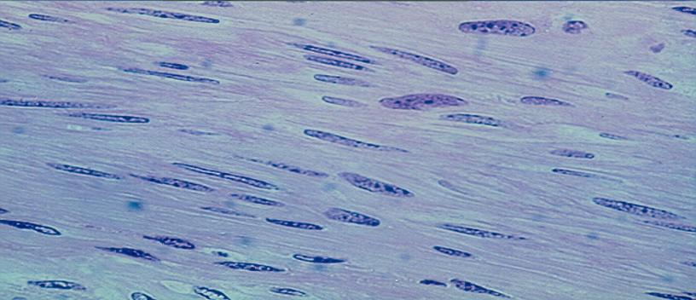
Visceral (smooth) Muscle
Spindle-shaped fibers(cells)
Unbranched, unstriated, uninucleated fibers(cells)
Found: internal (visceral) organs- such as esophagus, intestines, stomach, glands, etc.

Slide 5
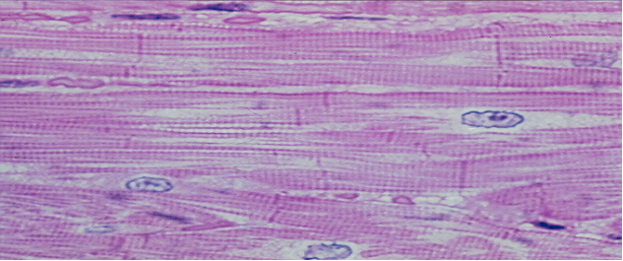
Cardiac Muscle
Branched, involuntary, striated, multinucleated fibers
Has intercalated discs
Found: Heart

Slide 6
4 Basic Tissue Types
Nerve Tissue
Coordination, communication, integration
Neuron
Dendrites- transport impulses toward the cell body
Axons – transport impulses away from the cell body
Cell body – interprets, coordinates

Slide 7
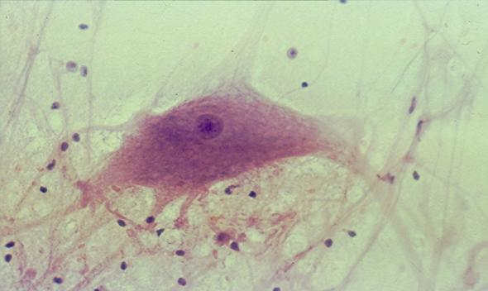
Nerve Tissue
Made up of neurons (nerve cells)
Located in brain, spinal cords, nerves

