Slide 1
Tissues
SC.912.L.14.11 Classify and state the defining characteristics of epithelial tissues connective tissue, muscle tissue, and nervous tissue.

Slide 2
4 Basic Tissue Types
Epithelial Tissue
Protects, secretes, absorbs
Simple squamous
Simple cuboidal
Simple columnar
Ciliated
Psuedostratified ciliated columnar

Slide 3
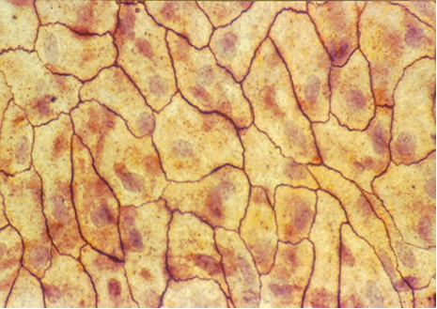
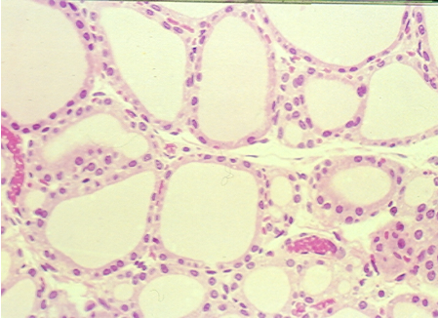
Squamous Epithelium
Flat cells
Allows rapid diffusion of substances
Found in the kidney, alveoli, capillaries

Slide 4
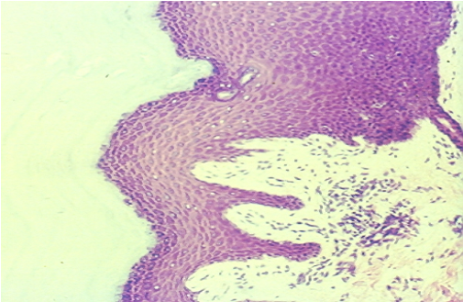
Stratified Squamous Epithelium
Composed of more than one layer of cells
Deepest layer sits on the basal surface (basement membrane)
Well suited to stress
Variations- keratinized (retards water loss, prevents penetration of disease organisms), nonkeratinized
Found: epidermal layer of skin, tongue, etc.

Slide 5
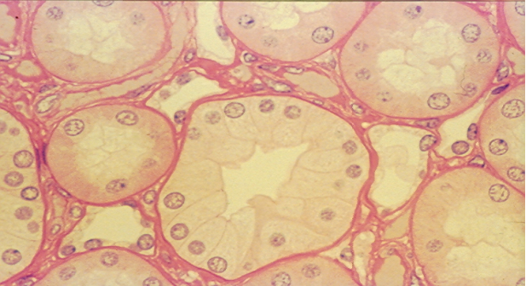
Cuboidal Epithelium
Cube- shaped cells
Absorption & secretion
Found in liver, thyroid gland, mammary gland, salivary gland, kidney tubules, etc.

Slide 6
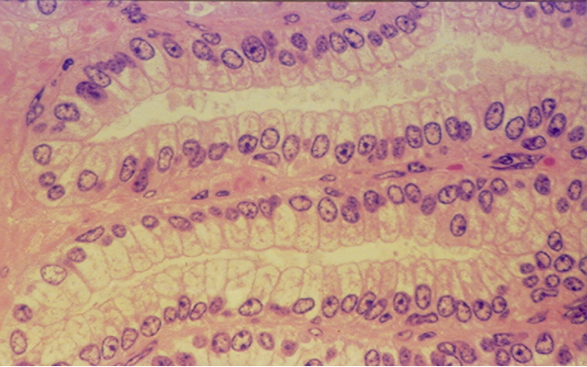
Columnar Epithelium
Tall, narrow cells
Absorption & secretion
Found in the inner lining of the gastrointestinal tract, uterus, kidney tubes, uterine (Fallopian) tubes, etc.

Slide 7
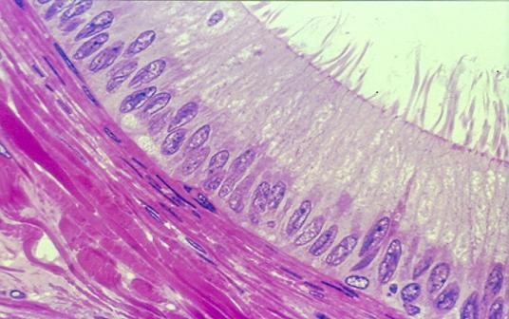
Psuedostratified Ciliated Columnar Epithelium
Single row of cells- not all will reach the free surface – each cell borders the basal surface
secretes & propels
Found in trachea, etc

Slide 8
4 Basic Tissue Types
Connective Tissue
Supports, binds together, protects
Bone
Adipose Tissue
Areolar Tissue
“White” Fibrous Tissue (Tendon)
“Yellow” Elastic Connective Tissue
Cartilage• Hyaline, Elastic, Fibrocartilage
Blood• Erythrocytes, Leucocytes, Thrombocytes

Slide 9
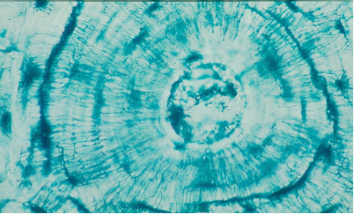
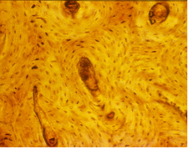
Compact Bone
Calcified matrix in concentric lamellae around Haversian canal – containing blood vessels; osteocytes in lacunae between lamellae connected by canaliculi
Physical support & framework, leverage for muscles, storage of minerals
Found in skeleton

Slide 10
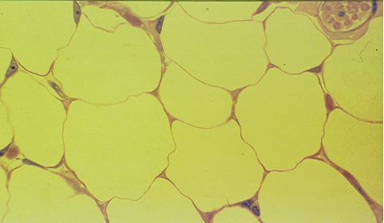
Adipose Tissue
Large, empty-looking cells (adipocytes) with thin margins; nucleus pressed against cell membrane
Stores fat, Energy storage, thermal insulation, space filled as cushioning, body contour
Subcutaneous fat beneath the skin & surrounding organs

Slide 11
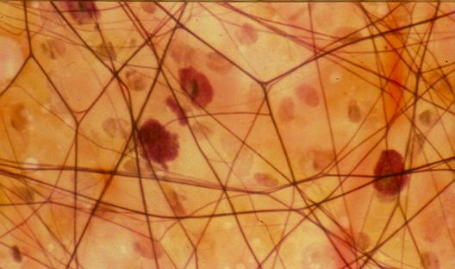
Areolar Tissue
Loose arrangement of collagen and elastic fibers, scattered cell types & abundant ground substance
Underlying all epithelia forming passageway for nerves & blood vessels; fascia between muscles

Slide 12
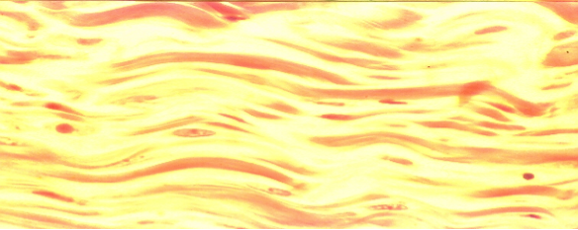
Dense Connective Tissue
Densely, packed, parallel collagen fibers; compressed fibroblast nuclei & scanty open space
Few blood vessels, injuries- slow to heal
White Fibrous Tissue-• Tendons- bind muscles to bones, Ligaments- bind bones to bones
Yellow Fibrous Tissue•– found: vocal cords, vertebral column, etc

Slide 13
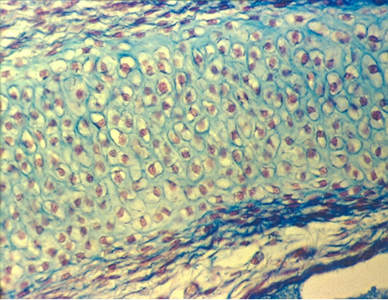
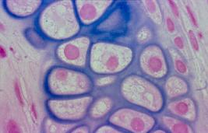
Hyaline Cartilage
Clear, glassy matrix; fine dispersed collagen fibers; chondrocytes in small clusters enclosed in lacunae
Supports airway, eases joint movement
Found over ends of bones at movable joints; sternal ends of ribs, supportive material in larynx, trachea, bronchi; fetal skeleton; end of the nose

Slide 14
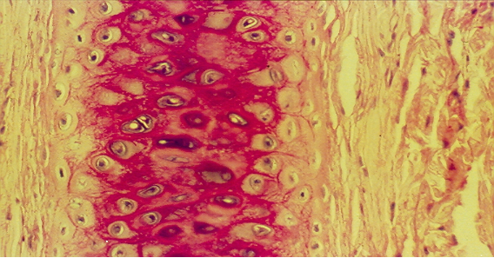
Elastic Cartilage
Web-like mesh of elastic fibers
Provides flexible, elastic support
External ear and epiglottis

Slide 15
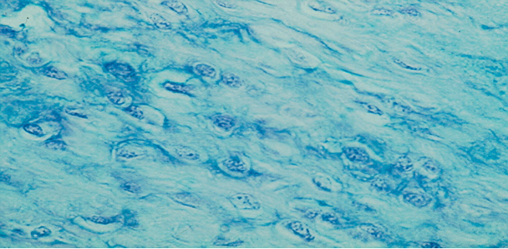
Fibrocartilage
Cartilage containing parallel collagen fibers
Resists compression and absorbs shock in some joints
Found in meniscus of knee, intervertebral discs of the vertebrae, etc.

Slide 16
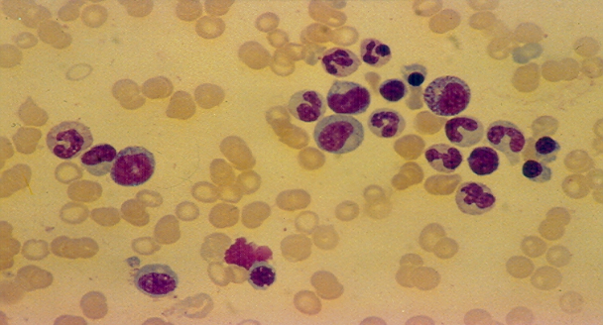
Blood
Erythrocytes (Red blood Cells)- contain hemoglobin which allows for transportation of oxygen, anucleated, disc-shaped cells
Leucocytes (White Blood Cells) – large, nucleated cells, help to fight infection, 5 different types – each type distinguished by shape of the nucleus
Thrombocytes (Platelets)- fragments of a cell, functions in blood clotting

