Slide 1
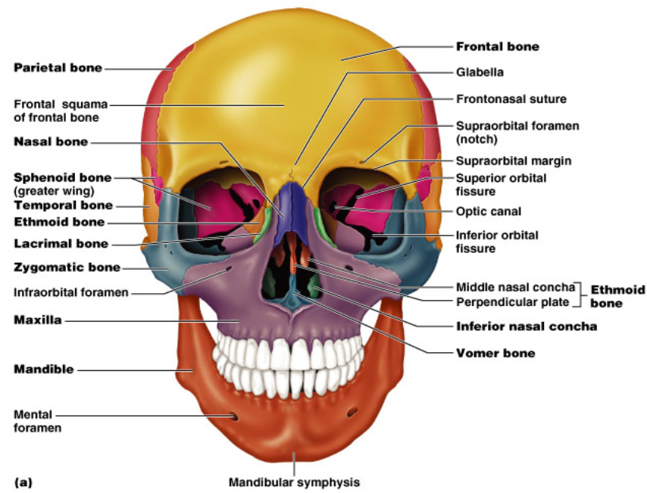

Slide 2
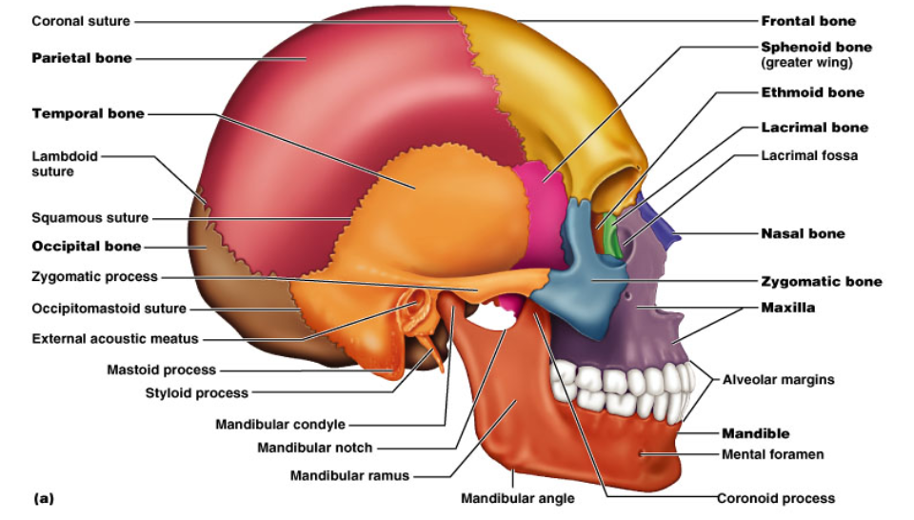
Figure 6.10

Slide 3
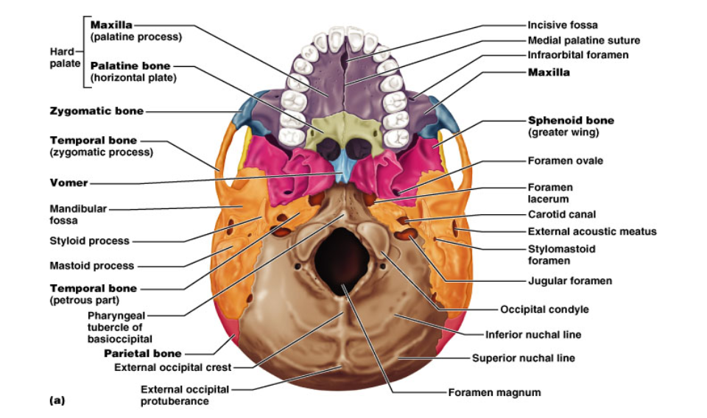
Figure 6.10

Slide 4
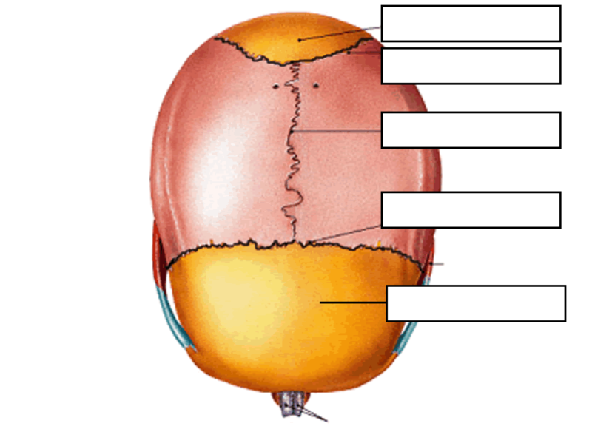

Slide 5
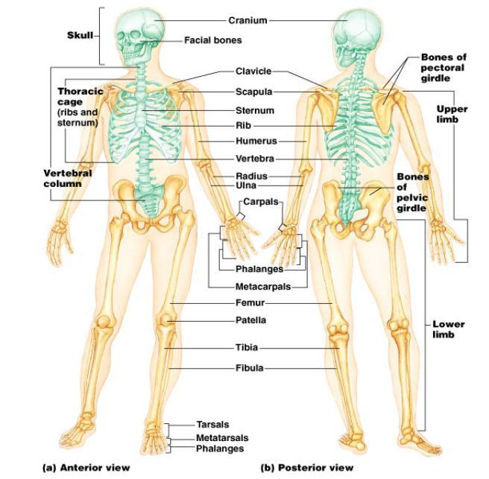
The Rest of the Bones

Slide 6
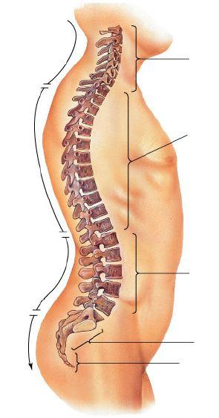
Vertebrae
Neck = cervical
Middle Back = thoracic
Lower Back = lumbar

Slide 7
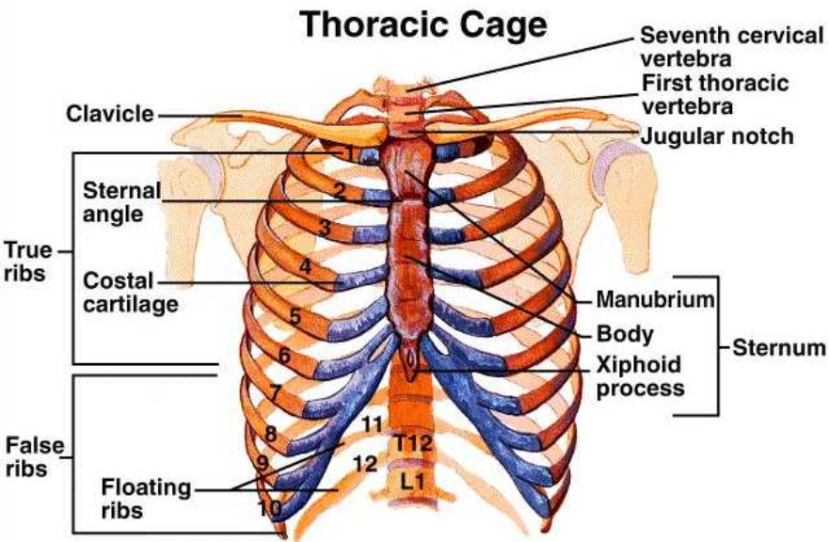
Thoracic Cage

Slide 8
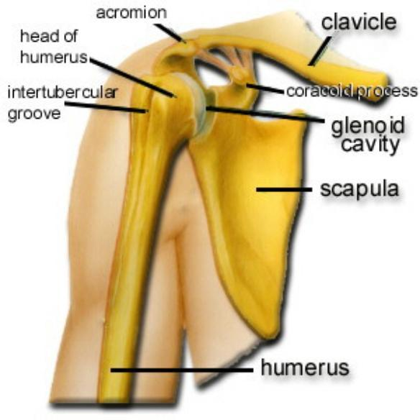
Pectoral Girdle

Slide 9
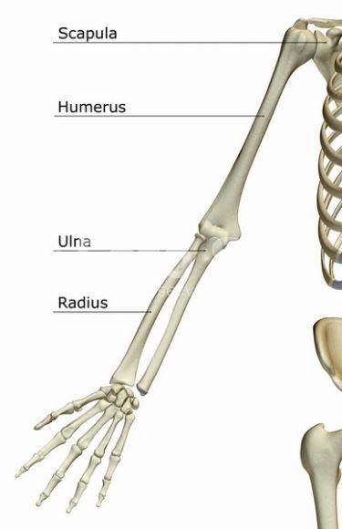
Bones of the Arm
Ulna goes to pinky (P-U)
Radius goes to thumb

Slide 10
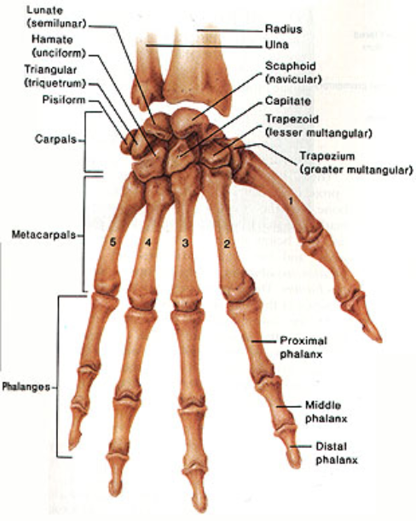
Wrist Bones
For test
Carpels
Metacarpals
Phalanges
*extra credit opportunity

Slide 11
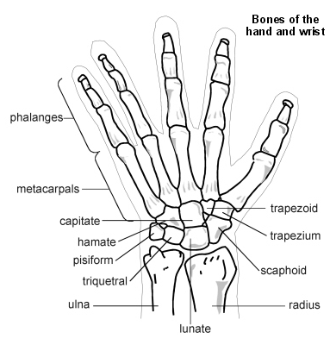
Name the carpals for extra credit on test.

Slide 12
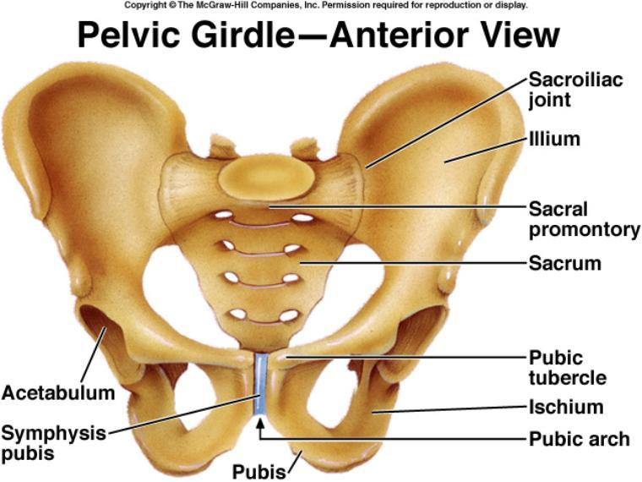
Pelvic Girdle

Slide 13
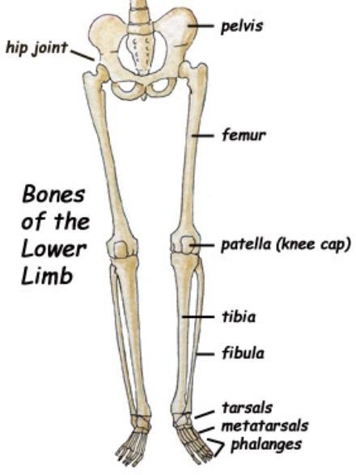
Bones of the Leg

Slide 14
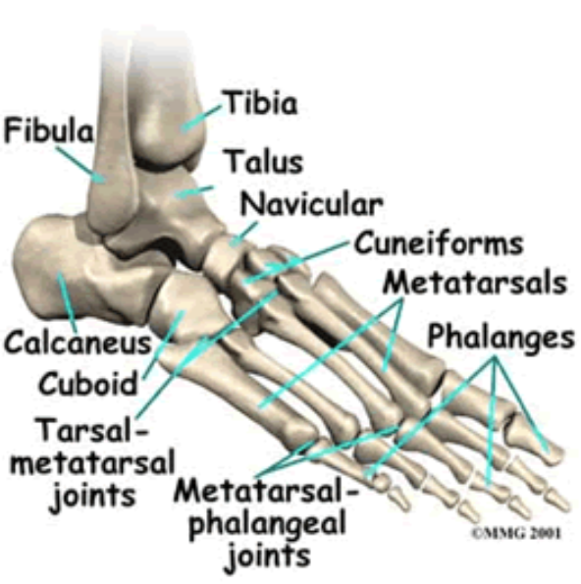

Bones of the Ankle
For Test
Calcaneous
Tarsals
Metatarsals
Phalanges
Assignment – Skeleton Labeling

Slide 15
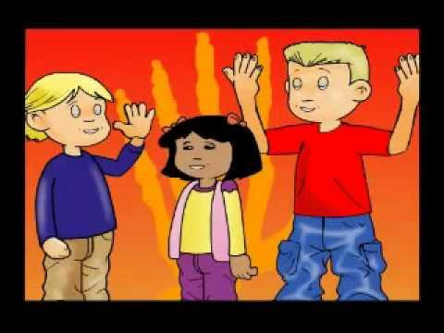

Slide 16
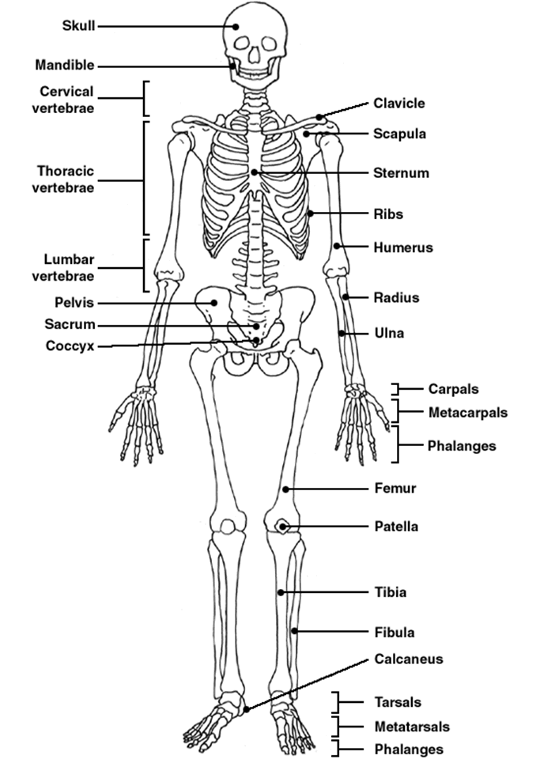

Slide 17
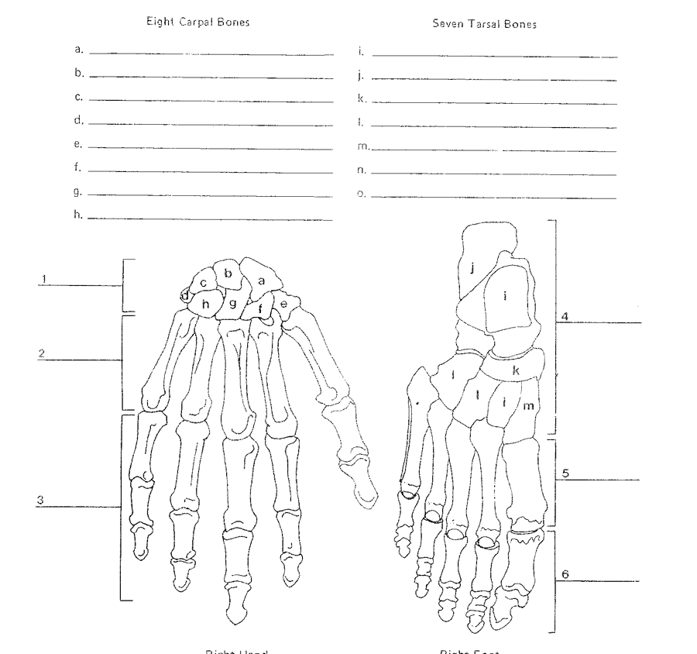

Slide 18
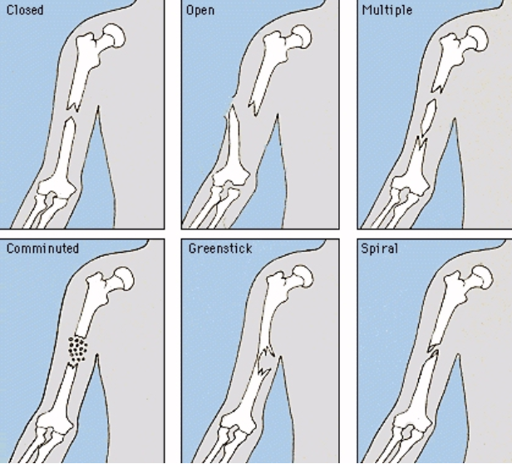
Broken Bones

Slide 19
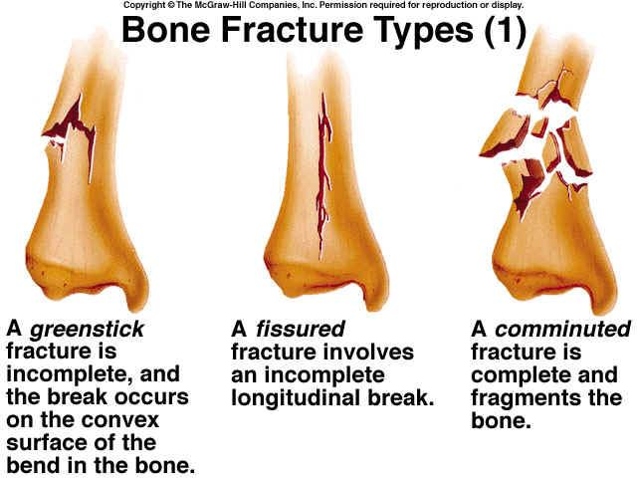

Slide 20
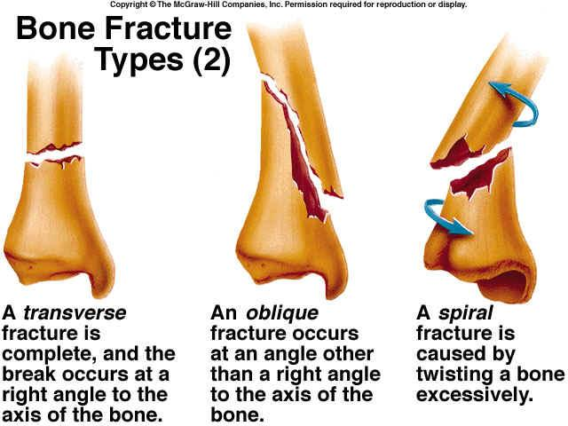

Slide 21
Upcoming Assignments
The Skeleton Mystery - read about a “crime scene” and reconstruct skeletons to identify the remains
Watch a Bones Episode
Identify Bones on a real skeleton • Lab Practical Test
Medical Imaging – learn how doctors view bones and diagnose problems

Slide 22
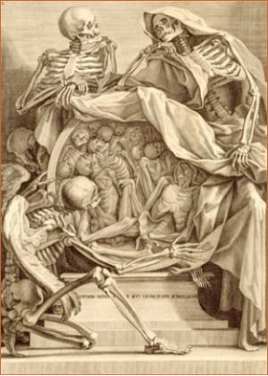
TEST INFORMATION
Test will cover everything in your notes and on the slides presented in class
Visit biologycorner.com for study aids
A second test will occur that covers the lab portion

Slide 23
Abnormal Bone Conditions
BONE SPURS: abnormal growth. Can occur on any bone (e.g. heel).
OSTEOPOROSIS: Increased activity of osteoclasts cause a break down bone, and the subsequent fewer minerals in the extracellular matrix make it fragile. The spongy bone especially becomes more porous.
Men get it as well as women. What’s the best way to prevent osteoporosis? Exercise! What does exercise do? Makes bones bigger.
The most common bone used for a bone graft is the iliac bone of the hip.

Slide 24
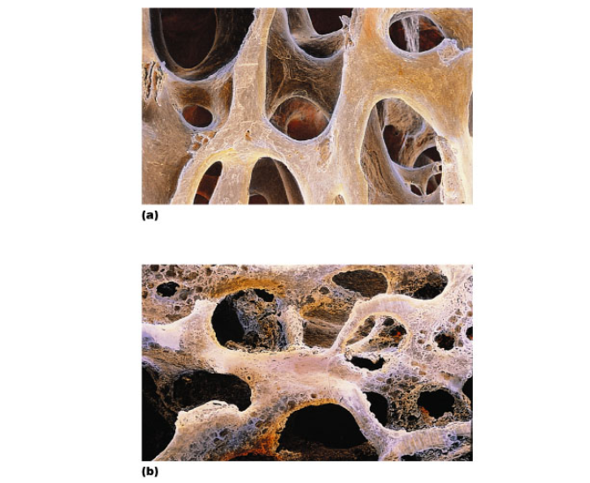
Osteoporosis
Figure 6.15

Slide 25
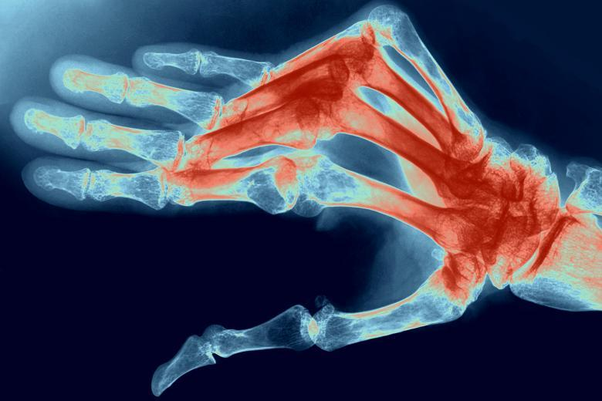
Rheumatoid arthritis is an autoimmune disease which causes joint stiffness and bone deformity
Source: http://www.thetimes.co.uk/tto/public/article3233439.ece

Slide 26
ABNORMALITIES OF THE SPINE
ABNORMALITIES OF THE SPINE
SCOLIOSIS is a lateral curve in the spine
KYPHOSIS is a hunchback curve
LORDOSIS is a swayback in the lower region.
ANKYLOSIS is severe arthritis in the spine and the vertebrae fuse.

Slide 27
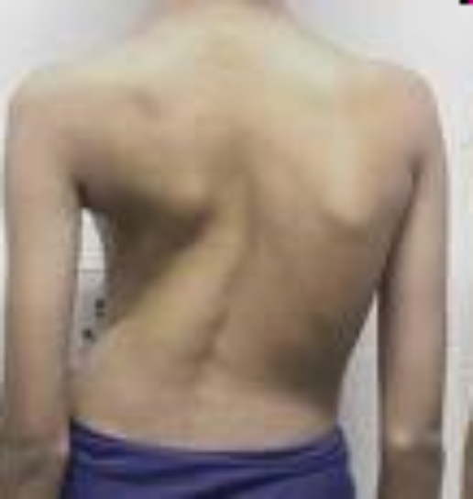
SCOLIOSIS

Slide 28
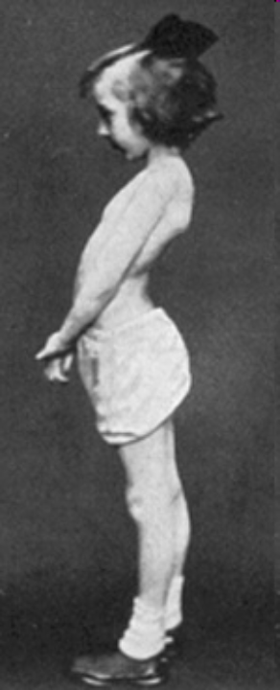
LORDOSIS

Slide 29
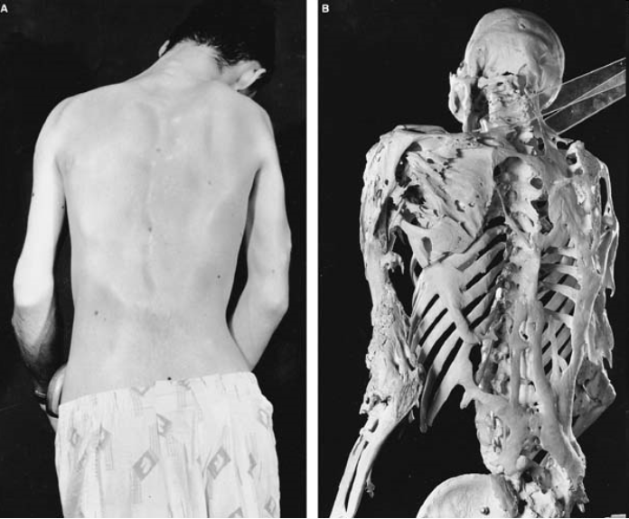
ANKYLOSIS

Slide 30
FUN FACTS ABOUT BONESBone is made of the same type of minerals as limestone.
Babies are born with 300 bones, but by adulthood we have only 206 in our bodies.
The giraffe has the same number of bones in its neck as a human: seven in total.
The long horned ram can take a head butt at 25 mph. The human skull will fracture at 5mph.

Slide 31
