Slide 1
Heart Actions
Cardiac Cycle: One complete heartbeat. The contraction of a heart chamber is called systole and the relaxation of a chamber is called diastole.

Slide 2
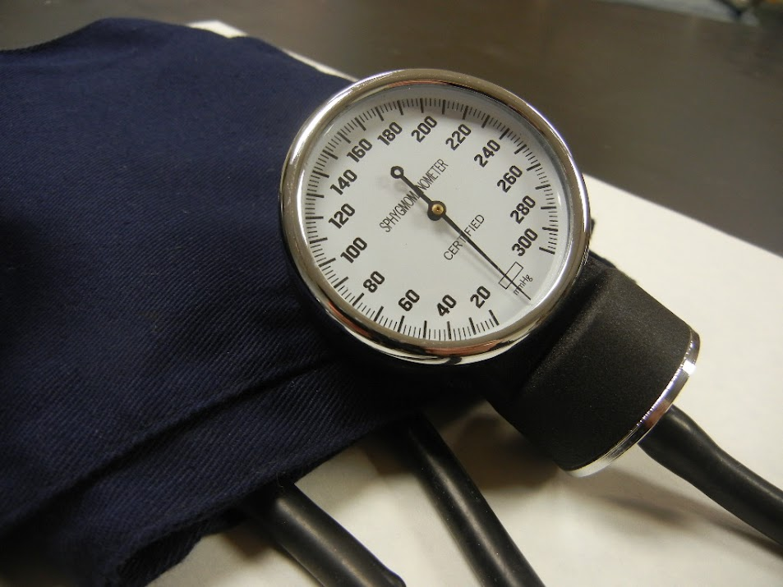
Blood pressure is the force of blood against the walls of arteries.
Blood pressure is recorded as two numbers—the systolic pressure (as the heart beats) over the diastolic pressure (as the heart relaxes between beats).

Slide 3
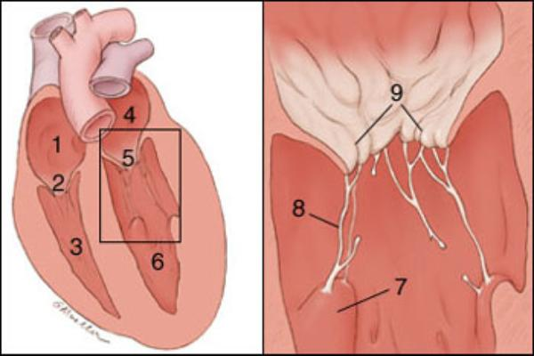
The cusps (flaps) of the bicuspid and tricuspid valves are anchored to the ventricle walls by fibrous “cords” called chordae tendineae, which attach to the wall by papillary muscles. This prevents the valves from being pushed up into the atria during ventricular systole.
Can you identify these parts?

Slide 4
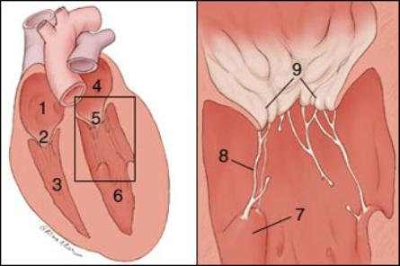
7. Papillary Muscle 8.Chordae Tendinae 9. Mitral Valve cusps
Right Atrium
Right Atrioventricular Valve (Tricuspid Valve)
Right Ventricle
Left Atrium
Left Atrioventricular Valve (Mitral Valve)
Left Ventricle

Slide 5
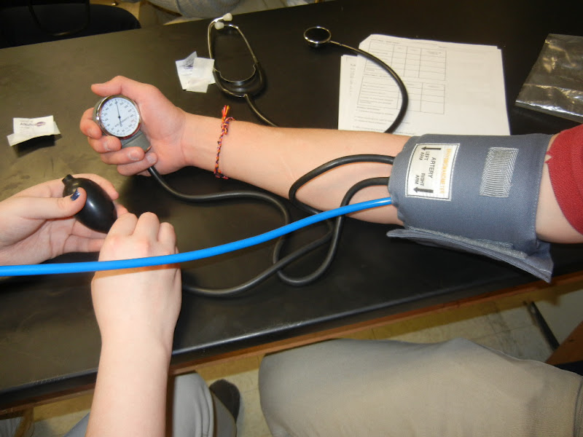
The average (normal) blood pressure for an adult is 120/80. This number varies by person and it is best if you know what is *normal* for you, so that you (or your doctor) recognize when something is not normal.
We will be doing a lab where you will learn to use a this device and check your own blood pressure.
SPHYGMOMANOMETER

Slide 6
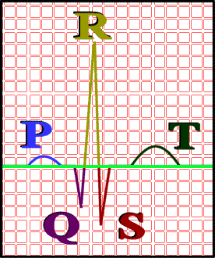
ECG – electrocardiogram – a recording of the electrical events (changes) during a cardiac cycle
P Wave – depolarization of the atria (atrial contraction – systole)
QRS Complex – depolarization of the ventricles (ventricular contraction, systole)
T Wave – Repolarization of the ventricles
Heart Sounds – opening and closing of the valves, flow of blood into and out of the chambers, vibrations in muscle

Slide 7
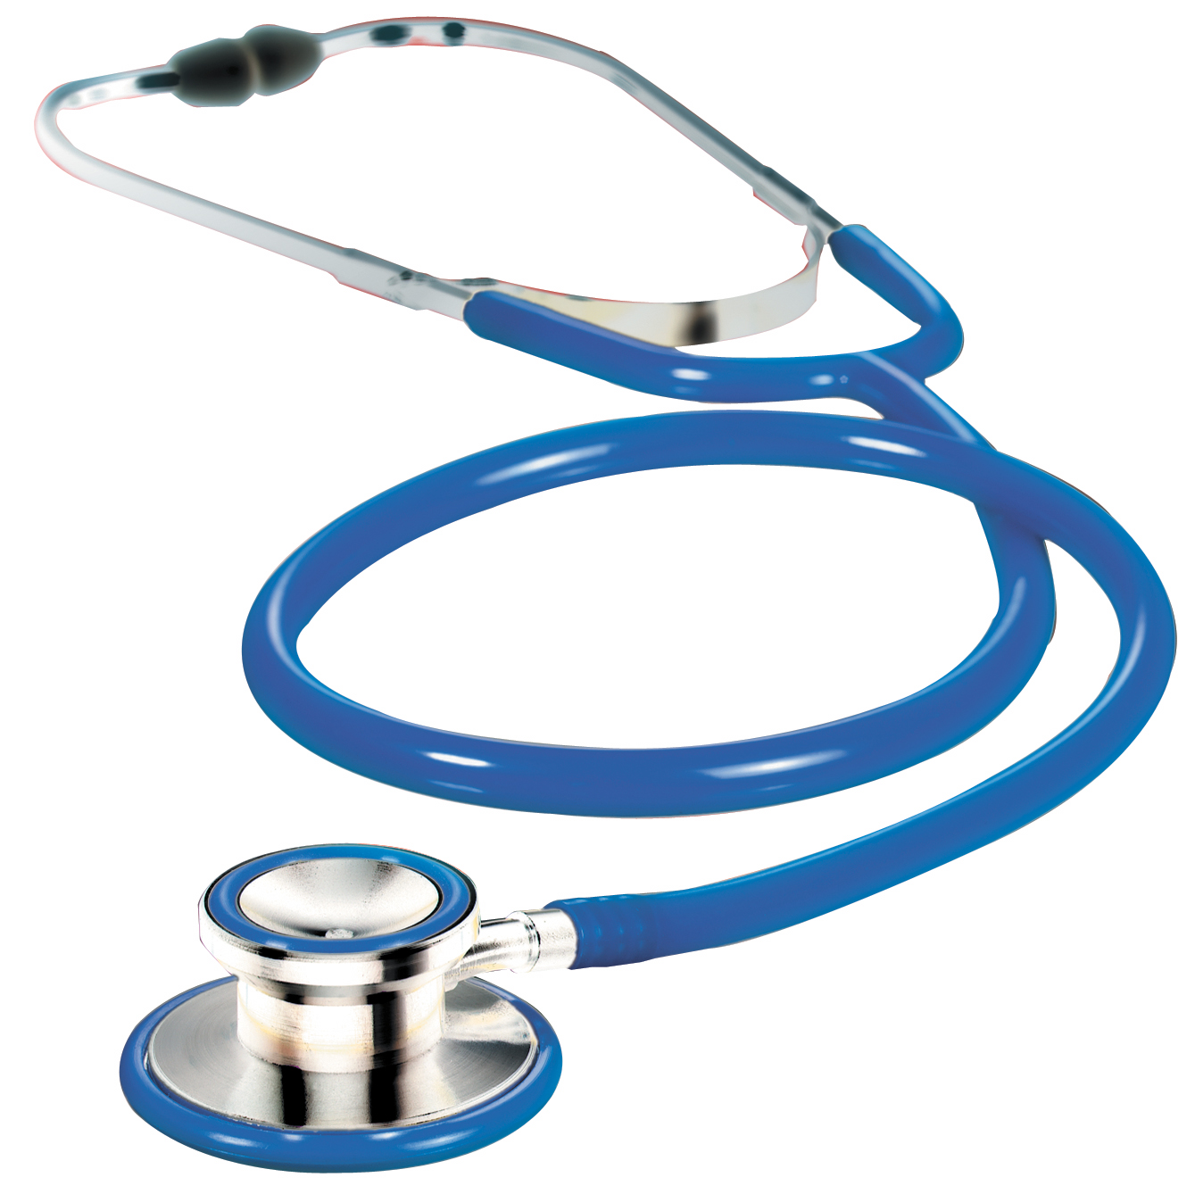
Heart Sounds - Opening and Closing of Valves, "Lub Dub"
Check out this page to hear different sounds of the heart:
Normal
Heart Murmurs Mitral Regurgitation
Stenosis
Stethoscope - instrument to listen and measure heart sounds

Slide 8
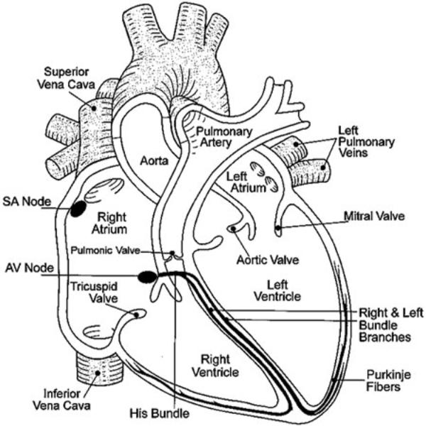
Cardiac Conduction
S-A Node
Junctional Fibers
A-V Node
A-V Bundle
Perkinje Fibers

Slide 9
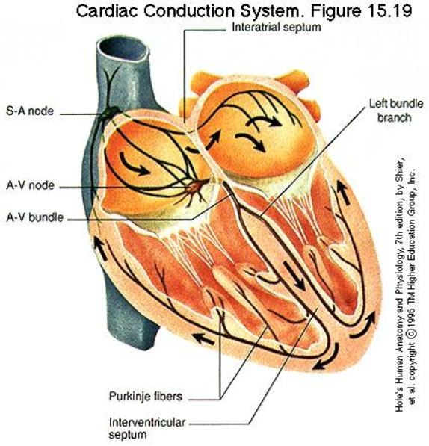
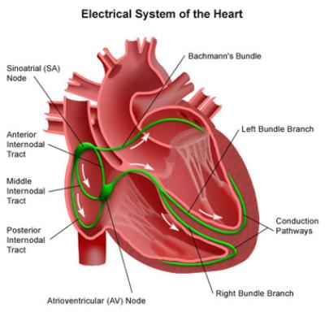

Slide 10
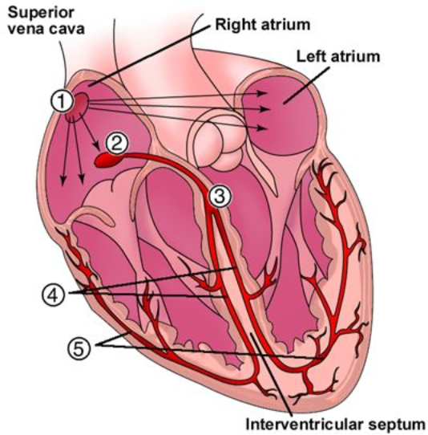
Can you identify these parts?

Slide 11
1 Sinoatrial node (Pacemaker) 2 Atrioventricular node 3 Atrioventricular Bundle (Bundle of His) 4 Left & Right Bundle branches 5 Bundle Branches (Purkinje Fibers)

Slide 12
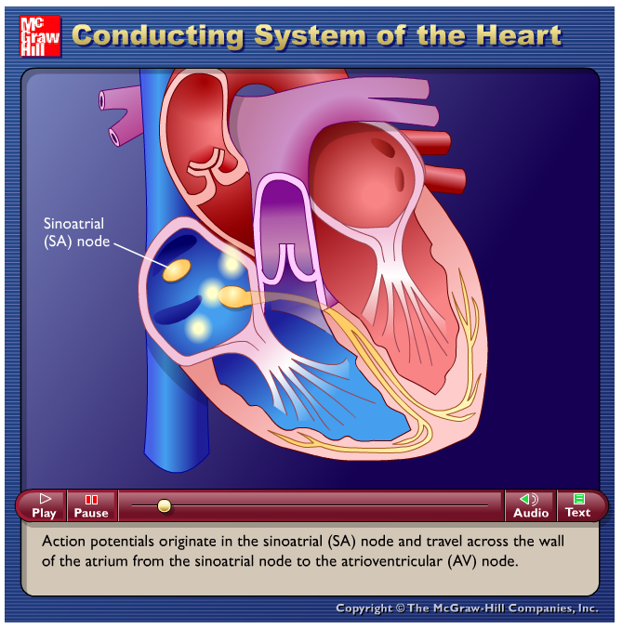
View the heart animations at McGraw Hill to understand the Cardiac Cycle

Slide 13
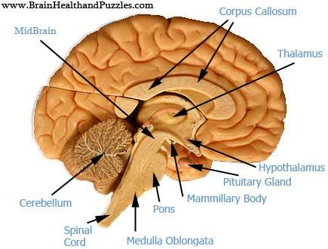
Regulation of Cardiac Cycle
controlled by the cardiac center within the medulla oblongata. The cardiac center signals heart to increase or decrease its rate according to many factors that the brain constantly monitors.
Muscle Activity
Body Temperature
Blood ion levels (potassium & calcium)

Slide 14
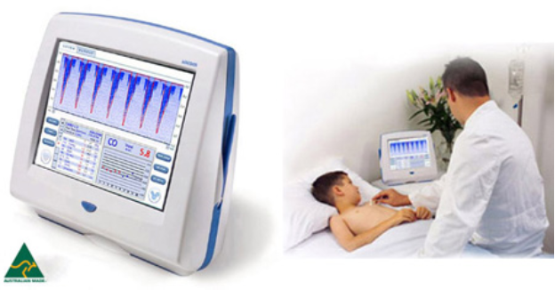
Cardiac Output
Cardiac Output = Stroke Volume x Heart Rate

Slide 15
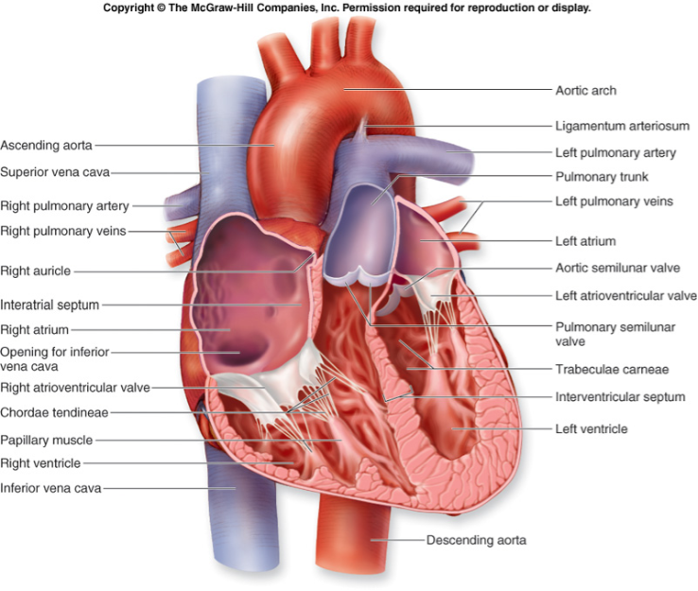

Slide 16
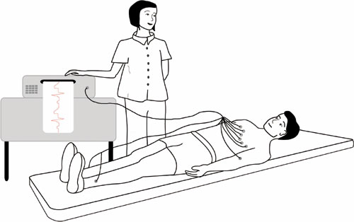
SADS = (Sudden Arrhythmia Death Syndromes or Sudden Adult Death Syndrome)
Routine ECG Screening may help prevent deaths in young people

Slide 17
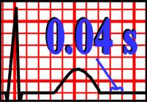
Interpreting ECGs
An ECG is printed on paper covered with a grid of squares.
Notice that five small squares on the paper form a larger square. The width of a single small square on ECG paper represents 0.04 seconds.
A common length of an ECG printout is 6 seconds; this is known as a "six second strip."

Slide 18
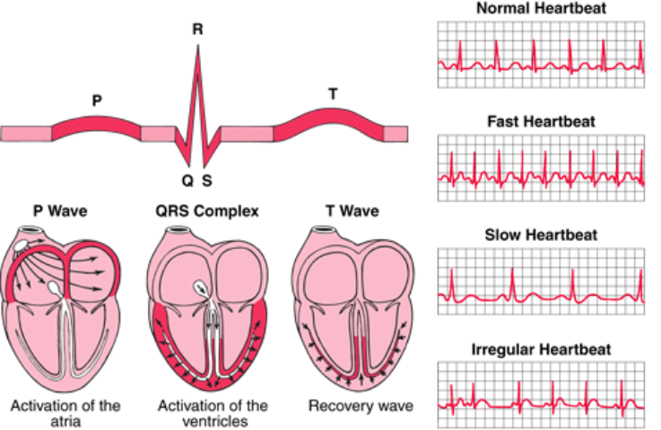

Slide 19
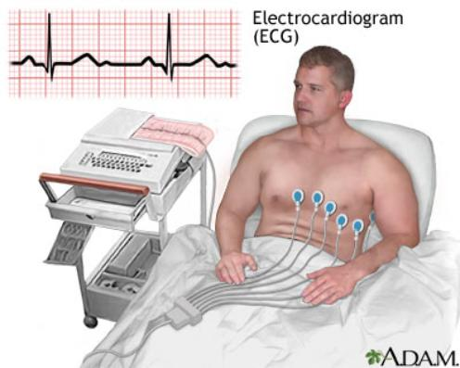
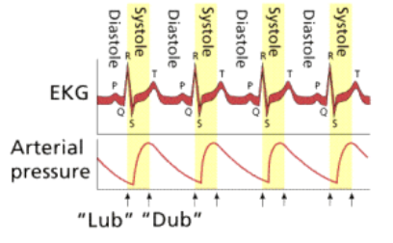

Slide 20
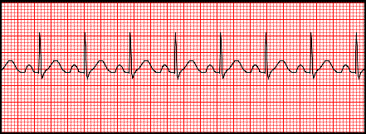
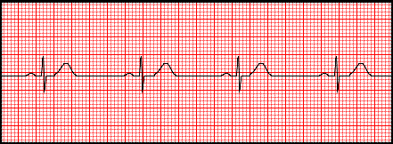
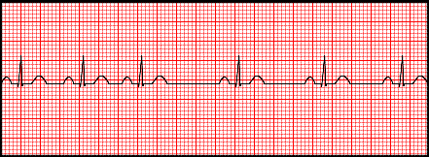
Analyze an ECG
Each one of the figures represents an ECG pattern displaying three types of abnormal rhythms: Tachycardia, Bradycardia, and Arrhythmia.
Identify each.

Slide 21
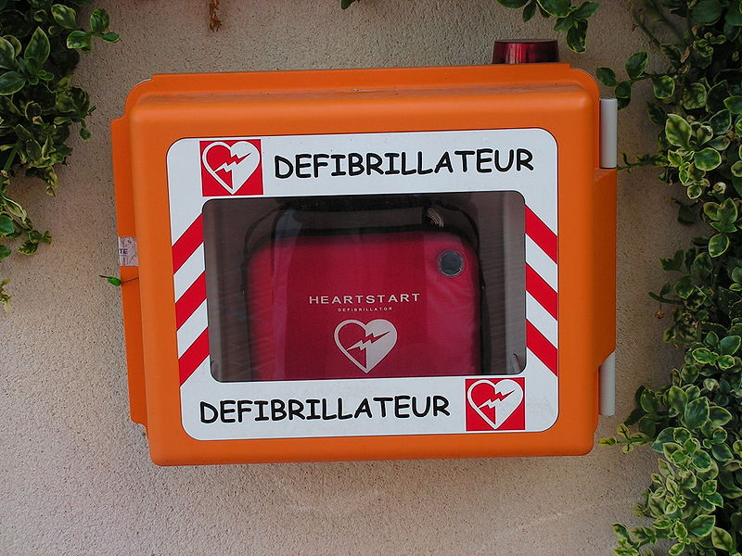
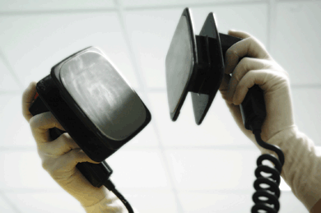
Defibrillator
common treatment for life-threatening cardiac arrhythmia
The device shocks the heart and allows it to re-establish its normal rhythm
The device can also be used to start a heart that has stopped.

Slide 22
13.4 BLOOD VESSELS
Blood Vessels: arteries, veins, capillaries
ARTERIES : strong elastic vessels which carry blood moving away from the heart. Smallest ones are arterioles which connect to capillaries.
VEINS - Thinner, less muscular vessels carrying blood toward the heart.
Smallest ones are called venules which connect to capillaries. Contain valves.

Slide 23
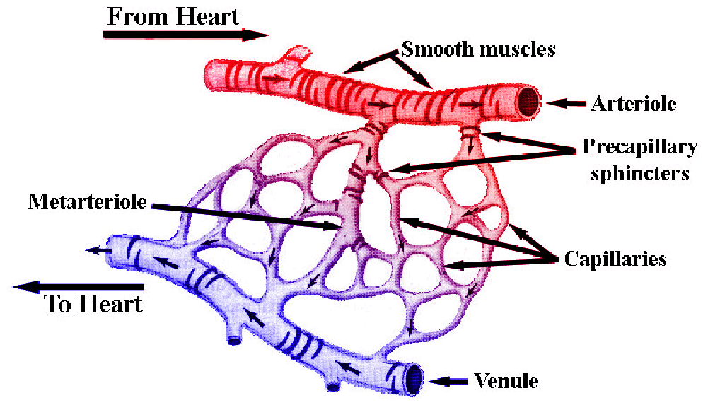
Capillaries: Penetrate nearly all tissues. Walls are composed of a single layer of squamous cells – very thin. Critical function: allows exchange of materials (oxygen, nutrients) between blood and tissues.

Slide 24
Control of Blood Flow:
Precapillary sphincters – circular, valve-like muscle at arteriole-capillary junction
Vasoconstriction – narrowing of vessel
Vasodilation –expanding blood vessel

Slide 25
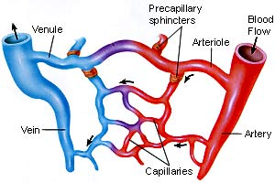
Sphincters open and close

Slide 26
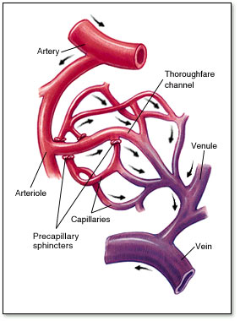
Blood flow through veins – not very efficient. Slow, weak, the following helps blood return to heart
1. Contraction of the diaphragm. 2. Pumping action of the skeletal muscles. 3. Valves in the veins.

Slide 27
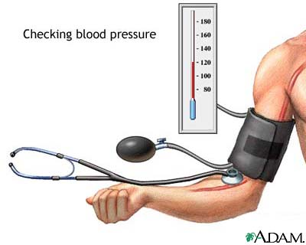
Factors affecting blood pressure: Average is 120/80 (higher number is the systolic pressure)
1. Cardiac Output
2. Blood volume (5 liters for avg adult)
3. Blood Viscosity
4. Peripheral Resistance
Cardiac output =
stroke volume x
heart rate

Slide 28
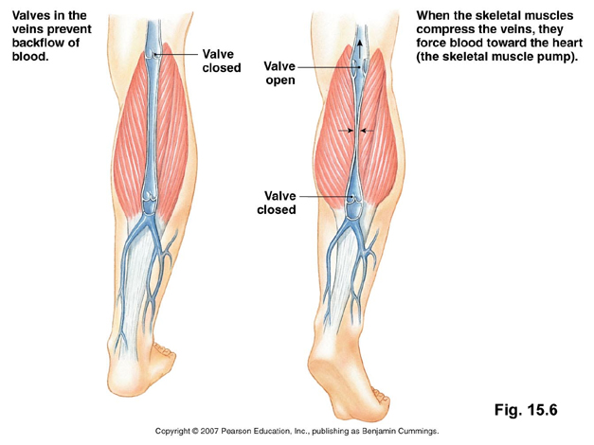
Blood Clots can occur if blood does not flow properly through the veins - can occur if a person does not move enough

Slide 29
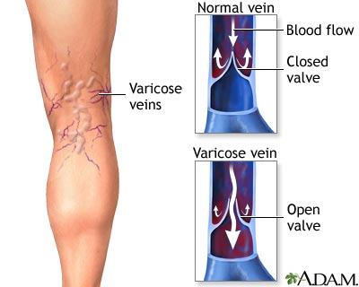
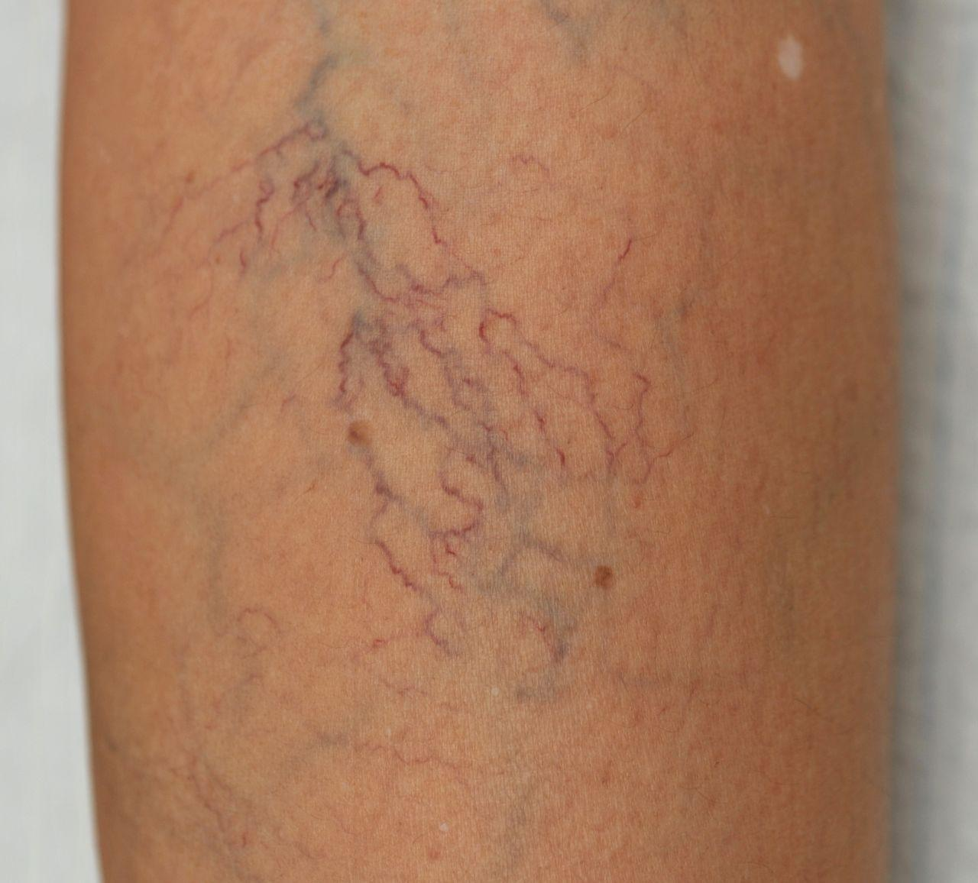
Varicose veins occur when blood pools in the veins.

Slide 30
Major Blood Vessels
Aorta - Ascending Aorta, Aortic Arch, Descending Aorta, Abdominal Aorta. The aorta is the largest artery. (leaves left ventricle)
Pulmonary Trunk – splits into left and right, both lead to the lungs (leaves left ventricle)
Pulmonary Veins – return blood from the lungs to the heart (connects to left atrium)
Superior and Inferior Vena Cava – return blood from the head and body to the heart (connects to right atrium)

Slide 31
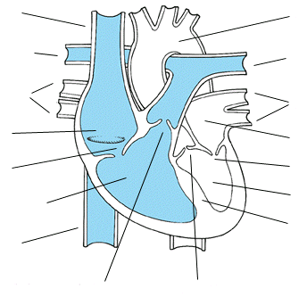

Slide 32
Branches of the Aorta
Coronary Arteries - supply blood to the heart itself
Brachiocephalic Artery branches into the
Right Subclavian ( supplies blood to the arms) Right Common Carotid (bicarotid)
Left Common Carotid (to head)
Left Subclavian Artery – supplies blood to the left arms
*Note that the vessels are not symmetrical.

Slide 33
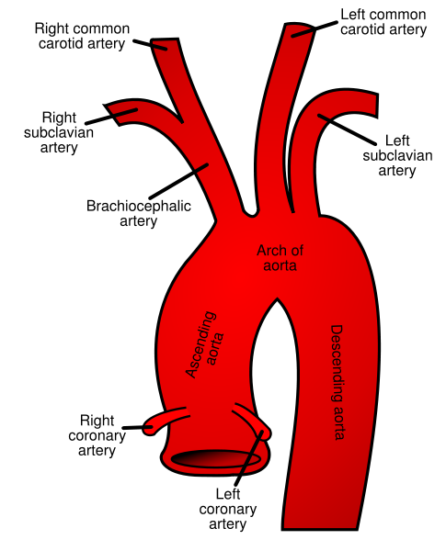
Aorta and Its Branches

Slide 34
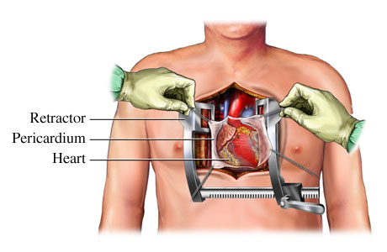
Disorders of the Circulatory System 1. MVP - mitral valve prolapse, valve shifts out of place; this creates a clicking sound at the end of a contraction.
2. Heart Murmurs – A heart murmur is an extra or unusual sound heard during a heartbeat which is not dangerous. Murmurs range from very faint to very loud. Sometimes they sound like a whooshing or swishing noise.
*may or may not be a valve problem

Slide 35
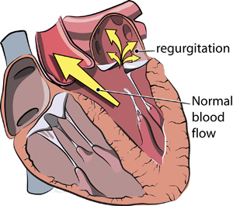
3. Mitral or aortic regurgitation: Regurgitation (backward flow) of blood can occur with mitral valve prolapse or mitral valve or aortic stenosis. To counteract this back flow, the heart must work harder to force blood through the damaged valve. Over time, this can weaken and/or enlarge the heart and can lead to heart failure.
This is also called a leaking valve.

Slide 36
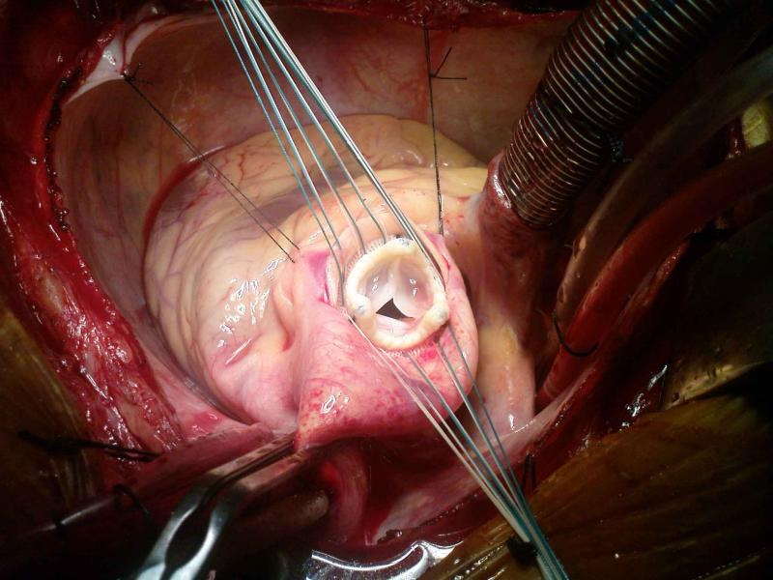
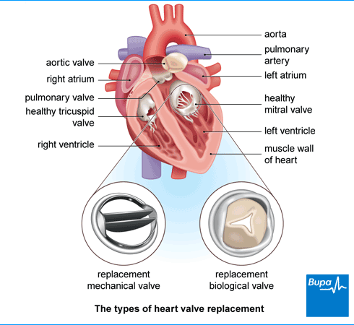
Valve Replacement Surgery
Valves can be replaced with biological tissue or with mechanical valves
See video of an aortic valve replacement (13 minutes) Protip - speed up video

Slide 37
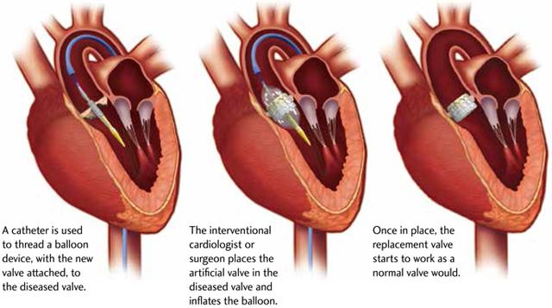
Transcatheter Aortic Valve Replacement (TAVR)
During a TAVR procedure, a very small incision is made in the groin to access the femoral artery or the chest (transapical approach). The cardiologist uses catheters and wires to place the balloon-expandable valve across the old diseased native valve, with the heart still beating. Crimped to the balloon device is the collapsed replacement valve. The surgeon then deploys the new valve within the diseased valve by expanding the balloon together with the new valve. He then secures it into place inside the old valve, displacing the old valve out of the way. In addition, the new valve starts to work as a normal valve should as soon as the balloon is deflated. Most of the time, the patients feel immediately better

Slide 38
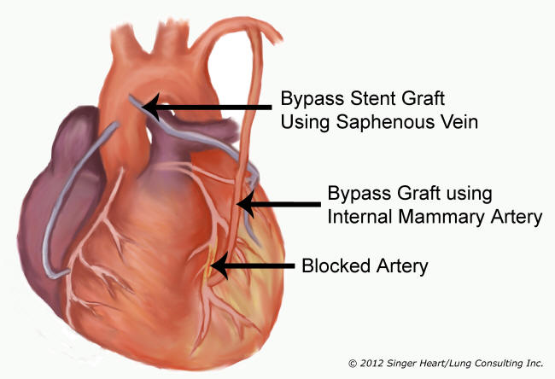
4. Myocardial Infarction (MI) - an obstruction to the coronary artery, commonly called a “heart attack”
Treatment can involve a bypass graft to restore blood flow to the heart.
Double or Quadruple refers to how many vessels have been bypassed.

Slide 39
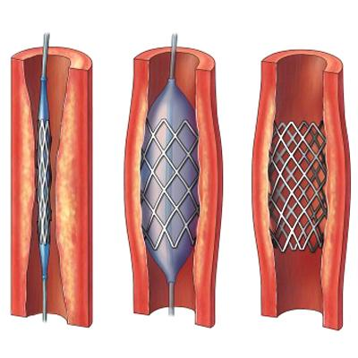
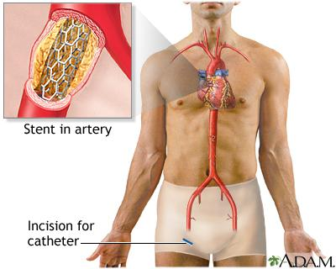
5. Atherosclerosis – deposits of fatty materials such as cholesterol form a “plaque” in the arteries which reduces blood flow. Also called arteriosclerosis.
Treatment: Angioplasty, where a catheter is inserted into the artery and a balloon is used to stretch the walls open. Video Showing a Stent and Angioplasty (Mayo Clinic)

Slide 40
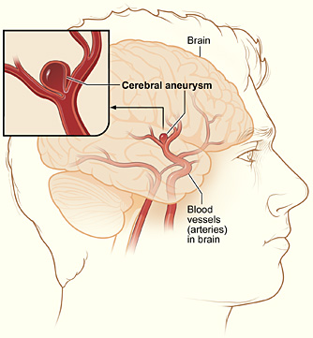
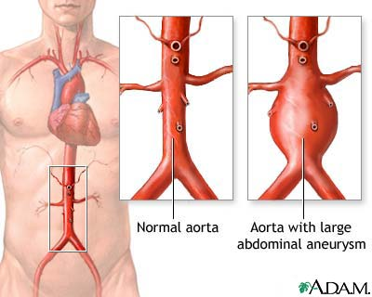
6. Hypertension – high blood pressure, the force within the arteries is too high. A sphygmomanometer can be used to diagnose hypertension
7. An aneurysm or aneurism is a localized, blood-filled balloon-like bulge in the wall of a blood vessel

Slide 41
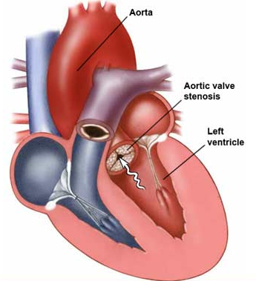
8. Aortic Stenosis
- valve or aorta is narrowed, limiting blood flow.
9. Ventricular Septal Defect
a hole exists between the two ventricles (septum)

