Slide 1
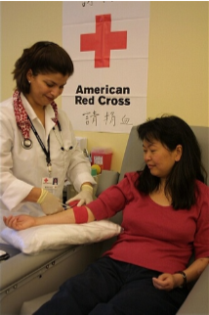
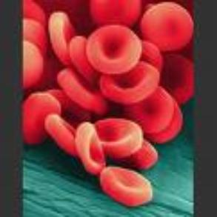
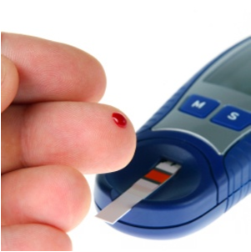
BLOOD

Slide 2
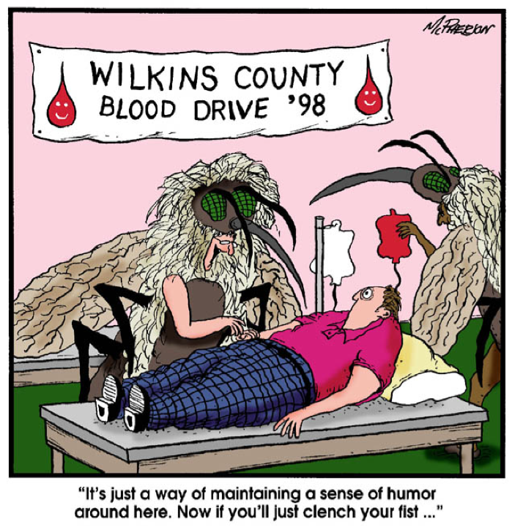
PHLEBOTOMIST
person trained to draw blood from a patient for clinical or medical testing, transfusions, donations, or research.

Slide 3
Blood transports substances and maintains homeostasis in the body
Hematophobia = fear of blood

Slide 4
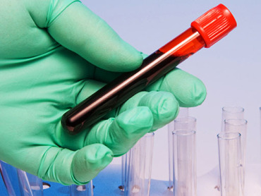
Blood and Blood Cells
Blood is a type of CONNECTIVE TISSUE
It has two basic components:
CELLS (rbc, wbc, platelets) = 45%
Plasma (water, proteins, amino acids..etc) = 55%

Slide 5
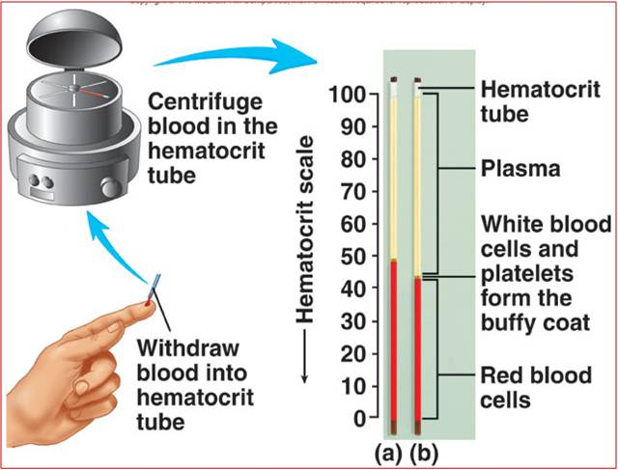
To determine the percentages, blood is placed in a centrifuge. Heavier cells settle to the bottom of the sample.
Hematocrit -
blood cells = 45%.
fluid (plasma) = (55%).

Slide 6
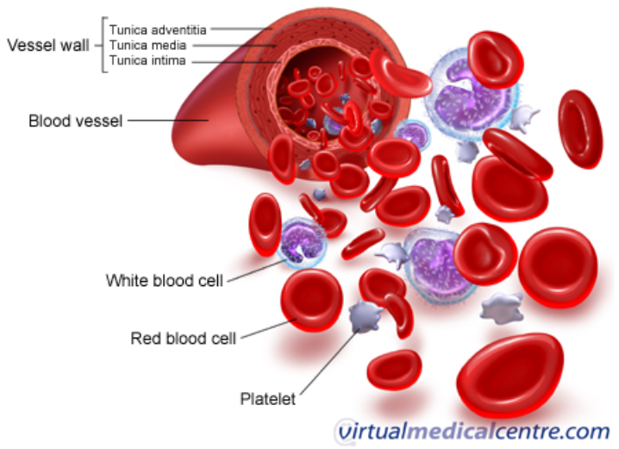
Three Types of Blood Cells
erythrocytes = red blood cells leukocytes = white blood cells thrombocytes= platelets

Slide 7
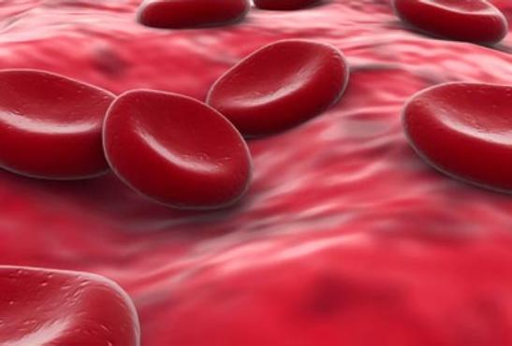
Shape = Biconcave discs
5 million per cubic millimeter
Red blood cells lack a NUCLEUS
They do not divide on their own.

Slide 8
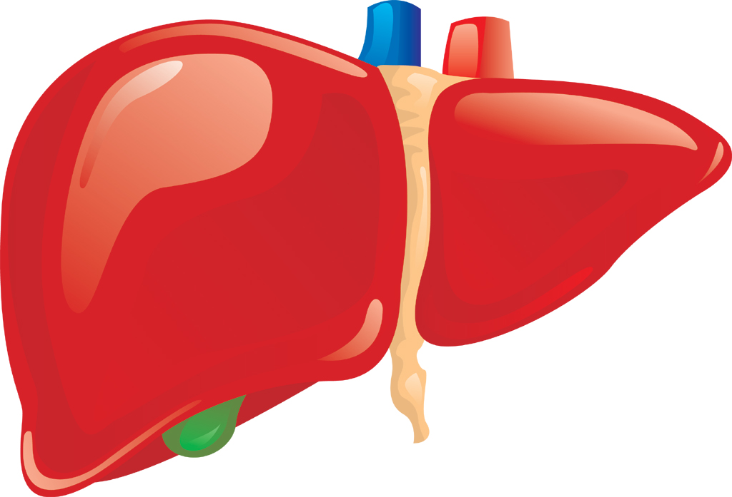
HEMATOPOEISIS
– formation of blood cells -- occurs in the bone marrow
Old blood cells are destroyed by the liver & spleen - phagocytosis

Slide 9
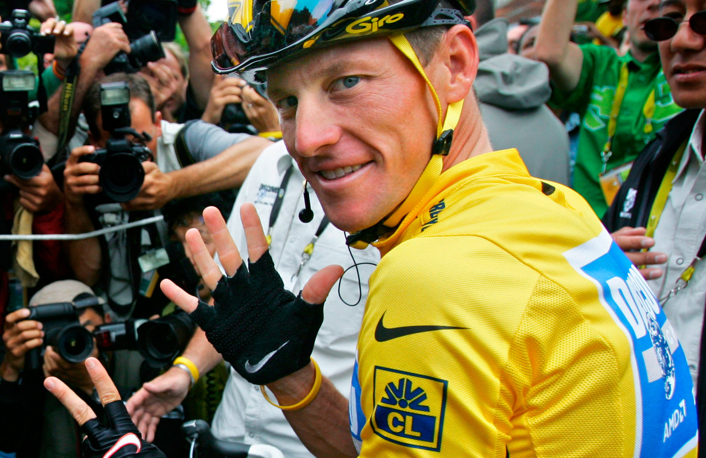
EPO, or erythropoietin, is a hormone that increases production of RBC’s.
In the first part of a two-night interview broadcast Thursday, disgraced cyclist Lance Armstrong admitted to Oprah Winfrey that he took banned substances, including EPO, during all seven of his Tour de France victories.
What is EPO? (Gizmodo Article)

Slide 10
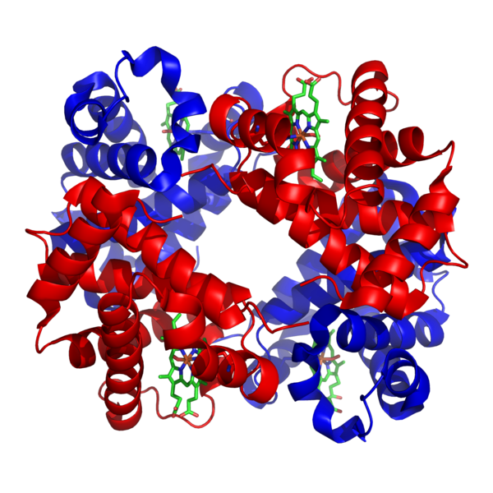
Main Functions of RBCs
Transports oxygen, remove carbon dioxide
HEMOGLOBIN - molecule that combines with O₂
IRON is critical to synthesize hemoglobin

Slide 11
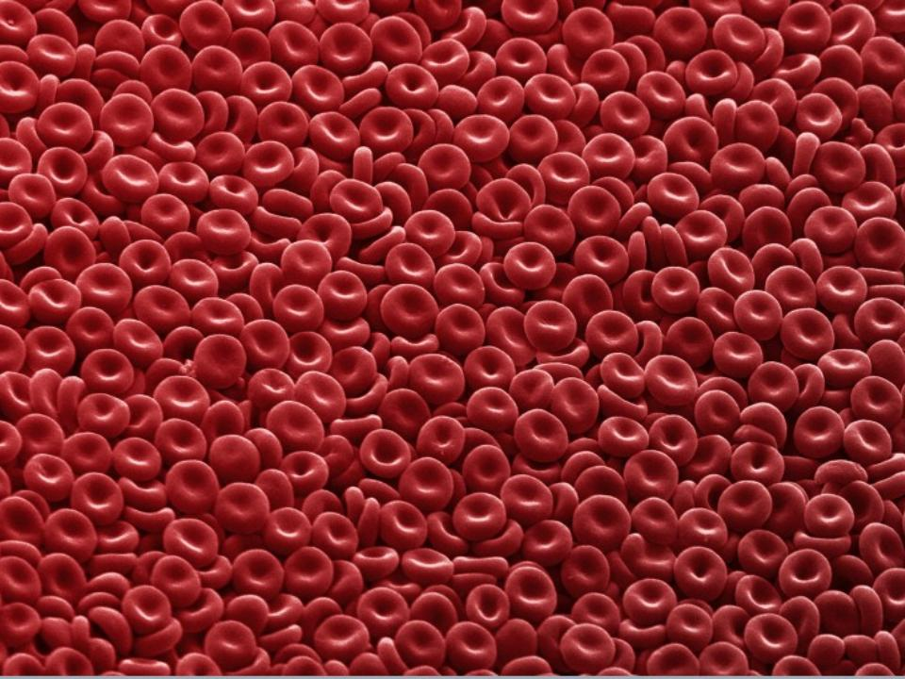
Oxygen Levels
Oxyhemoglobin = plenty of oxygen; “bright red”
Deoxyhemoglobin = low in O2, “dark red”

Slide 12
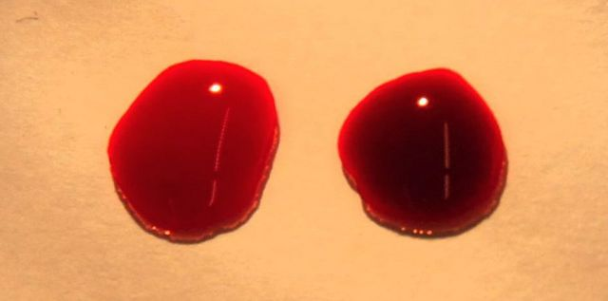
It is a myth that deoxygenated blood appears blue.
The blood on the left is oxygenated, the right is deoxygenated blood (from a vein)
Source: Wikipedia Commons

Slide 13
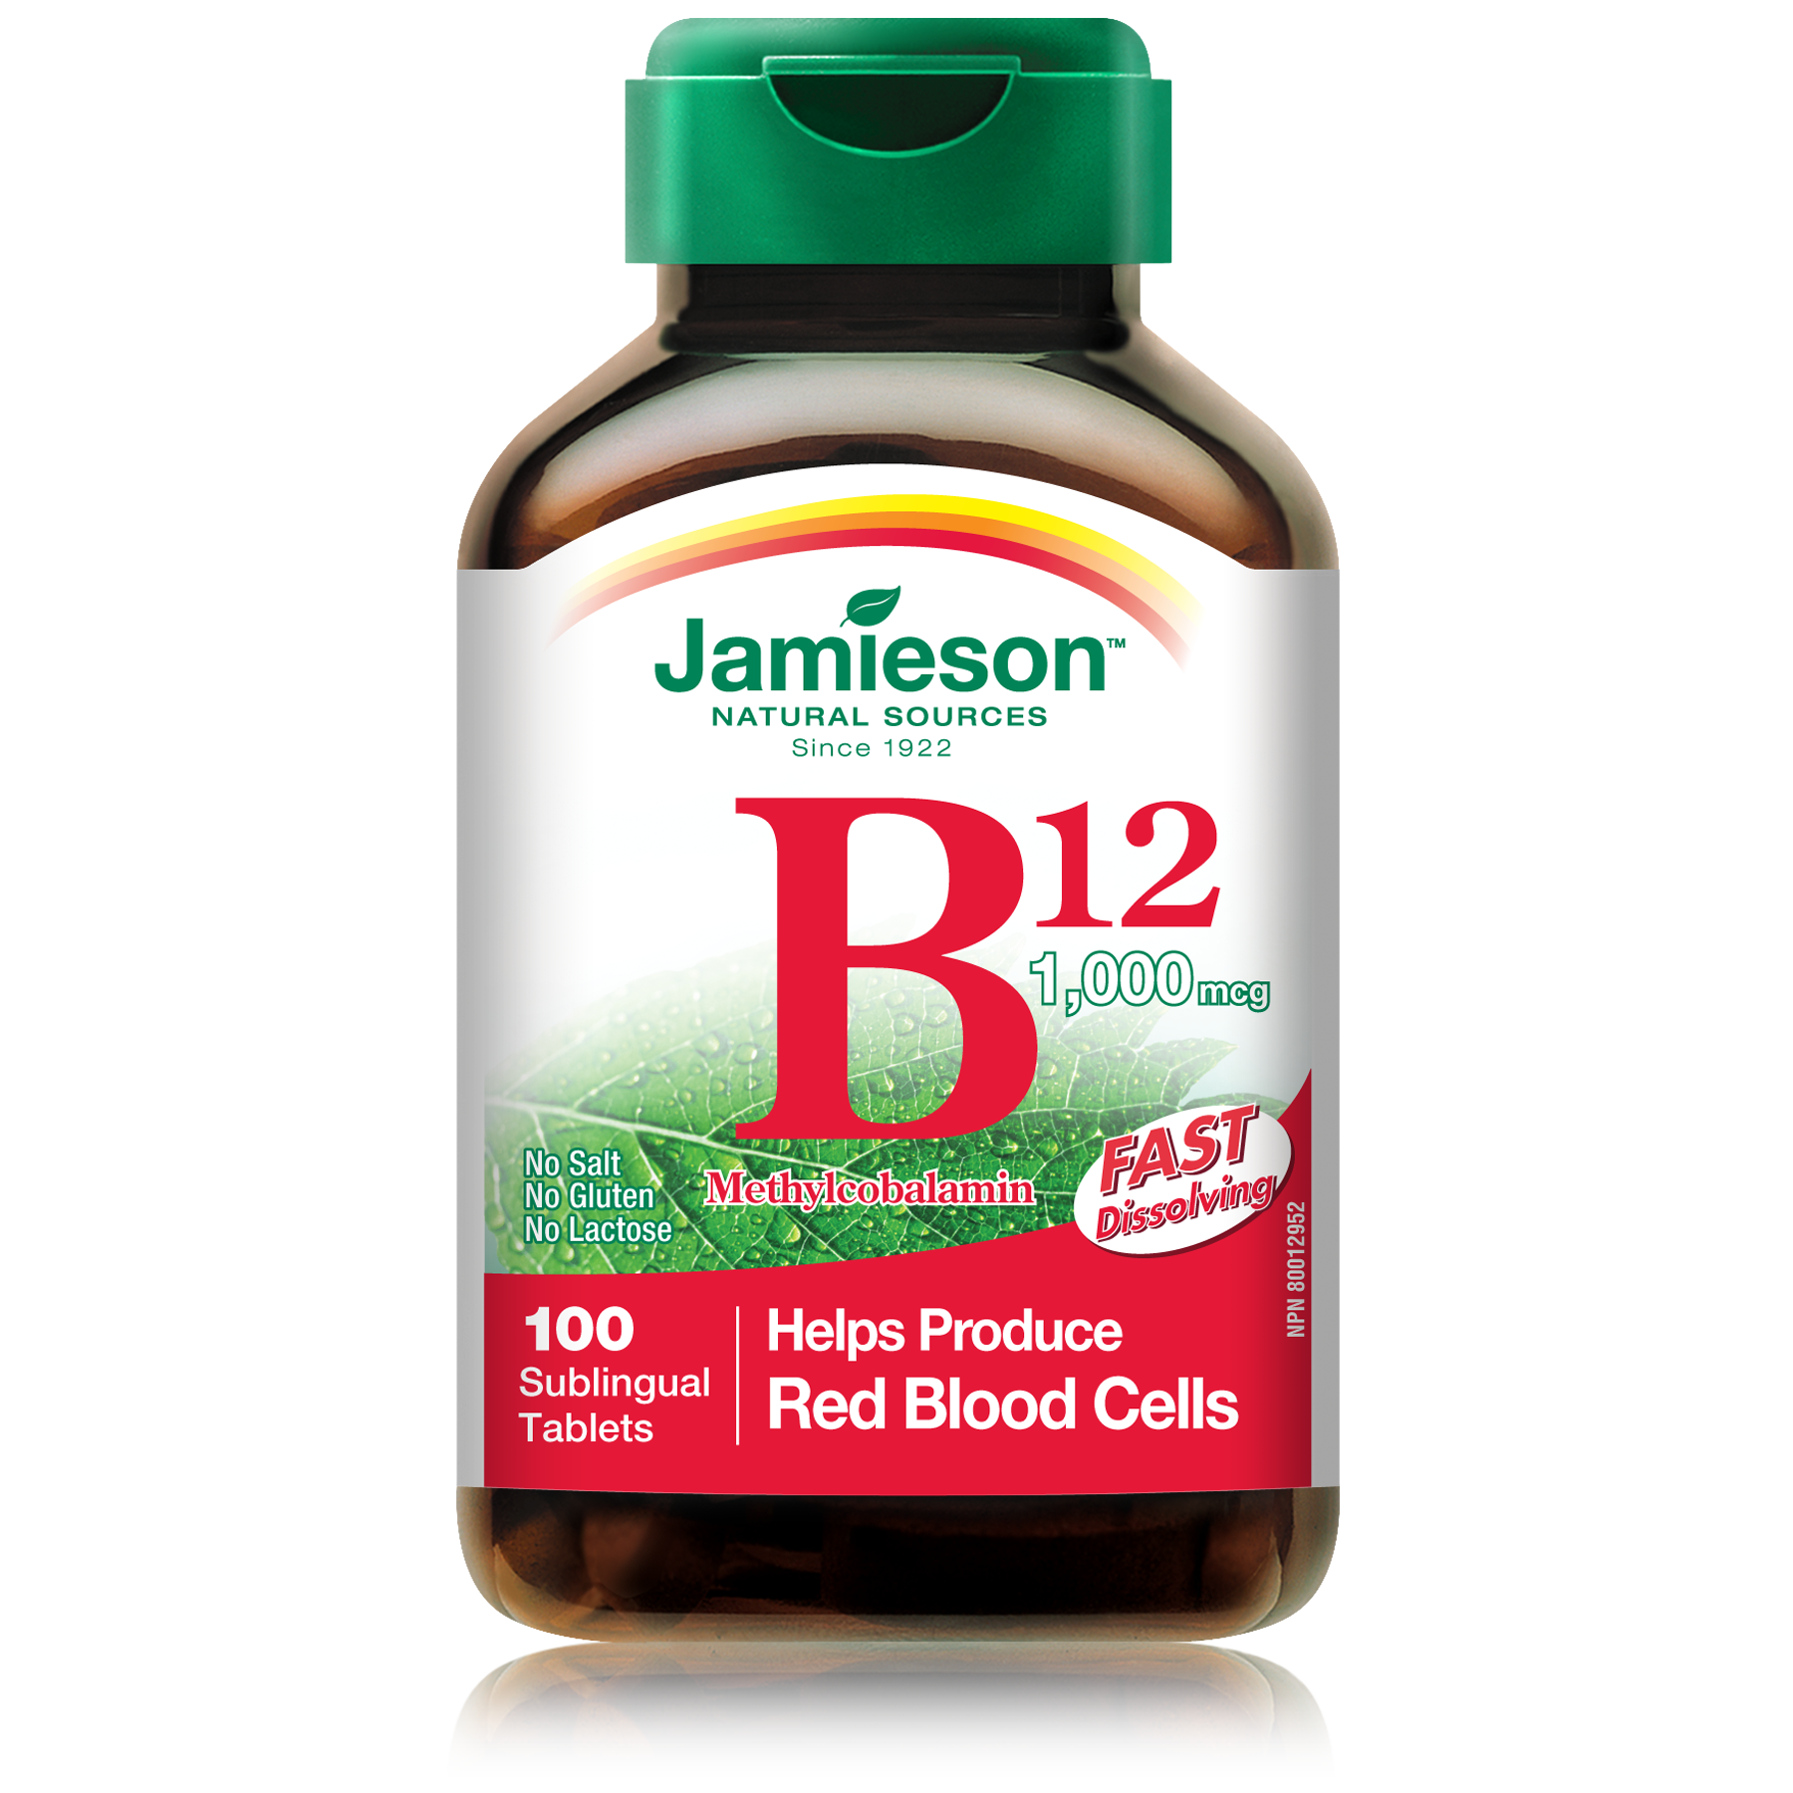
Elements Critical to RBC Production
Folic Acid
Vitamin B12
Iron
Too few RBC = anemia

Slide 14
WHITE BLOOD CELLS (Leukocytes)
General function is to protect the body against disease
There are FIVE different kinds of WBCs
Granulocytes (granular cytoplasm)
Neutrophils, Eosinophils, Basophils
Agranulocytes (lacking granular cytoplasm)
Monocytes, Lymphocytes

Slide 15
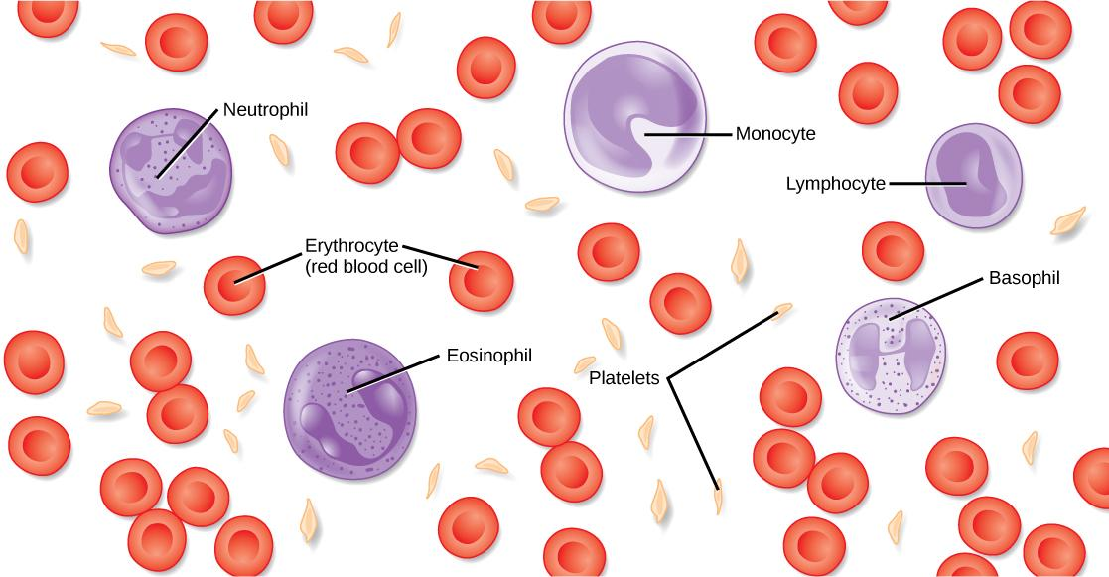
The white blood cells are found within the red blood cells, there are not as many WBC’s and generally, they are larger than RBC’s.

Slide 17
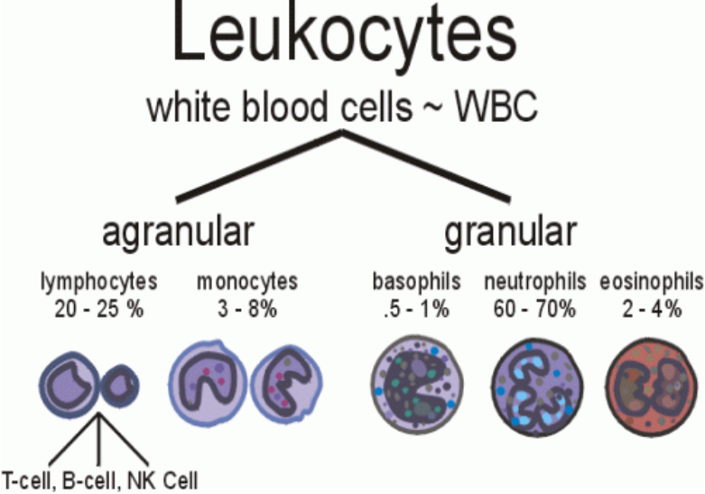

Slide 18
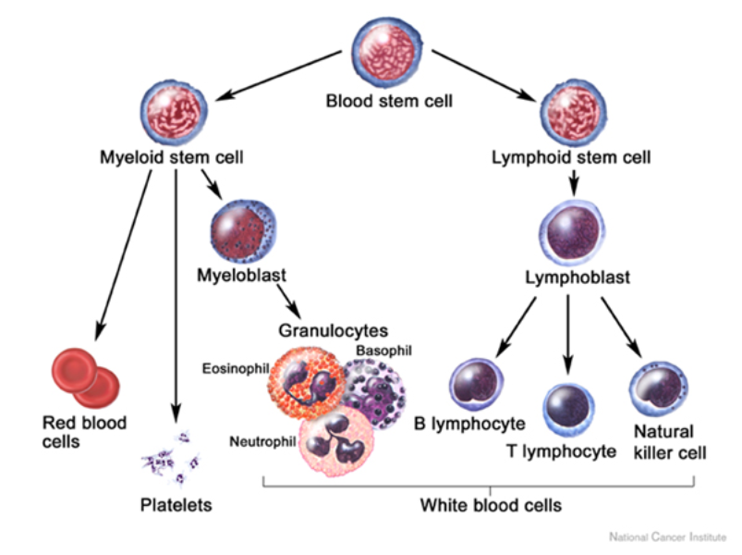

Slide 19
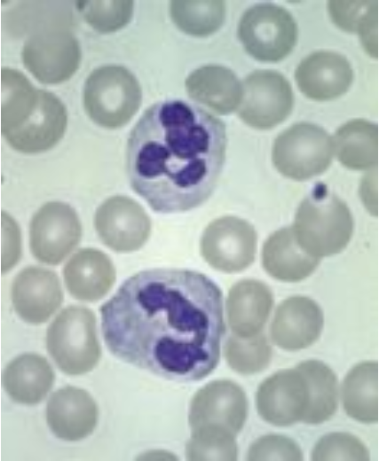
Neutrophil (nucleus has several lobes)
Active phagocytes
60% of WBC
Present in the pus of wounds

Slide 20
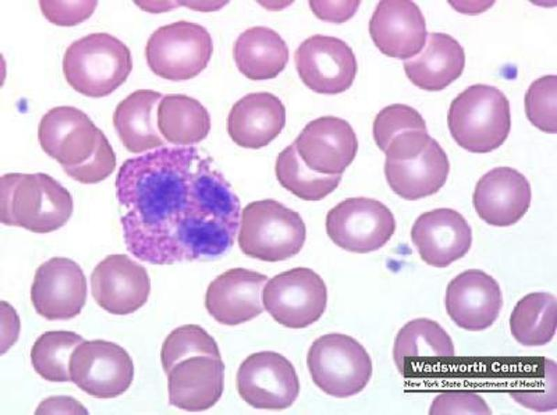
Eosinophil
Mainly attack parasites
2% WBC

Slide 21
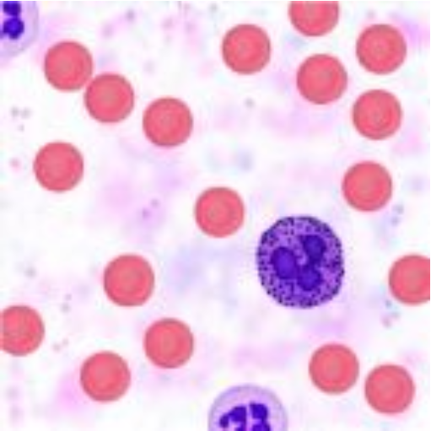
Basophil
Produces
Heparin = blood thinner
Histamines = Important in Inflammatory Reaction
1% WBC
Writing on Legs

Slide 22
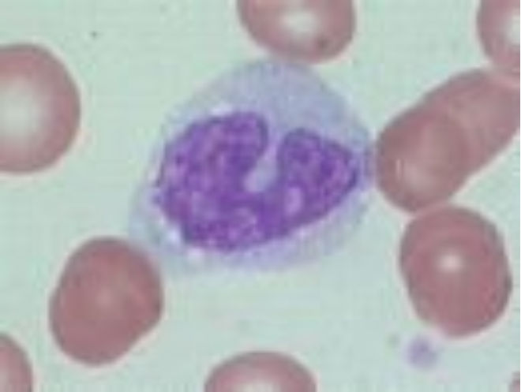
Monocyte (larger cell, horseshoe shaped nucleus)
Become macrophages
6% of wbc’s

Slide 23
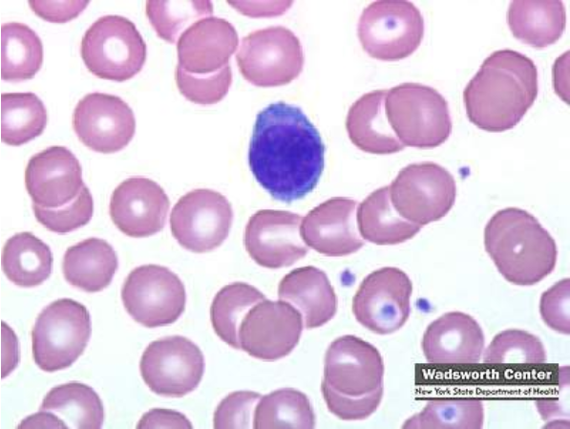
Lymphocyte (nucleus is dark and takes up almost whole cell; almost no cytoplasm seen)
Main defense (immune system)
Produce Antibodies
30% WBC

Slide 25
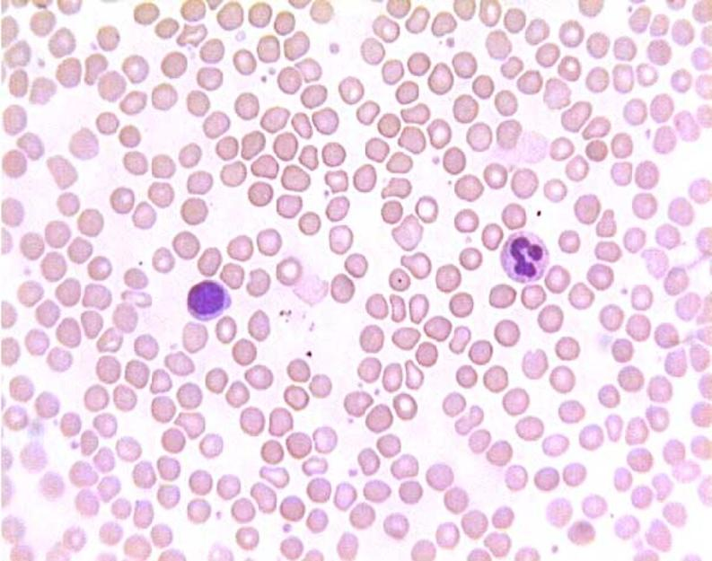
Left: Lymphoctye | Right: Neutrophil

Slide 26
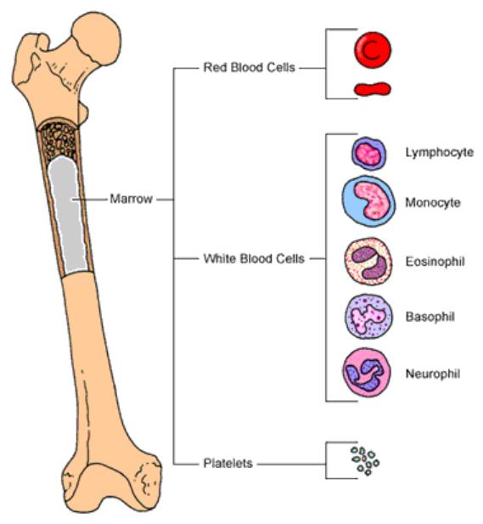

Slide 27
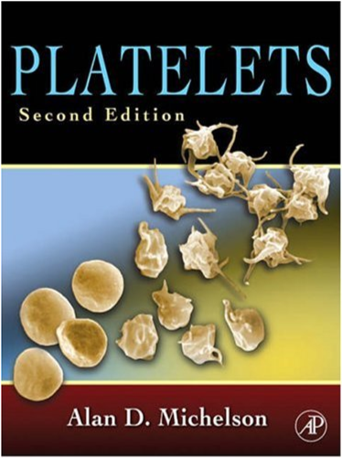
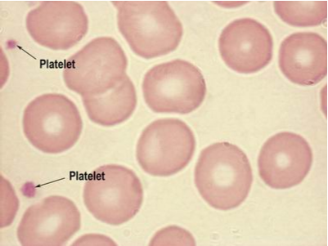
Platelets (thrombocytes)
Blood clots and vessel repair

Slide 28
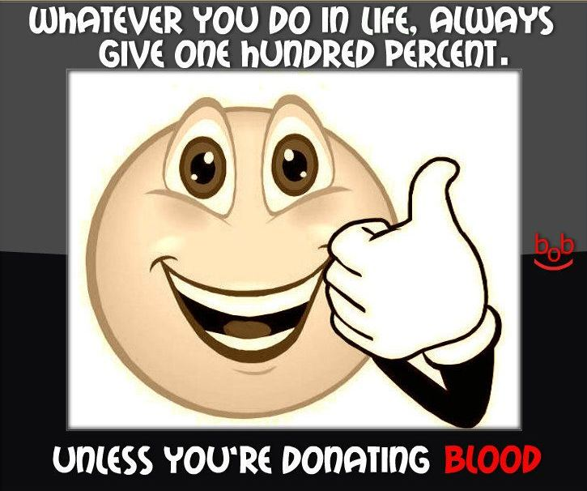

Slide 29
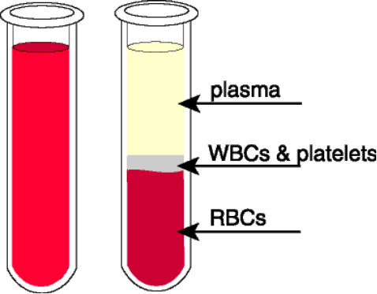
PLASMA
The liquid portion of blood is 92% water
Also contains nutrients, gases, vitamins (etc) and plasma proteins

Slide 30
Plasma Proteins
Albumins – blood pressure
Globulins – transport lipids and antibodies for immunity
Fibrinogen – important for blood clotting

Slide 31
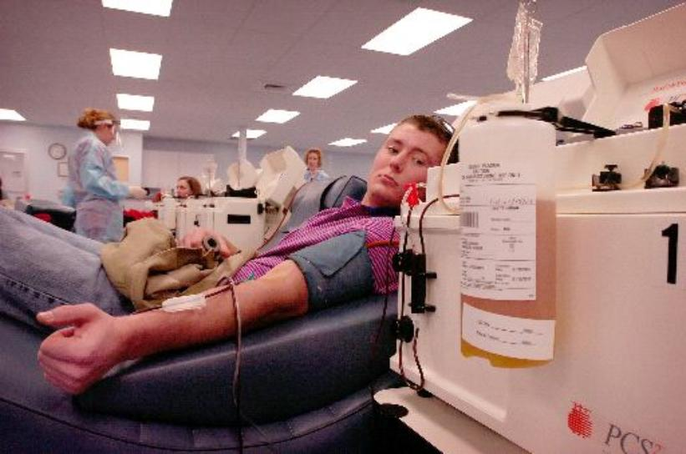
This machine removes the plasma from the blood and returns the RBC’s to the donor.

Slide 32
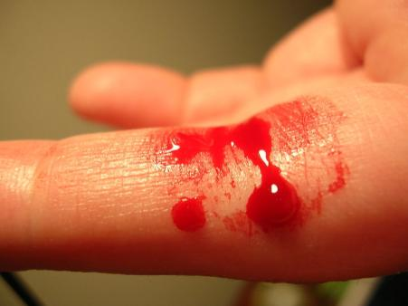
HEMOSTASIS
The process of stopping bleeding
Involves the coagulation and clotting of the blood to seal the site of damage

Slide 33
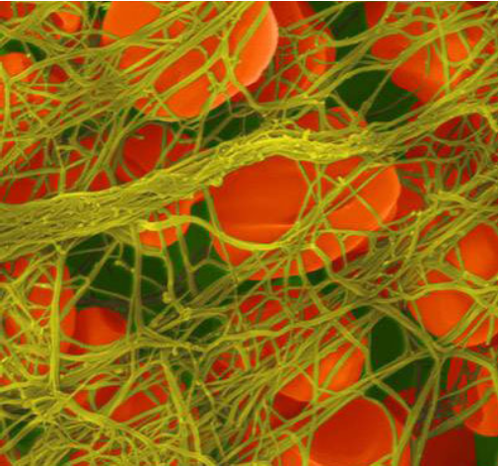
THREE EVENTS IN HEMOSTASIS
1. Blood Vessel Spasm
Seratonin = vasoconstrictor
2. Platelet plug formation
= plugs opening
3. Blood coagulation
conversion of fibrinogen to fibrin
*thrombin is an enzyme that causes the conversion

Slide 34
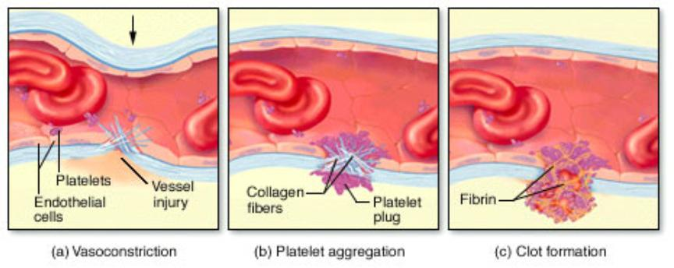
Hemostasis

Slide 35
COAGULATION - the thickening of blood to form a clot (hematoma)

Slide 36
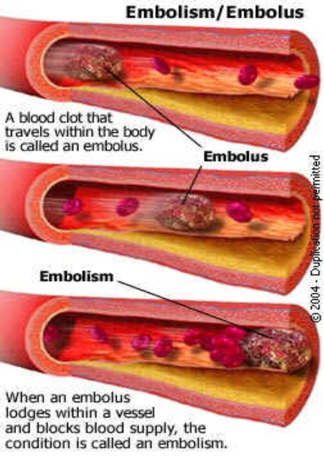
THROMBUS – blood clot (abnormal)
EMBOLUS – when the clot moves to another place.

Slide 37
What is DVT?
Video: Deep Vein Thrombosis

