Slide 1

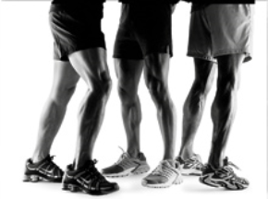

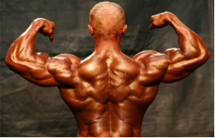
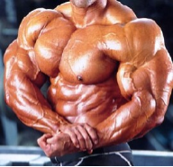
Muscular System

Slide 2
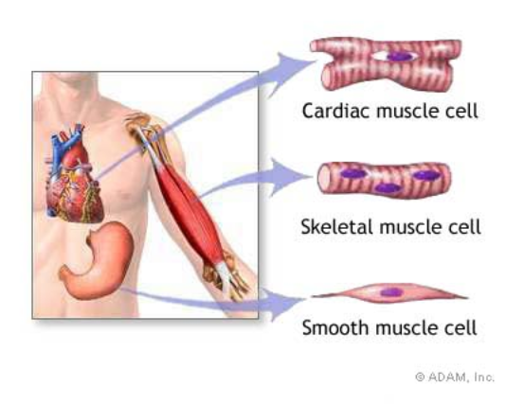
Types of Muscle
Skeletal – striated & voluntary
Smooth – involuntary
Cardiac - heart

Slide 3
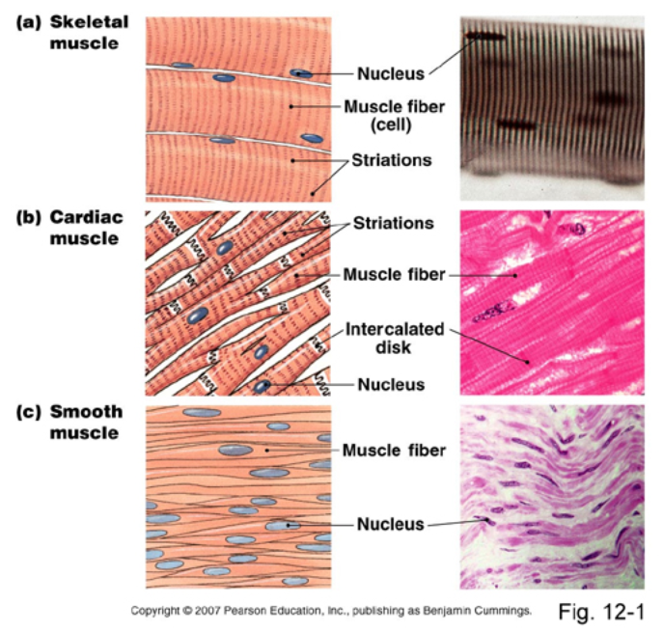

Slide 4
Muscles and Muscle Fibers
Muscles are composed of many fibers that are arranged in bundles called FASCICLES
Individual muscles are separated by FASCIA, which also forms tendons and aponeuroses

Slide 5
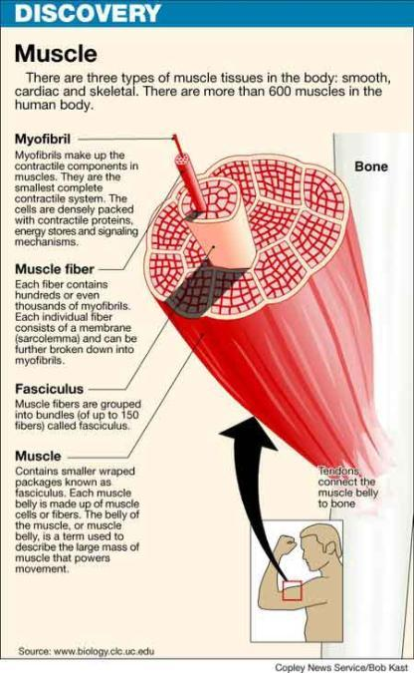

Slide 6
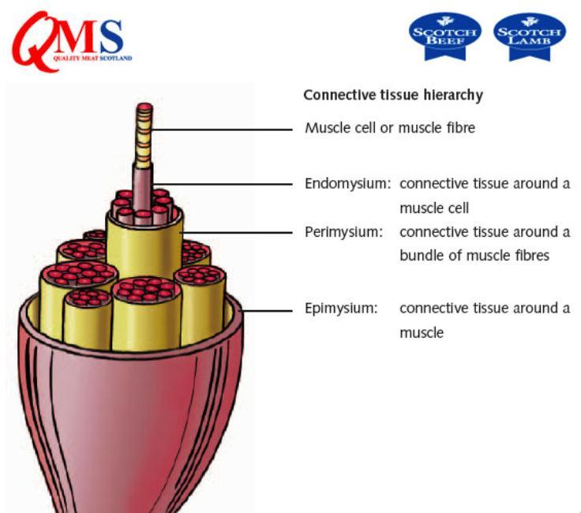
Muscle Layers

Slide 7
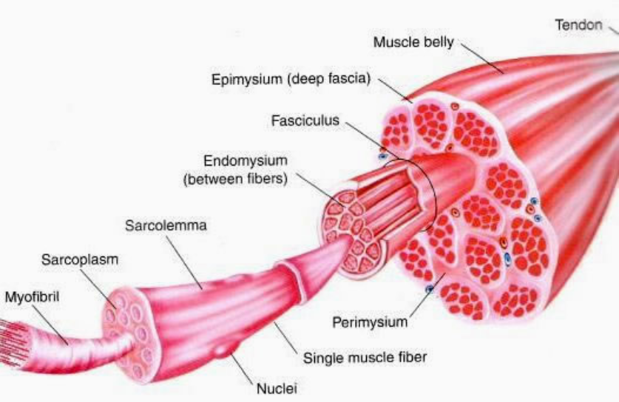

Slide 8
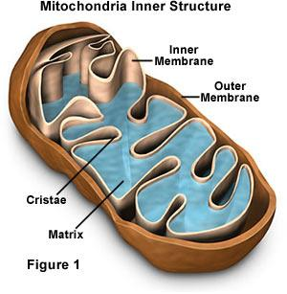
ENERGY
Fibers contain multiple mitochondria for energy
Most fibers have multiple nuclei

Slide 9
SARCOLEMMA
Sarcolemma = muscle fiber membrane
Sarcoplasm = inner material surrounding fibers (like cytoplasm)
Myofibrils = individual muscle fibers --> made of myofilaments

Slide 10
Myofibril
Contains protein filaments
– ACTIN (thin) and MYOSIN (thick)
These filaments overlap to form dark and light bands on the muscle fiber
      A band = dArk • thick (myosin)
      I band = lIght • thIn (actin)
In the middle of each I band are Z lines. A sarcomere is on Z line to the other

Slide 11
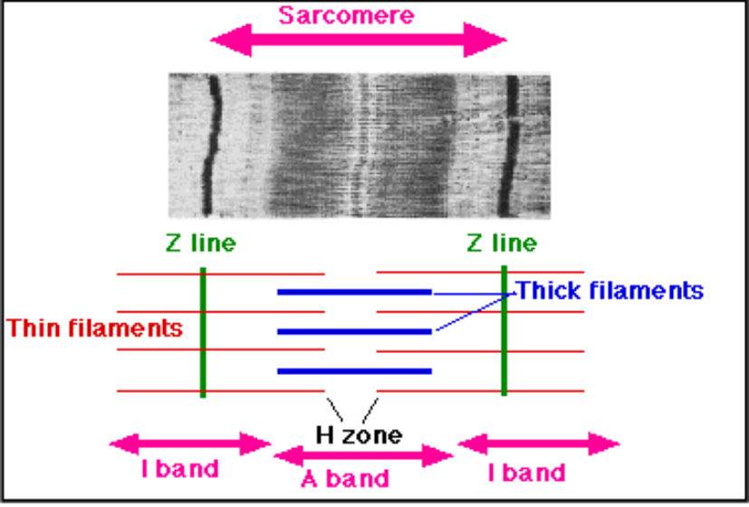

Slide 12
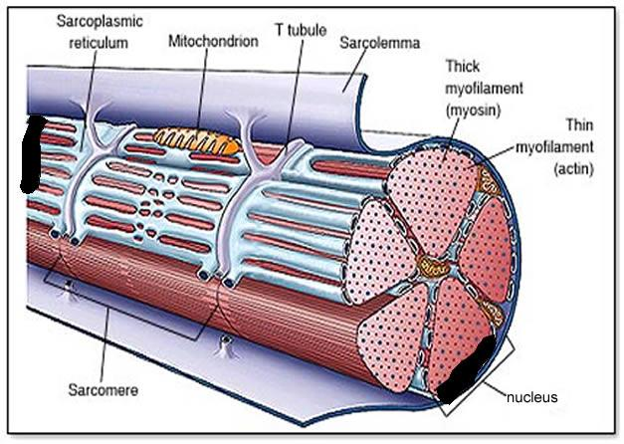

Slide 13
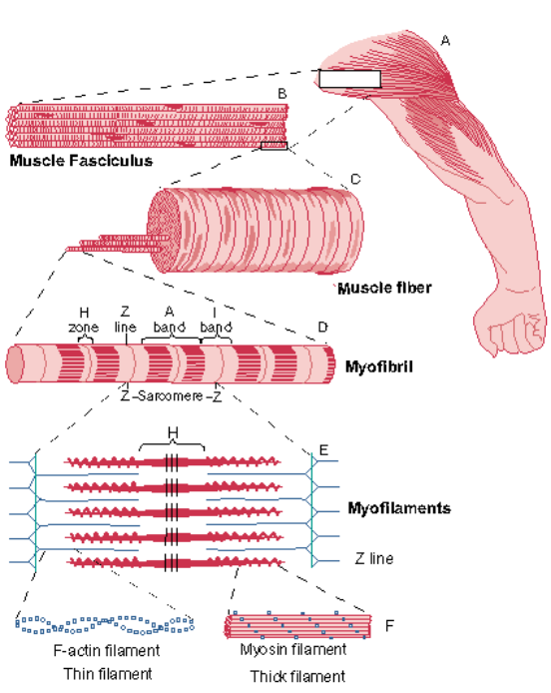

Slide 14
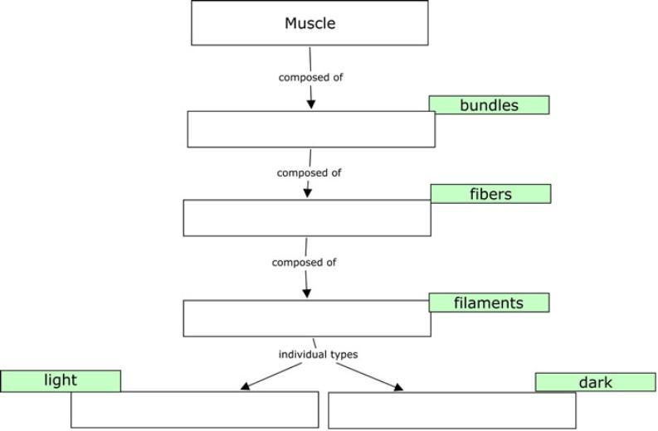
It is important to remember the heirarchy
myosin
myofibrils
fasicles
myofilaments
actin

Slide 15
It is important to remember the heirarchy
fasicles
myofibrils
myofilaments
actin
myosin

Slide 16
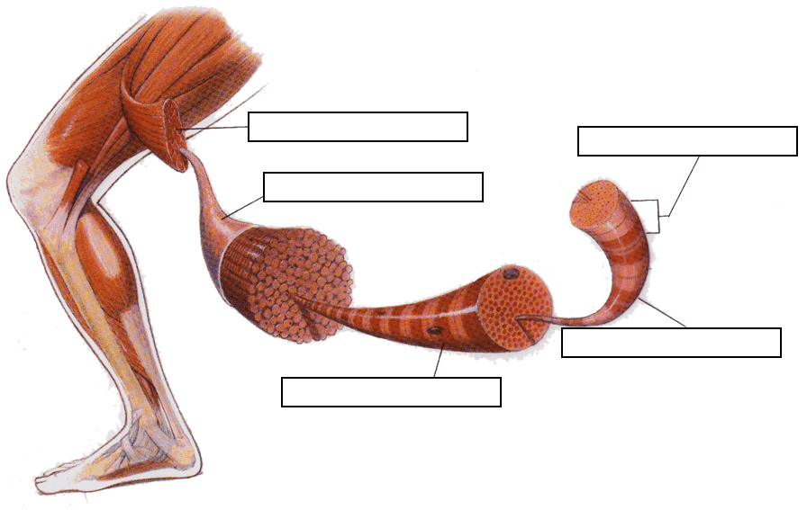
muscle fiber
myofilament
myofibrils
epimysium
muscle
sarcomere

Slide 17
myofilament
muscle
sarcomere
epimysium
myofibrils
muscle fiber

Slide 18
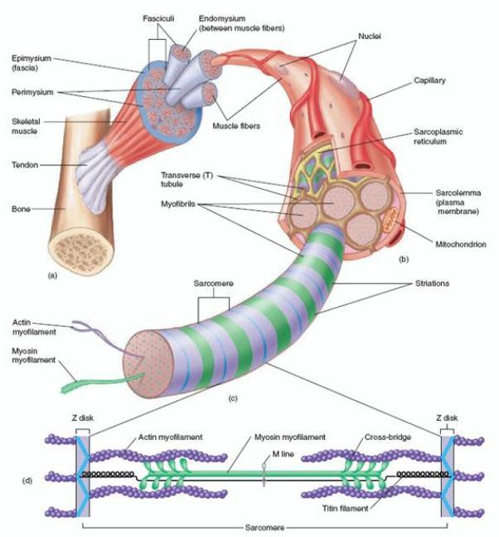

Slide 19
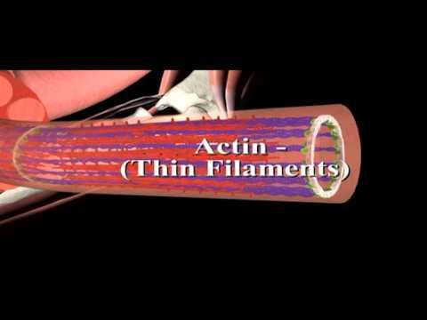

Slide 20
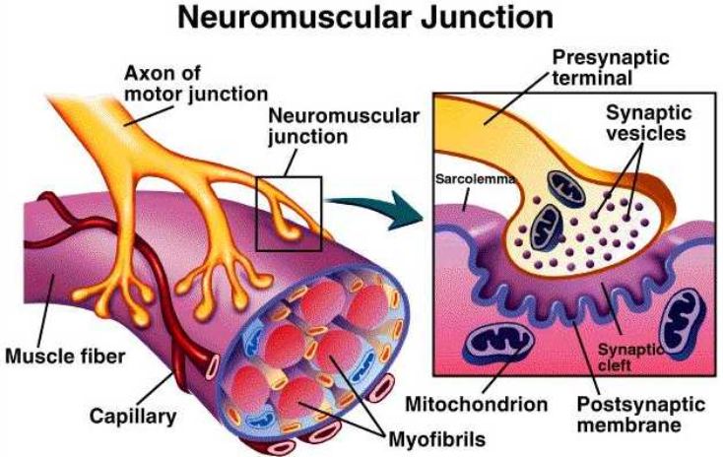
Muscles & Nervous System

Slide 21
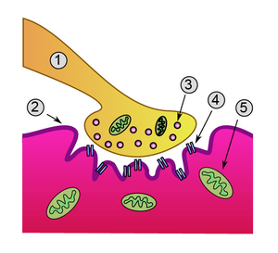
Motor Unit or Neuromuscular Junction
1. Neuron 2. Sarcolemma (or motor end plate)
3. Vesicle 4. Synapse 5. Mitochondria

Slide 22
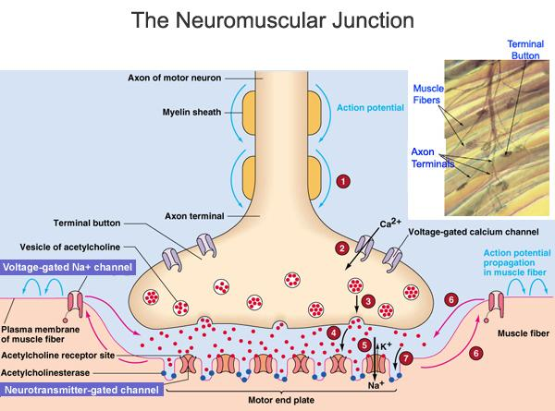
The neurotransmitter that crosses the gap is ACETYLCHOLINE.
This is what activates the muscle.
Acetylcholine is stored in vesicles

Slide 23
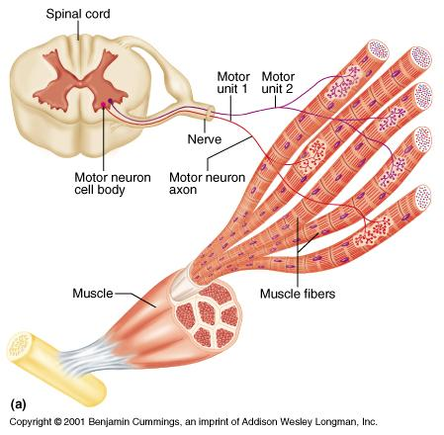
Motor Unit
The muscle fiber and the motor neuron

Slide 24
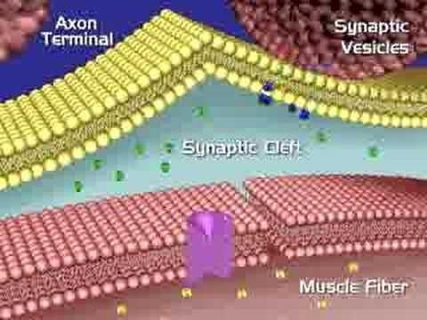

Slide 25
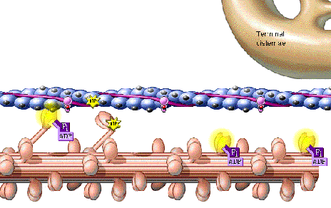
SLIDING FILAMENT THEORY (MODEL)
The theory of how muscle contracts is the sliding filament theory. The contraction of a muscle occurs as the thin filament slide past the thick filaments. The sliding filament theory involves five different molecules plus calcium ions.
The five molecules are:
myosin
actin
tropomyosin
troponin
ATP

Slide 26
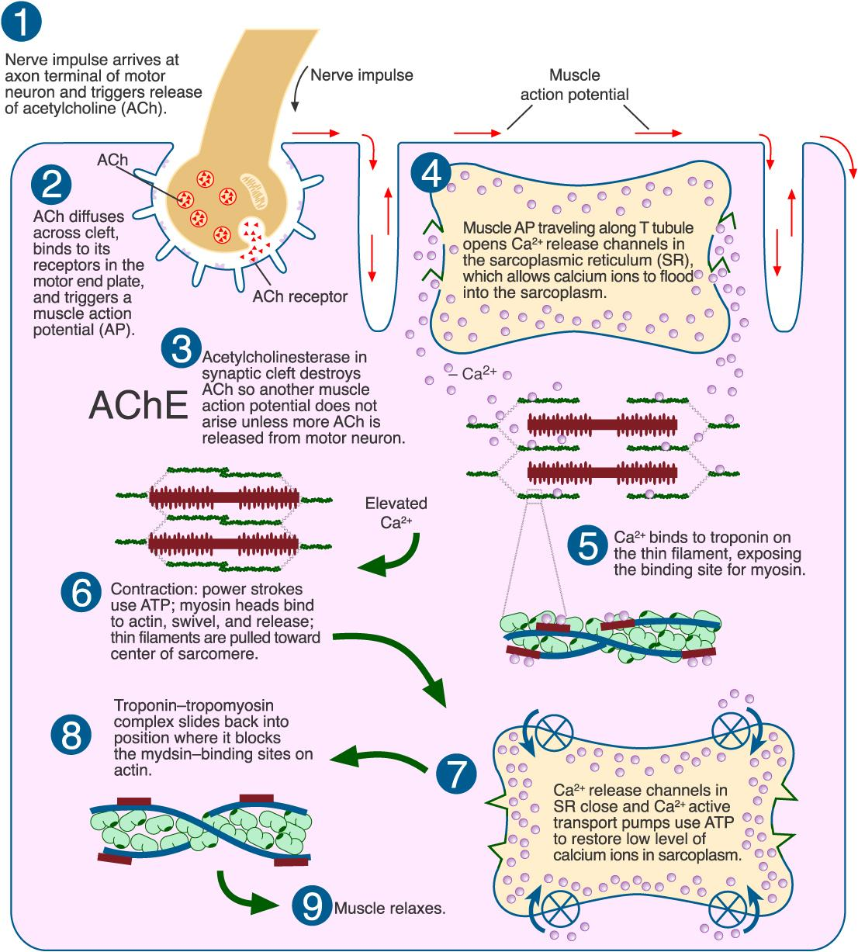
Sliding Filament Handout

Slide 27
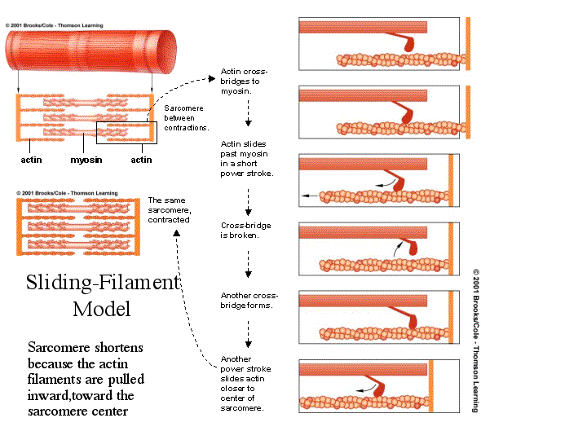
Sliding Filament Handout

Slide 28
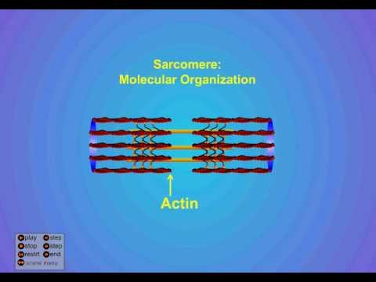
ANIMATION OF SLIDING FILAMENT
http://www.blackwellpublishing.com/matthews/myosin.html

Slide 29
Energy Source
Provided by ATP from cellular respiration (mitochondria)
Creatine phosphate increases regeneration of ATP
Much of the energy forms heat, which keeps our bodies warm

Slide 30
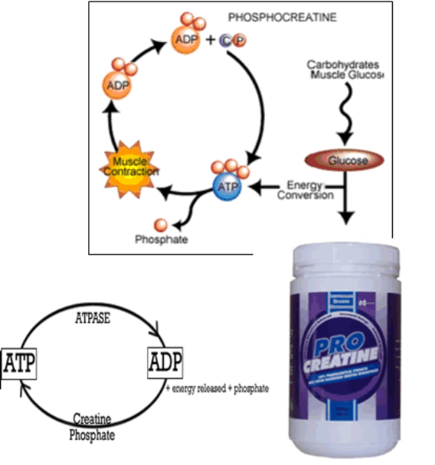

Slide 31
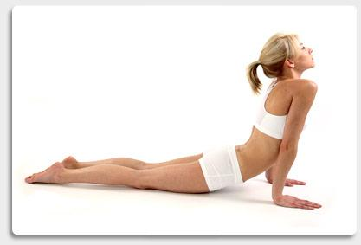
Other Terms
1. Threshold Stimulus
2. All-or-None Response
3. Motor Unit
5. Recruitment
6. Muscle Tone
7. Muscular Hypertrophy
8. Muscular Atrophy
9. Muscle Fatigue
10. Muscle Cramp
11. Oxygen Debt

Slide 32
Threshold Stimulus
Minimal strength required to cause a contraction
Motor neuron releases enough acetylcholine to reach threshold
All-or-None Response
Fibers do not contract partially, they either do or don't

Slide 33
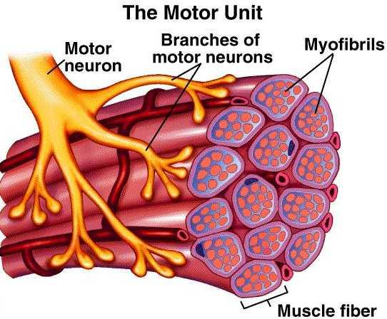

Motor Unit
The muscle fiber + the motor neuron
Recruitment
more and more fibers contract as the intensity of the stimulus increases
Muscle Tone
Sustained contraction of individual fibers, even when muscle is at rest

Slide 34
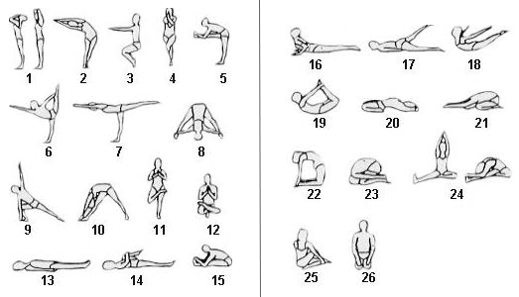

Slide 35
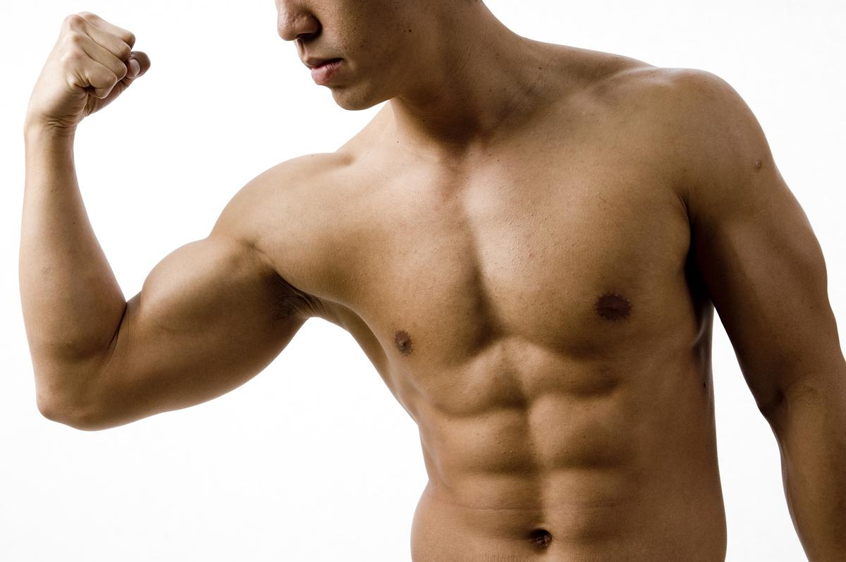
Hypertrophy - muscles enlarge (working out or certain disorders)
Atrophy - muscles become small and weak due to disuse

Slide 36
Muscle Fatigue - muscle loses ability to contract after prolonged exercise or strain
Muscle Cramp - a sustained involuntary contraction
Oxygen Debt - oxygen is used to create ATP, during exercise you may not have enough oxygen --> this causes Lactic Acid to accumulate in the muscles
*See Magic School Bus

Slide 37
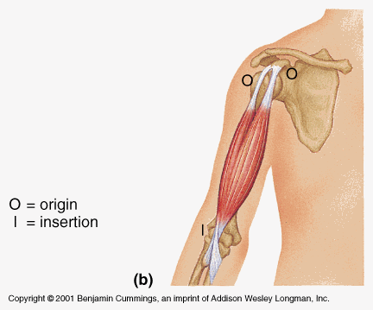
Origin and Insertion
Origin = the immovable end of the muscle
Insertion = the movable end of the muscle
**when a muscle contracts the insertion is moved toward the origin
The biceps brachii has two origins (or two heads).

Slide 38
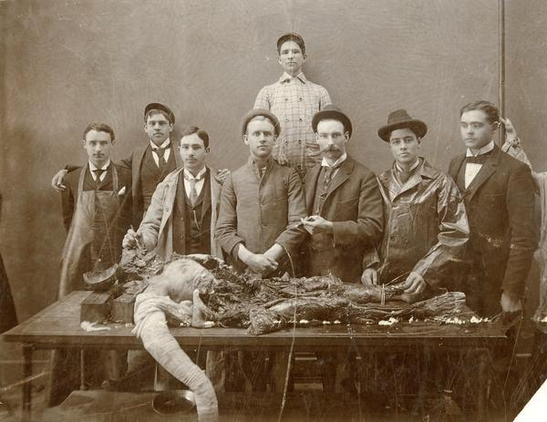
What is rigor mortis?
A few hours after a person or animal dies, the joints of the body stiffen and become locked in place. This stiffening is called rigor mortis. Depending on temperature and other conditions, rigor mortis lasts approximately 72 hours. The phenomenon is caused by the skeletal muscles partially contracting. The muscles are unable to relax, so the joints become fixed in place.

Slide 39
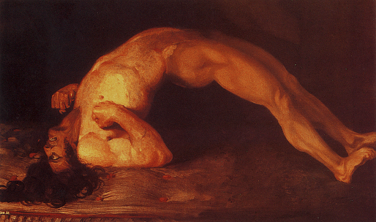
What is tetanus?
Tetanus causes cholinosterase to not break down the acetylcholine in the synapse. This results in a person's muscles contracting and not relaxing.
A tetanus shot must be administered shortly after exposure to the bacteria.
Once you develop tetanus, there is no cure.

Slide 40
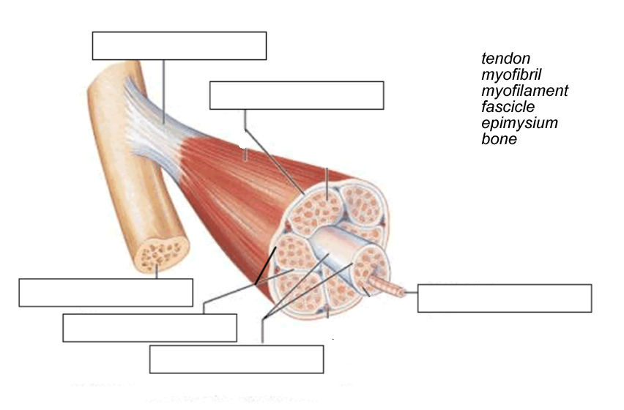

Slide 41
