Slide 1
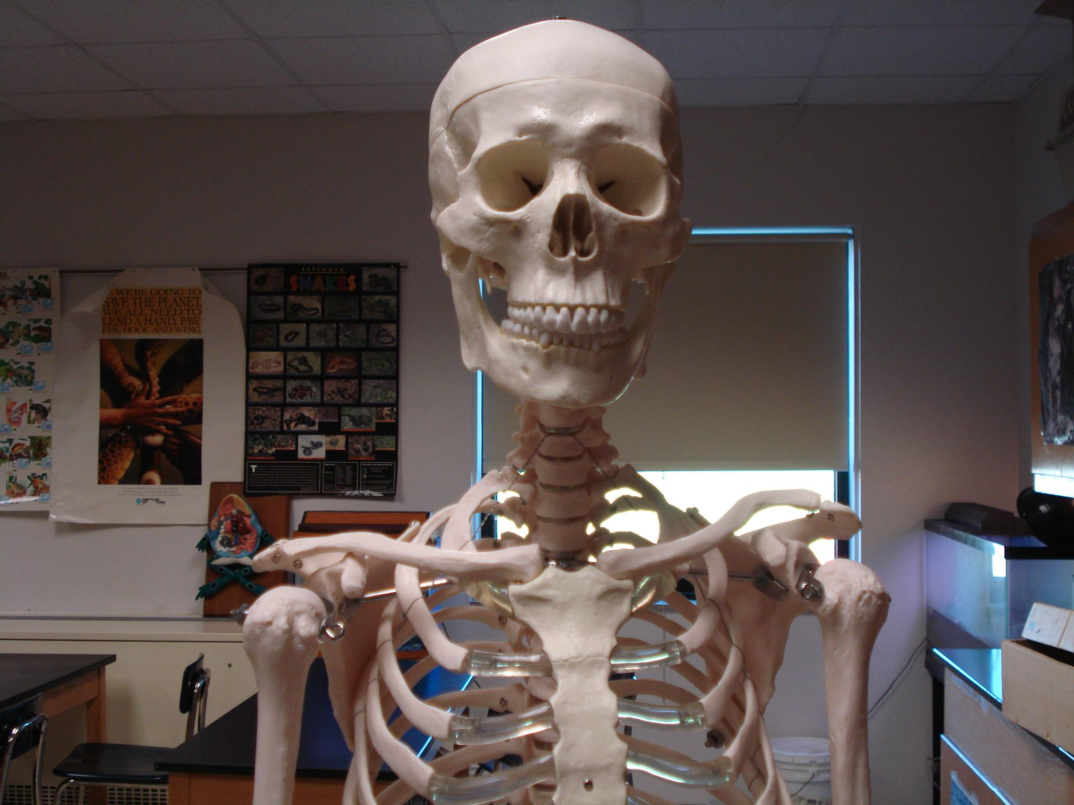
SKELETAL SYSTEM

Slide 2
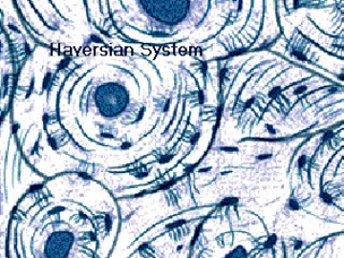
Functions of the Skeletal System
Bones are made of OSSEOUS TISSUE
Support and Protection
Body movement
Blood cell formation (bone marrow) - hemopoiesis
Storage of inorganic materials
(salt, calcium, potassium….)

Slide 3
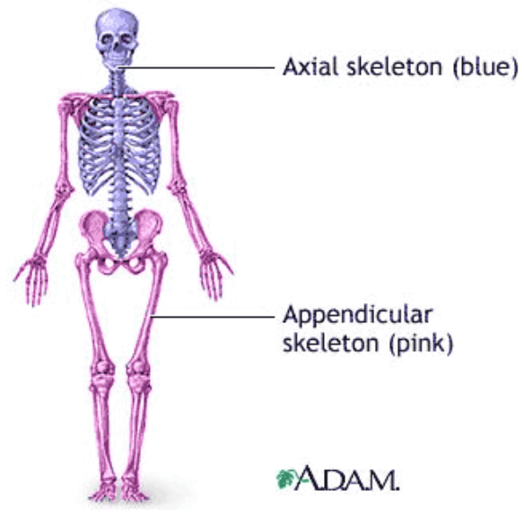
ORGANIZATION
About 206 bones
2 Main Divisions – Axial & Appendicular

Slide 4
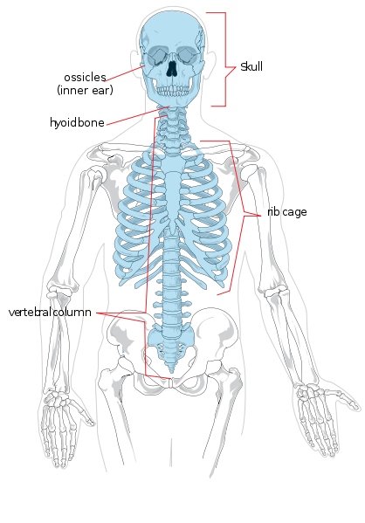
Axial Skeleton
Head, neck, trunk
Skull
Hyoid Bone
Vertebral Column
Thoracic Cage (ribs, 12 pairs)
Sternum

Slide 5
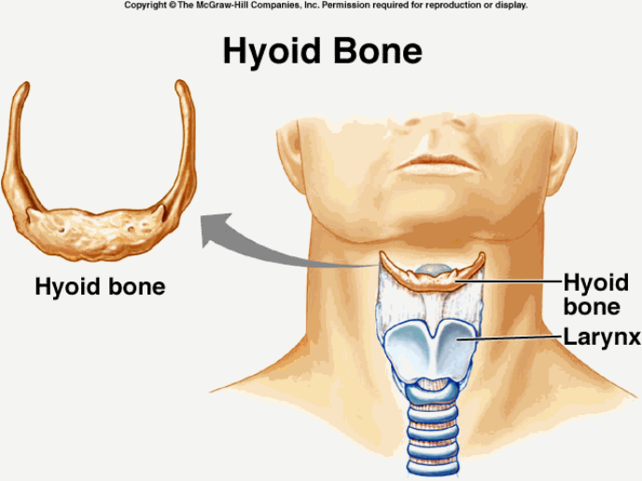
Hyoid Bone

Slide 6
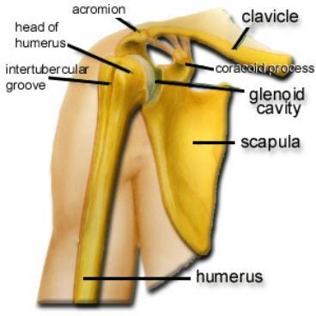
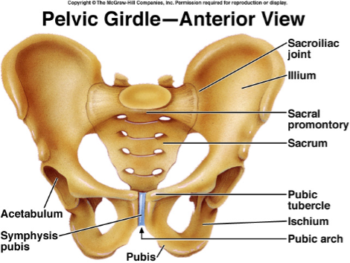
Appendicular Skeleton
Limbs & Bones that connect to the
  Pectoral Girdle (shoulders)
  Pelvic Girdle (hips)

Slide 7
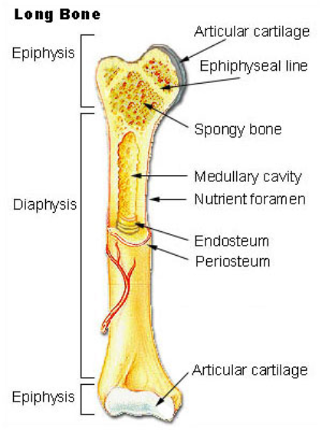
BONE STRUCTURE - Long Bone
Epiphysis
Diaphysis
Articular Cartilage
Periosteum

Slide 8
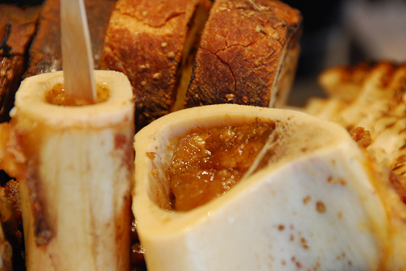
Inside the Long Bone
Medullary Cavity – hollow chamber filled with bone marrow
Red Marrow (blood)
Yellow Marrow (fat)
Endosteum
– lining of the medullary

Slide 9
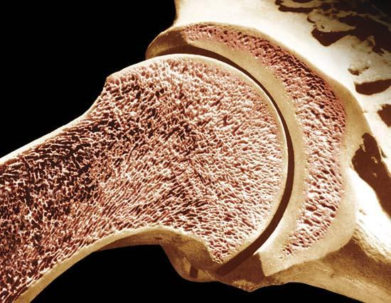
Types of Bone Tissue
Compact (wall of the diaphysis)
Spongy (cancellous, epiphysis) - red marrow

Slide 10
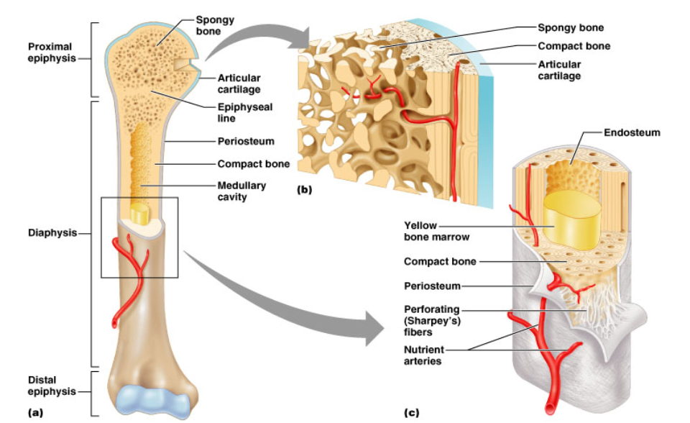
Structure of a Long Bone
Figure 6.3a-c

Slide 11
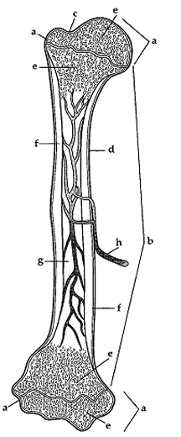
* Assignment
– Coloring of a Long Bone

Slide 12

Review the Structure of a Long Bone
Matching quiz at http://www.mhhe.com/biosci/ap/holehaap/student/olc2/chap07matching01.html

Slide 13
Microscopic Structure
MATRIX - where the bone cells live
OSTEOCYTES - mature bone cells, enclosed in tiny chambers called LACUNAE
OSTEOCYTES form rings (LAMELLAE) around a HAVERSIAN CANAL which houses blood vessels
Osteocytes are linked by CANALICULI
Haversian Canals are linked by VOLKMAN's CANALS

Slide 14

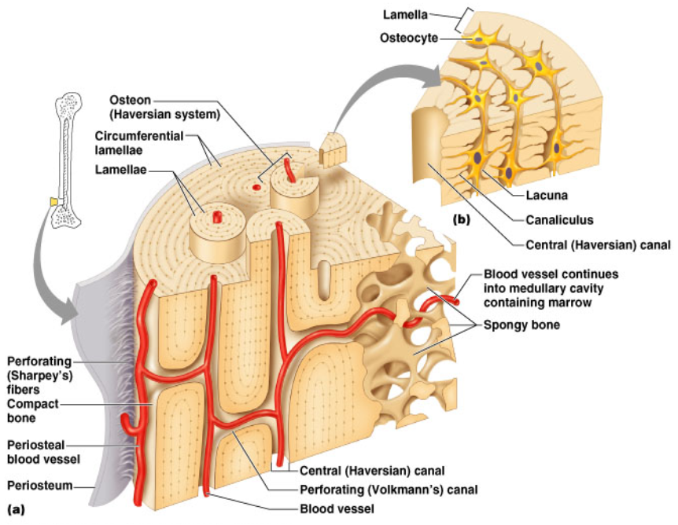
Compact Bone
BONE COLORING!

Slide 15
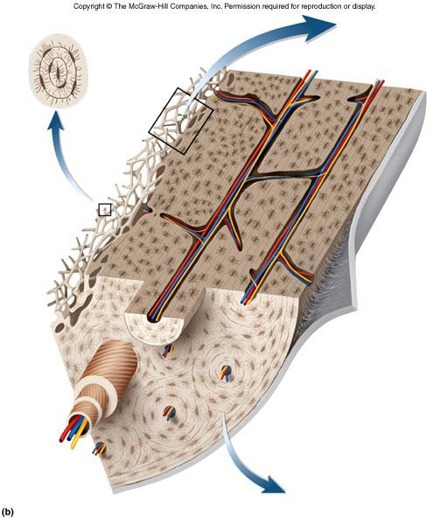
Test Yourself
Find the...
Haversian Canal
Volkman's Canal
Lamellae
Spongy Bone
Compact Bone

Slide 16
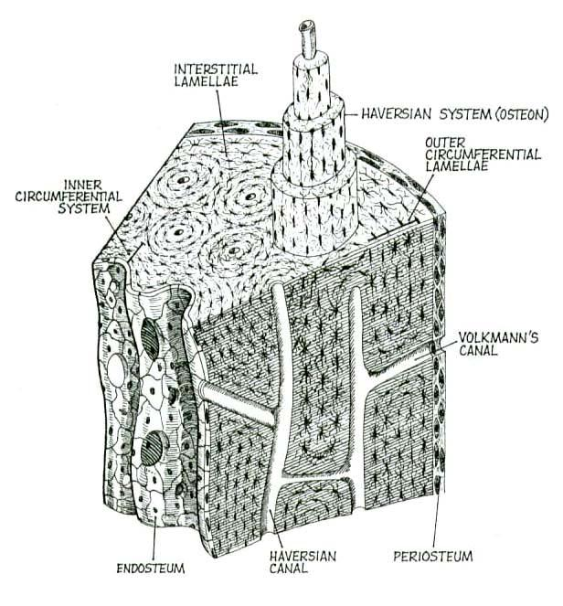

Slide 17
BONE DEVELOPMENT & GROWTH
Intramembranous bones – flat, skull
Endochondral bones – all other
ALL BONES START AS HYALINE CARTILAGE, areas graduallly turn to bone
PRIMARY OSSIFICATION CENTER (shaft)
SECONDARY OSSIFICATION CENTER (ends)

Slide 18
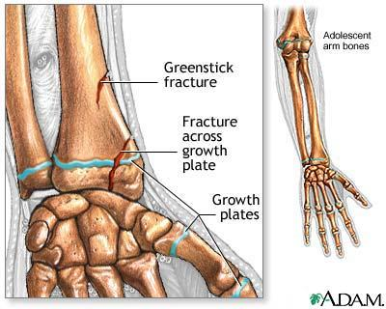
Bone Development & Growth
EPIPHYSEAL DISK (growth plate) is a band of cartilage between the epiphysis and diaphysis
These areas increase bone length as the cells ossify
Cartilage becomes OSTEOBLASTS become OSTEOCYTES

Slide 19
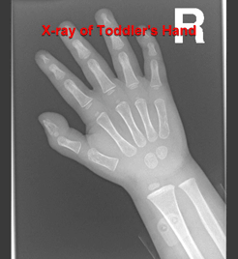
RESORPTION
OSTEOCLASTS - dissolve bone tissue to release minerals, process is called RESORPTION

Slide 20
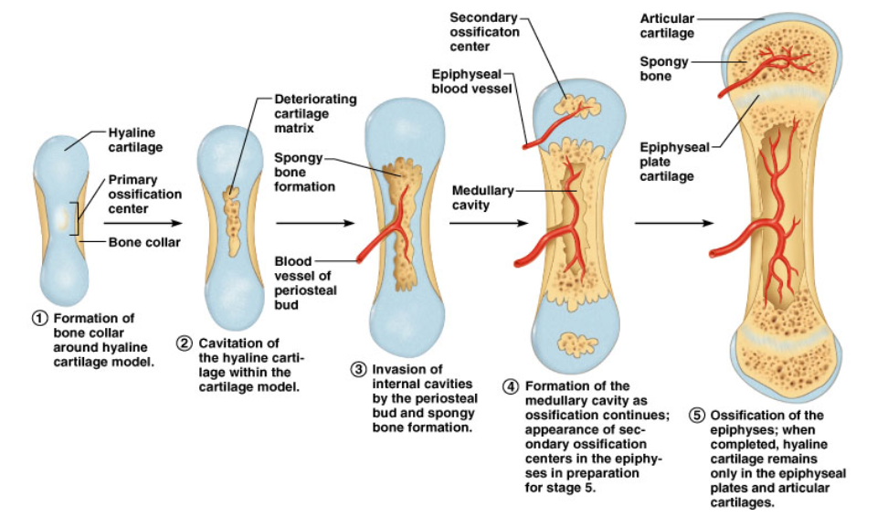
Bone Growth

Slide 21
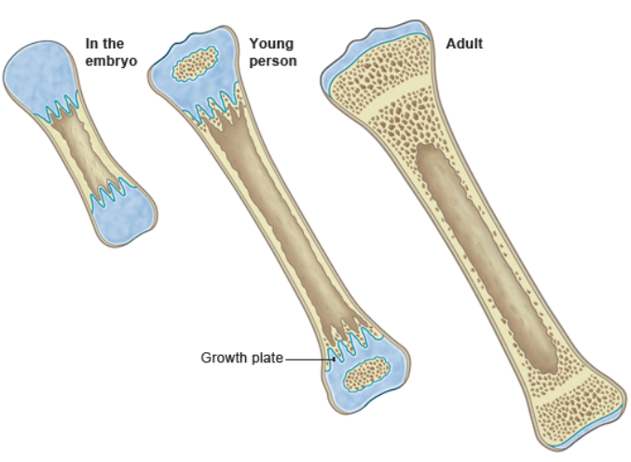
Bone Growth
* Assignment - Coloring of the Aging Hand

Slide 22
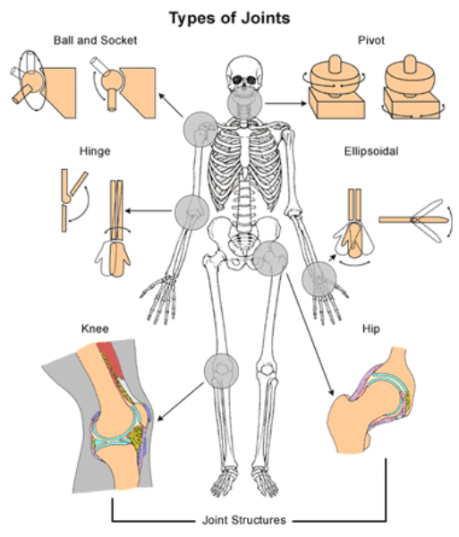
Types of Joints (articulations)
Synarthrotic (not moveable, aka sutures)
Amphiarthrotic (slightly moveable, vertebrae)
Diarthrotic (moveable joint, aka synovial joints)

Slide 23
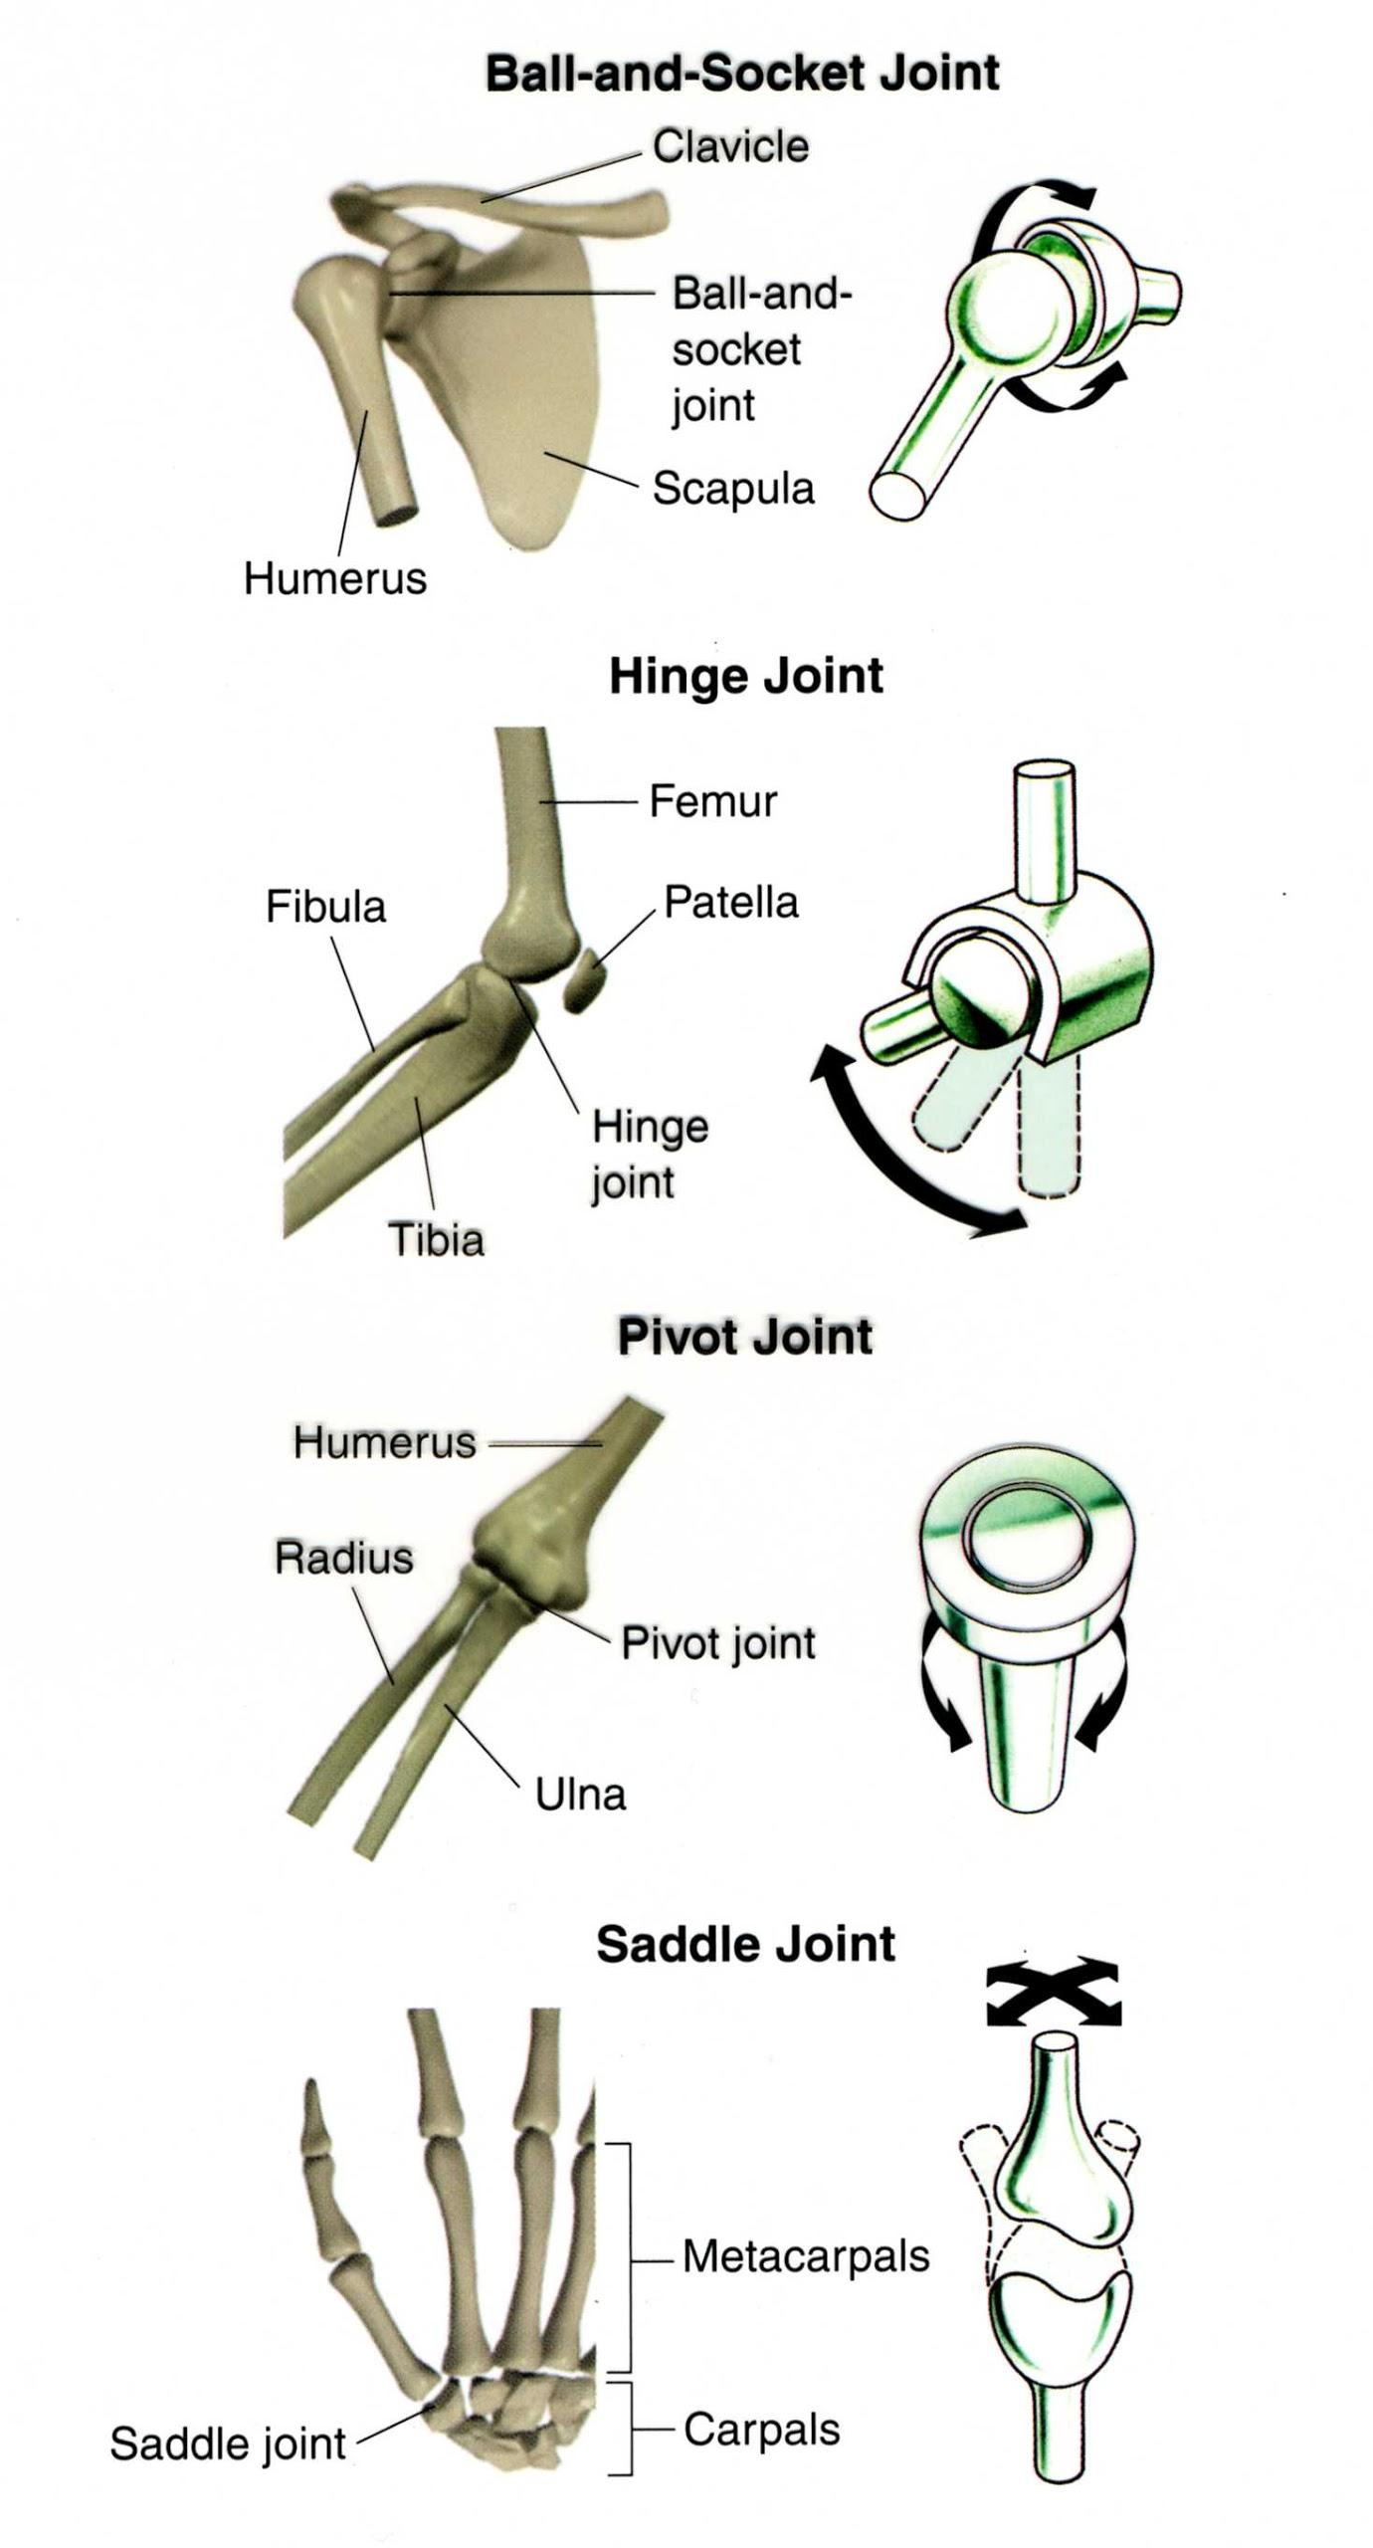
Synovial fluid - fluid within the joints that helps to lubricate
Types of Joints
1. Ball and Socket
2. Hinge
3. Pivot
4. Saddle

Slide 24
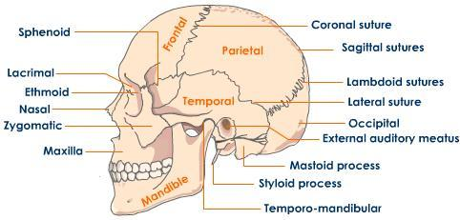
BONES OF THE SKULL
1. Frontal -
2. Parietal -
3. Occipital -
4. Temporal -
5. Sphenoid -
6. Maxilla -
7. Mandible -
8. Zygomatic -

Slide 25
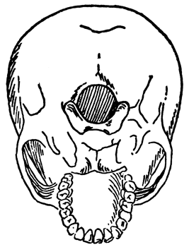
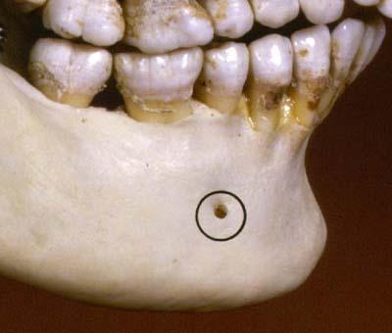
TOPOGRAPHY OF THE SKULL
Foramen - refers to any tiny opening, nerves and blood vessels leave this opening to supply the face
Mental Foramen

Slide 26
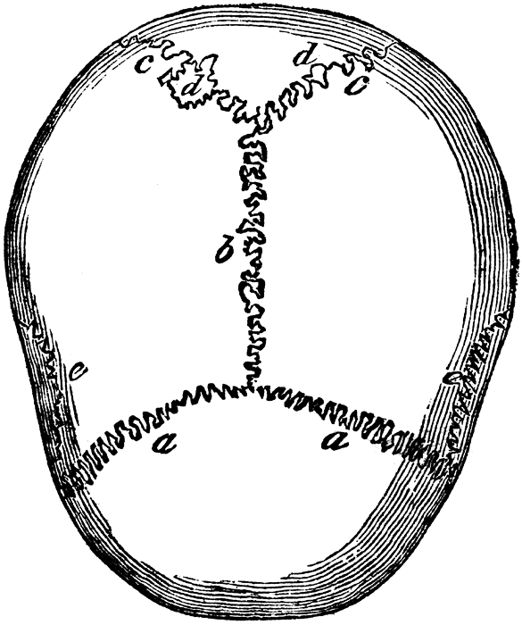
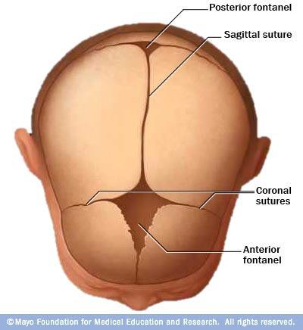
Suture - refers to any connection between large bones (in fetal skulls, these are called fontanels)
Fissure - any wide gap between bones

Slide 27
Sutures
1. Coronal - between frontal and parietal bones
2. Lambdoidal - between occipital and parietal bones
3. Squamosal - between temporal and parietal bones
4. Sagittal - between parietal bones

Slide 28
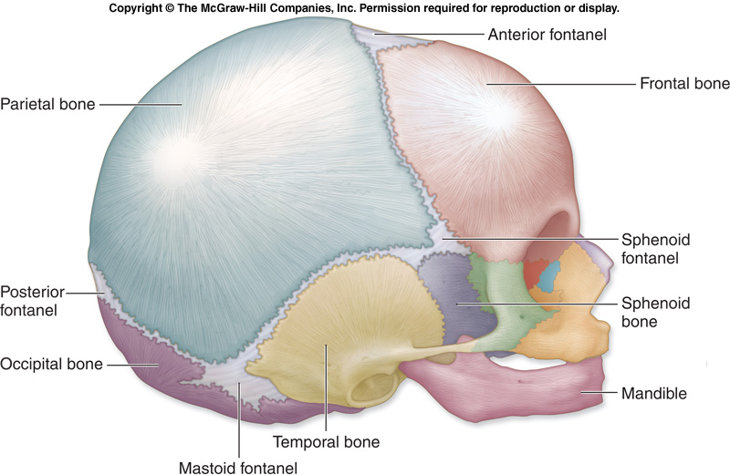
Bones of the Skull & Sutures

Slide 29
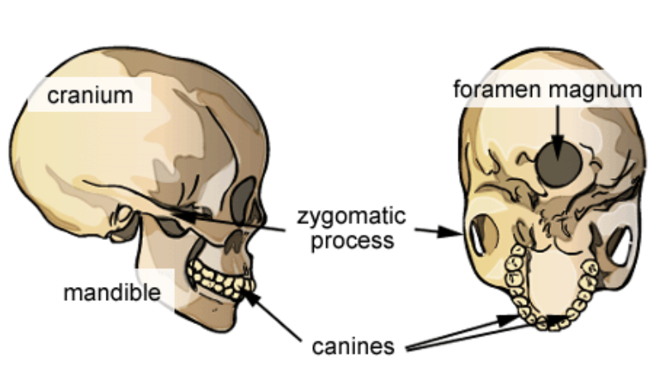

Foramen Magnum
* Assignment: Skull Labeling

