Slide 1

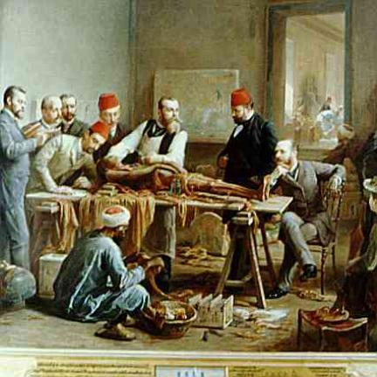

Introduction to Human Anatomy and Physiology

Slide 2

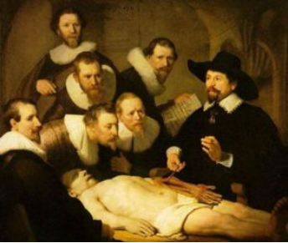
Anatomy – the structure of body parts (also called Morphology)
Physiology – the function of the body parts, what they do and how they do it

Slide 3

Movement - self initiated change in position, motion of internal parts
Responsiveness (irritability) - Ability to sense changes within, or around the organism and react to them
Growth - increase in body size
Reproduction - Parents produce offspring / producing new individuals
Respiration - Obtaining oxygen (O2), using it to release energy from food substances, and getting rid of wastes

Slide 4
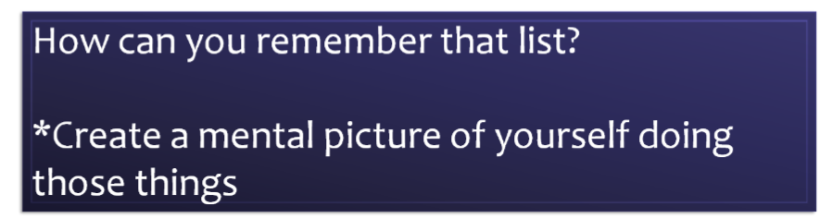
Digestion - Chemically changing (breaking down) food substances, and getting rid of wastes
Absorption - Passage of Digested products (food substances) through membranes and into body fluids
Circulation - Movement of substances throughout the body
Assimilation - Changing absorbed substances into chemically different substances
Excretion - Removal of wastes

Slide 5

I am walking to Mcdonalds (movement)
I stop at the traffic light (response)
My body is growing (growth)
I am breathing air (respiration)
I get a hamburger and eat it (digestion)
My body absorbs the hamburger (absorption)
The hamburger circulates in my body (circulation)
The hamburger is changed to things my body needs (assimilation)
Eventually, I go to the bathroom (excretion)
Someday I may reproduce (reproduction)

Slide 6

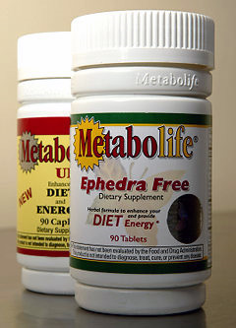
Metabolism = all the physical and chemical changes
Bodily needs = food, oxygen, water, heat
Homeostasis = tendency of the body to maintain a stable, balanced, internal environment. “Sameness”

Slide 7

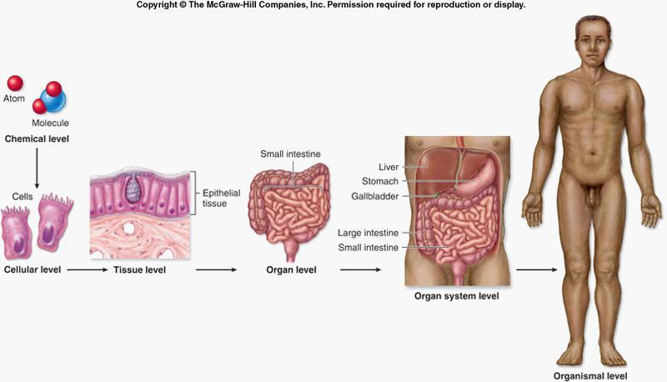

Slide 8
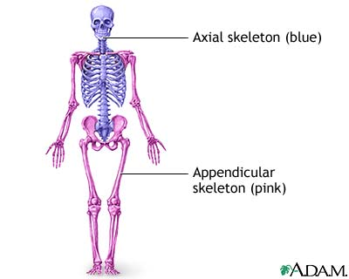
Axial Portion - head, neck, trunk
Appendicular Portion - arms & legs
1. Several body cavities
2. Layers of membranes within cavities
3. Variety of organs and organ systems within cavities (VISCERA = internal organs. "Visceral organs")

Slide 9

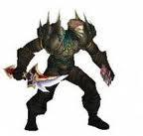
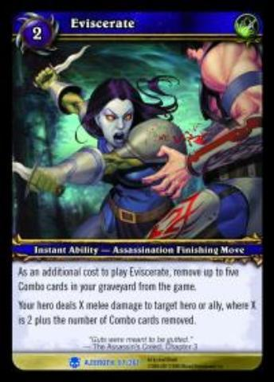

Popular in horror movies and games

Slide 10
Body Cavities
Dorsal = back side
Ventral = front side
Thoracic = chest (heart, trachea, lungs..)
Abdomen = stomach area (spleen, intestines)
Pelvic = lower abdomen (bladder, reproductive organs)
DIAPHRAGM: Separates the thoracic and pelvic region
SEROUS MEMBRANE - covers and surrounds organs
SERIOUS FLUID - lubricates organs

Slide 11
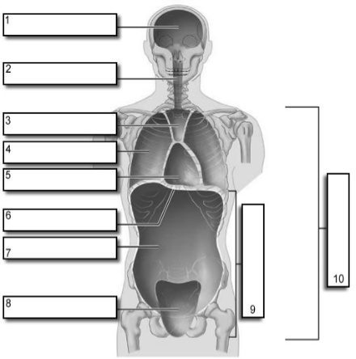
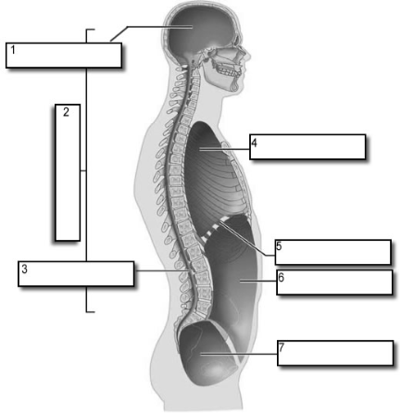
It's easier to visualize the body cavities on pictures - see Body Cavity Label | Label 2
Label the body cavities (use your book)

Slide 12

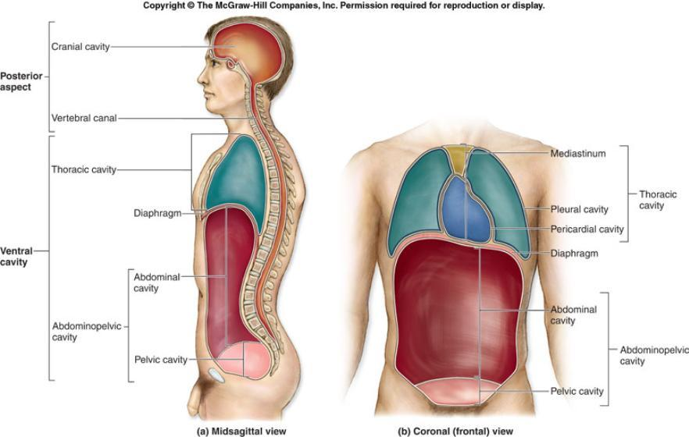

Slide 13
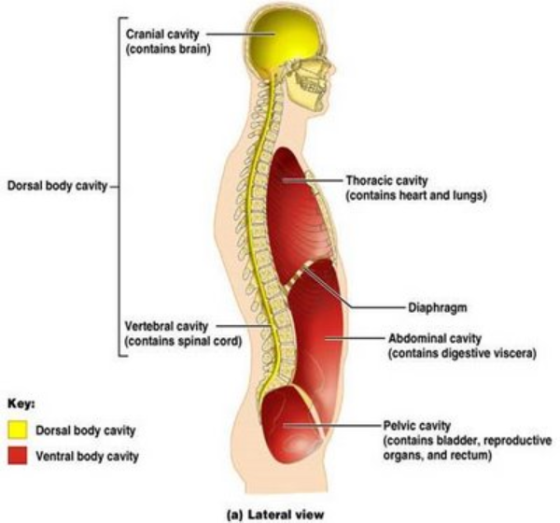

Slide 14

Serous Membrane - two layered, covers organs
  Outer layer = parietal
  Inner layer = visceral (lines the organs)
Serous fluid – lubricating fluid

Slide 15

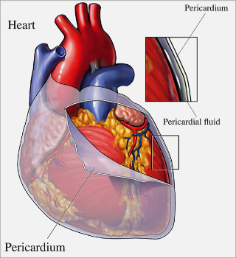
Pleura = lungs
Pericardium = heart
Peritoneum = organs (abdominopelvic region)

Slide 16
Visceral Pleura / Parietal Pleura
Visceral Pericardium / Parietal Pericardium
Visceral Peritoneum / Parietal Peritoneum

Slide 17
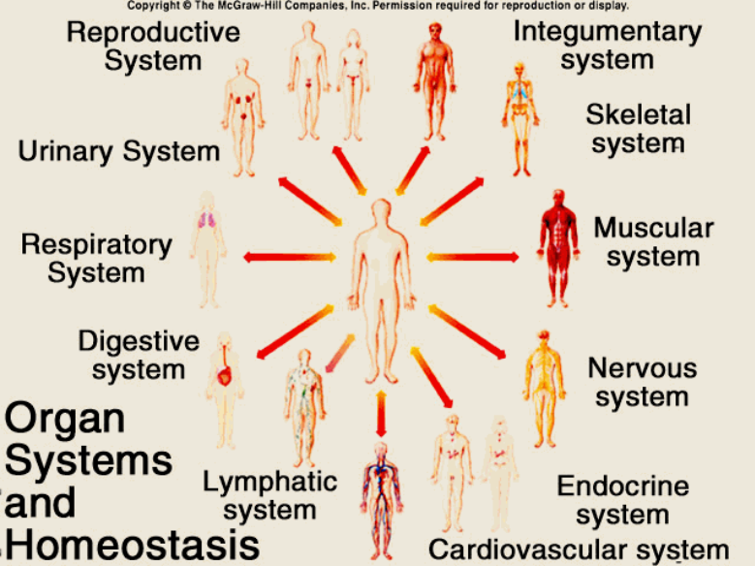
Homework: Organ Systems Concept Map

Slide 18
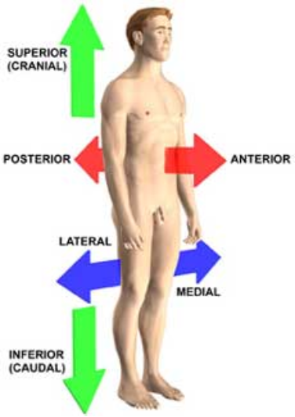
Anatomical TerminologyAnatomical Position = standing erect, face forward, arms at side, palms facing forward*Study and learn the following terms*
1. Superior
2. Inferior
3. Anterior
4. Posterior
5. Medial
6. Lateral
7. Proximal
8. Distal9. Superficial
10. Deep

Slide 19

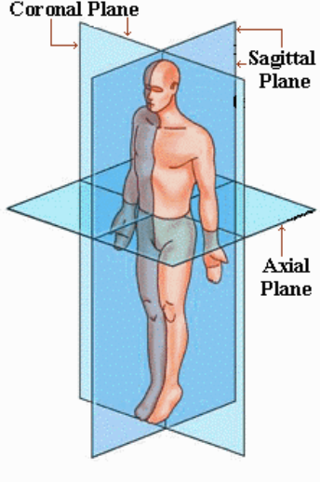
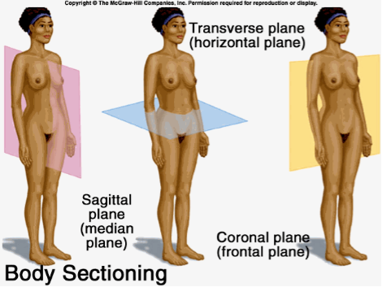

Slide 20

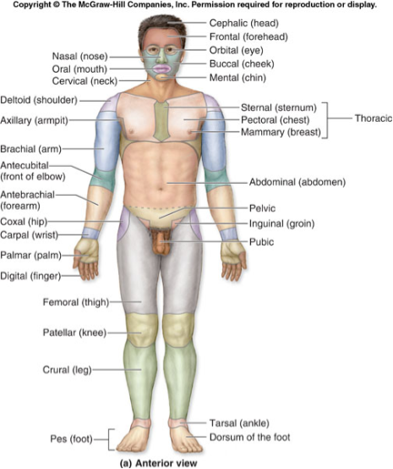
Homework: Fill out the chart on the body regions

Slide 21

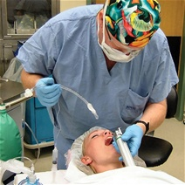
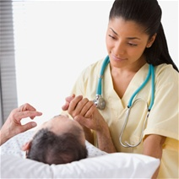
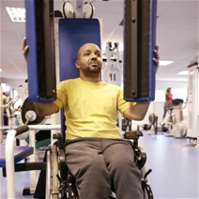
There are tons of careers, some of them only require a short term of training. What are your goals?
See Explore Health Careers
Homework: Medical and Applied Science

