Slide 1
Human Circulatory System
Major Vessels

Slide 2
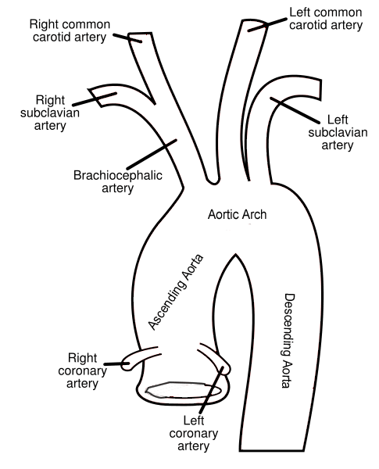

Slide 3
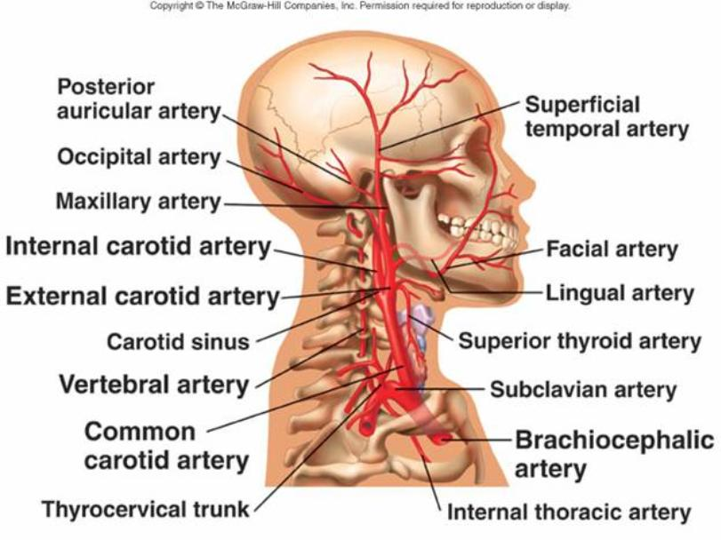

Slide 4
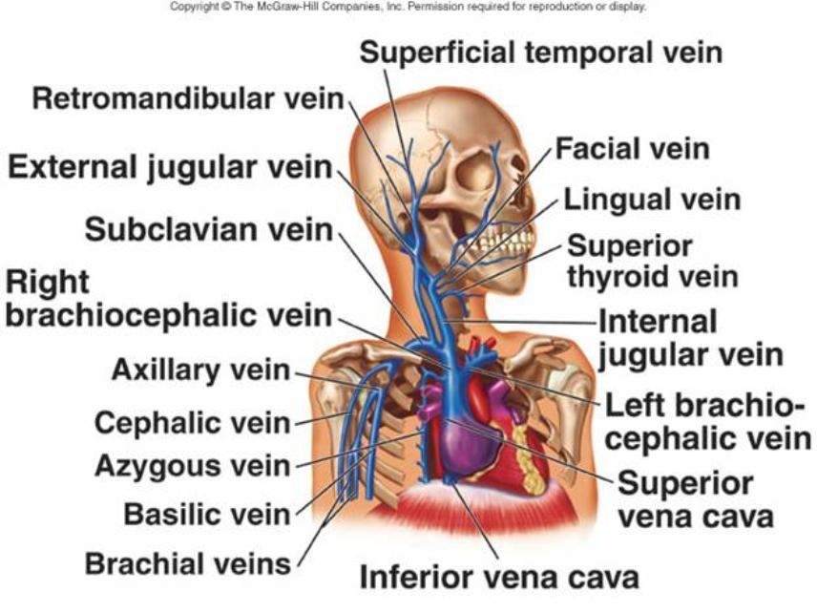

Slide 5
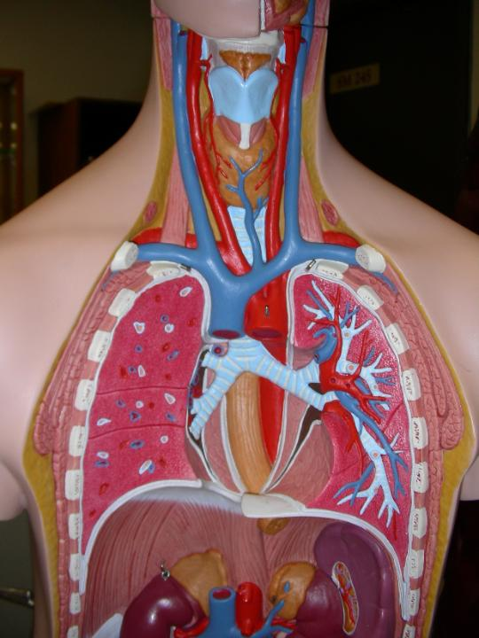
External jugular vein
Common carotid artery
Brachiocephalic vein
Subclavian artery and vein

Slide 6
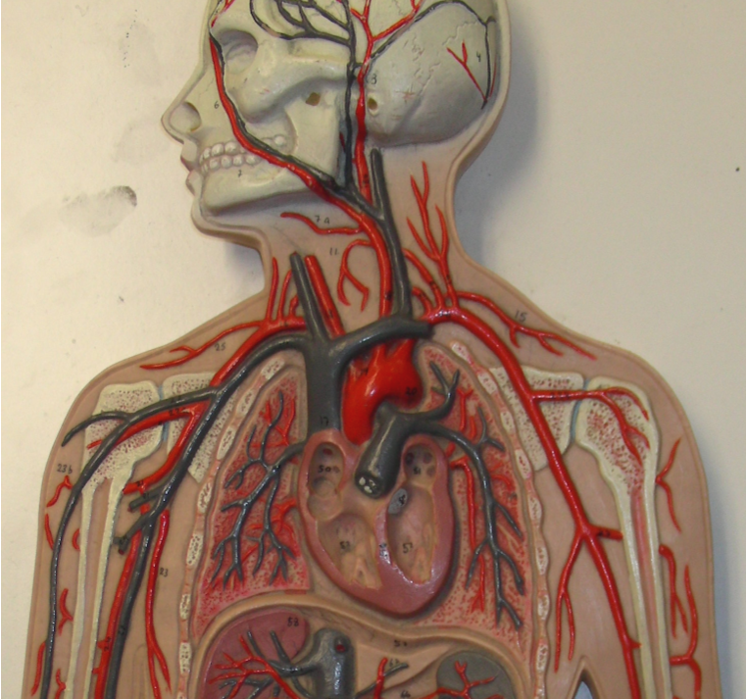
Internal jugular vein
Common carotid artery
External jugular vein
Subclavian artery
Brachiocephalic vein
Subclavian artery and vein
Axillary artery
Axillary artery and vein
Superior vena cavae
Aortic arch
Brachiocephalic artery
Inferior vena cavae
Brachial artery

Slide 7
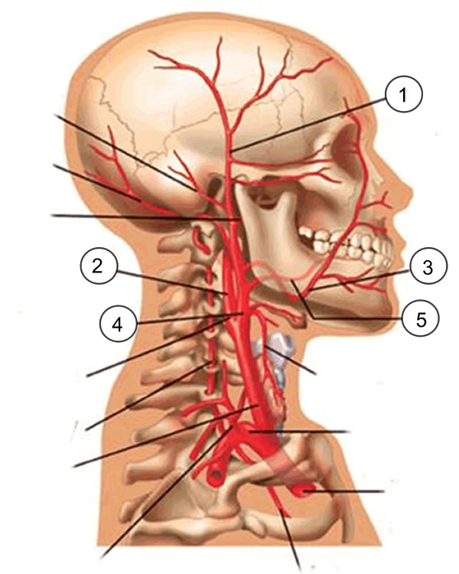
Quick Check!

Slide 8
1. Superficial Temporal
2. Internal Carotid
3. Facial
4. External Carotid
5. Lingual

Slide 9
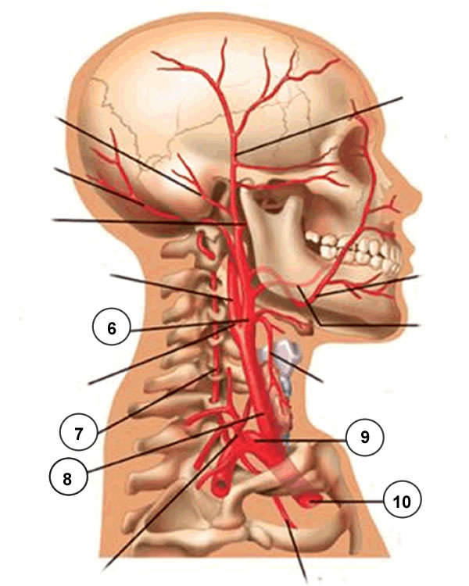

Slide 10
6. External Carotid
7. Vertebral
8. Common Carotid
9. Subclavian
10. Brachiocephalic

Slide 11
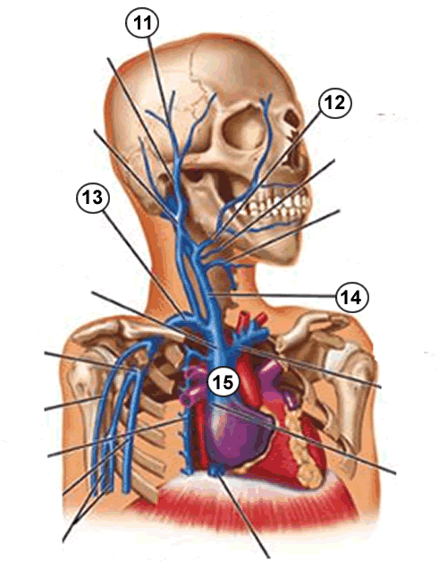

Slide 12
11. Superficial Temporal Vein
12. Facial Vein
13. Subclavian Vein
14. Internal Jugular Vein
15. Superior Vena Cava

Slide 13
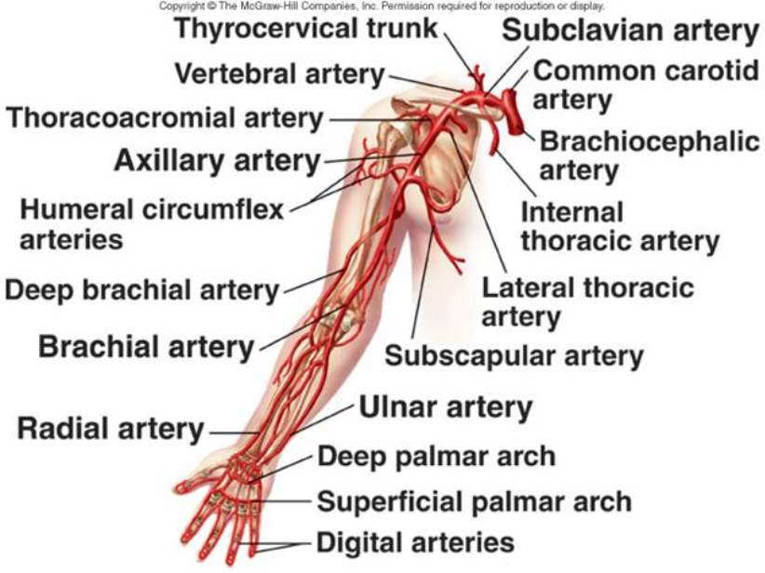

Slide 14
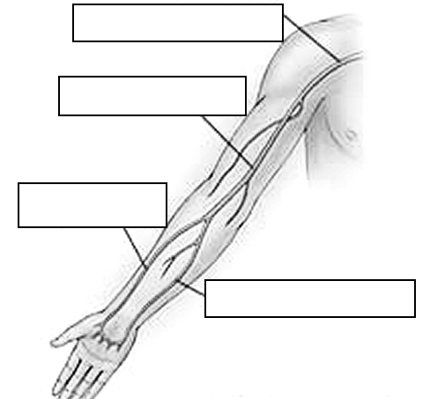
Axillary
Brachial
Radial
Ulnar

Slide 15
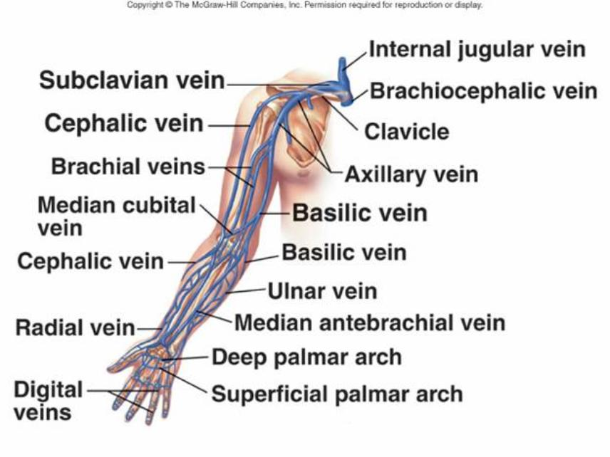

Slide 16
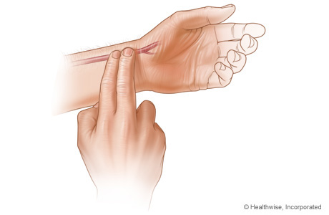
The radial artery is often used to take a person's pulse. If you lift your thumb slightly, the "pocket" created is a good spot to feel for a pulse. Try it!

Slide 17
NOW LET'S PRACTICE NAMING THE ARTERIES OF THE ARM

Slide 18
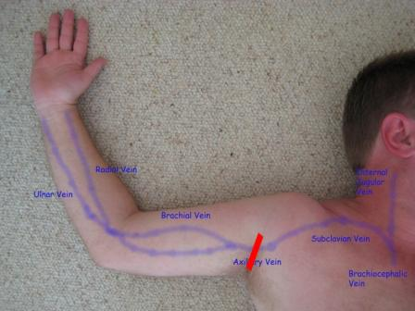

Slide 19
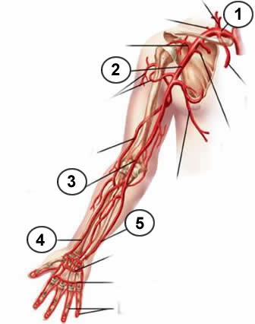

Slide 20
1. Subclavian
2. Axillary
3. Brachial
4. Radial
5. Ulnar

Slide 21
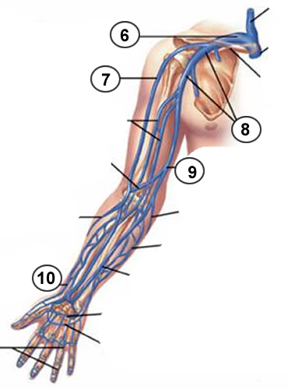

Slide 22
6. Subclavian
7. Cephalic
8. Axillary
9. Basilic
10. Radial

Slide 23
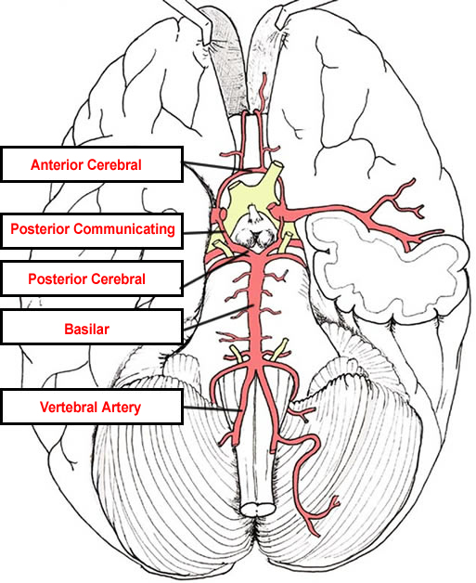
Anterior Cerebral
Communicating
Posterior Cerebral
Basilar
Vertebral

Slide 24
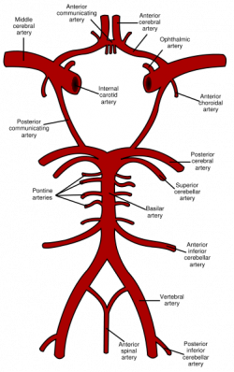

Slide 25
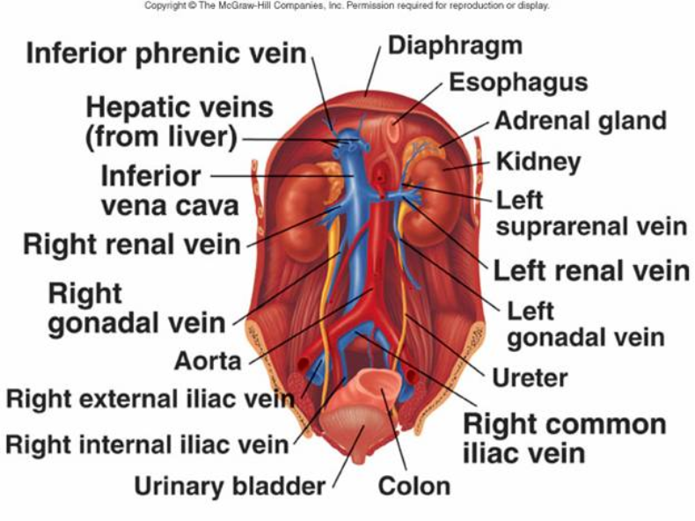

Slide 26
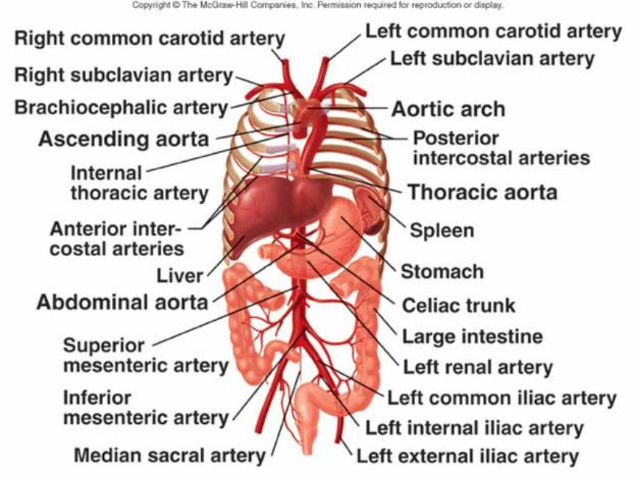

Slide 27
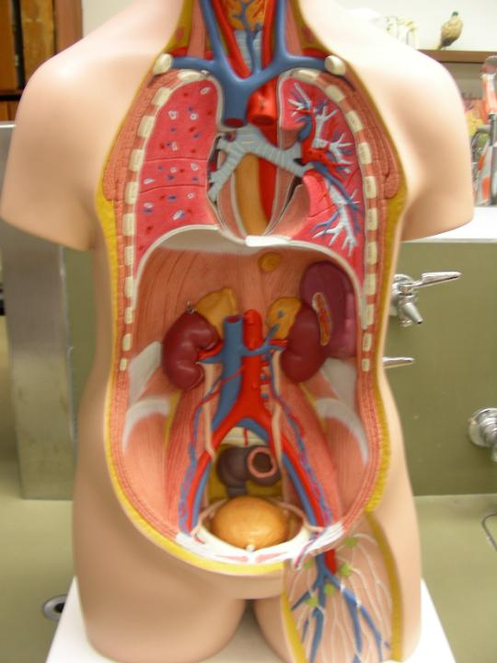
Inferior vena cavae
Abdominal aorta
Common iliac artery and vein
External iliac artery and vein
Femoral artery and vein

Slide 28
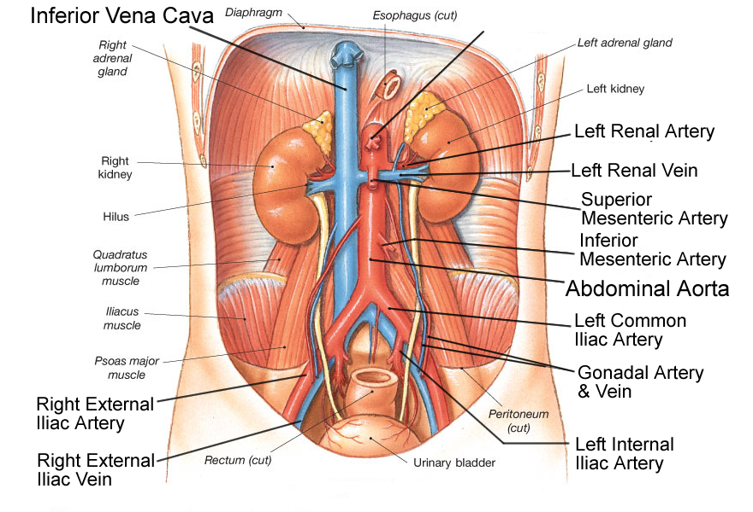

Slide 29
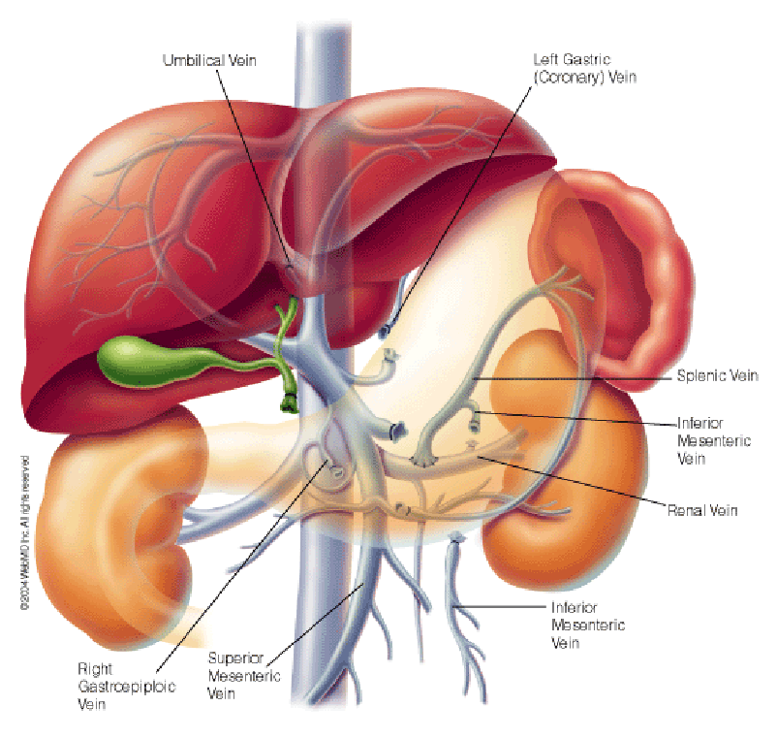
HEPATIC PORTAL VEIN

Slide 30
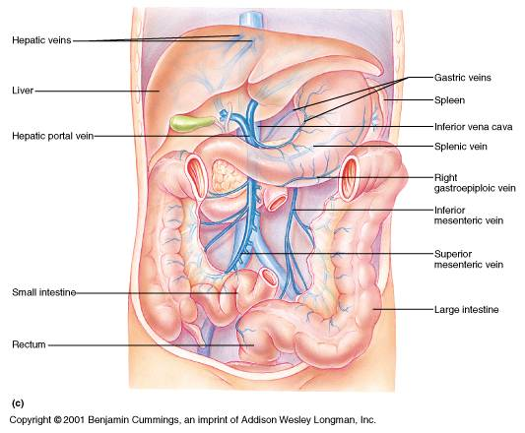

Slide 31
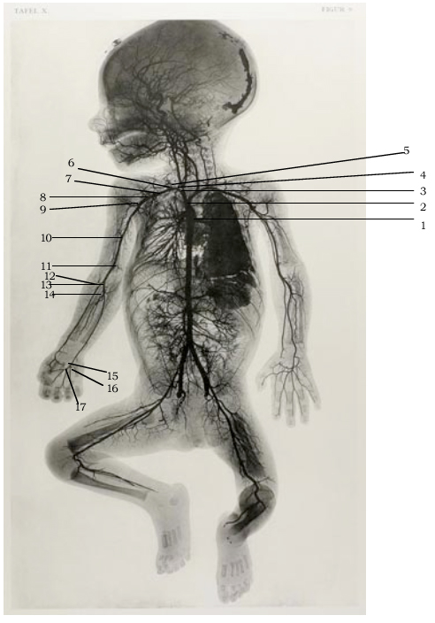
Let's Practice Naming the Arteries and Veins of the Chest and Abdomen

Slide 32
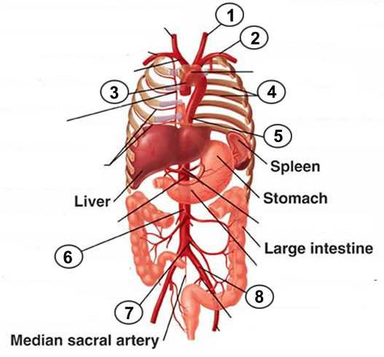

Slide 33
1. Left common carotid
2. Left Subclavian
3. Ascending Aorta
4. Intercostal
5. Thoracic Aorta
6. Superior Mesenteric
7. Inferior Mesenteric
8. Common Iliac

Slide 34
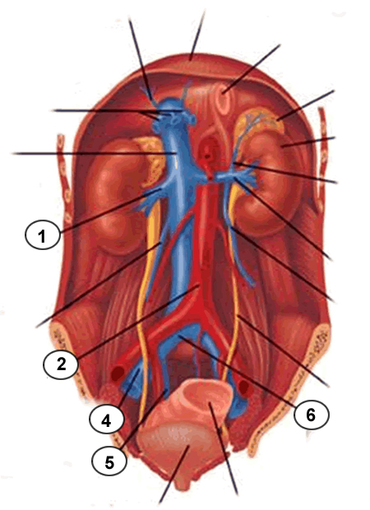
3

Slide 35
1. Renal Vein
2. Abdominal Aorta
3. - missing
4. External Iliac
5. Internal Iliac
6. Common Iliac

Slide 36
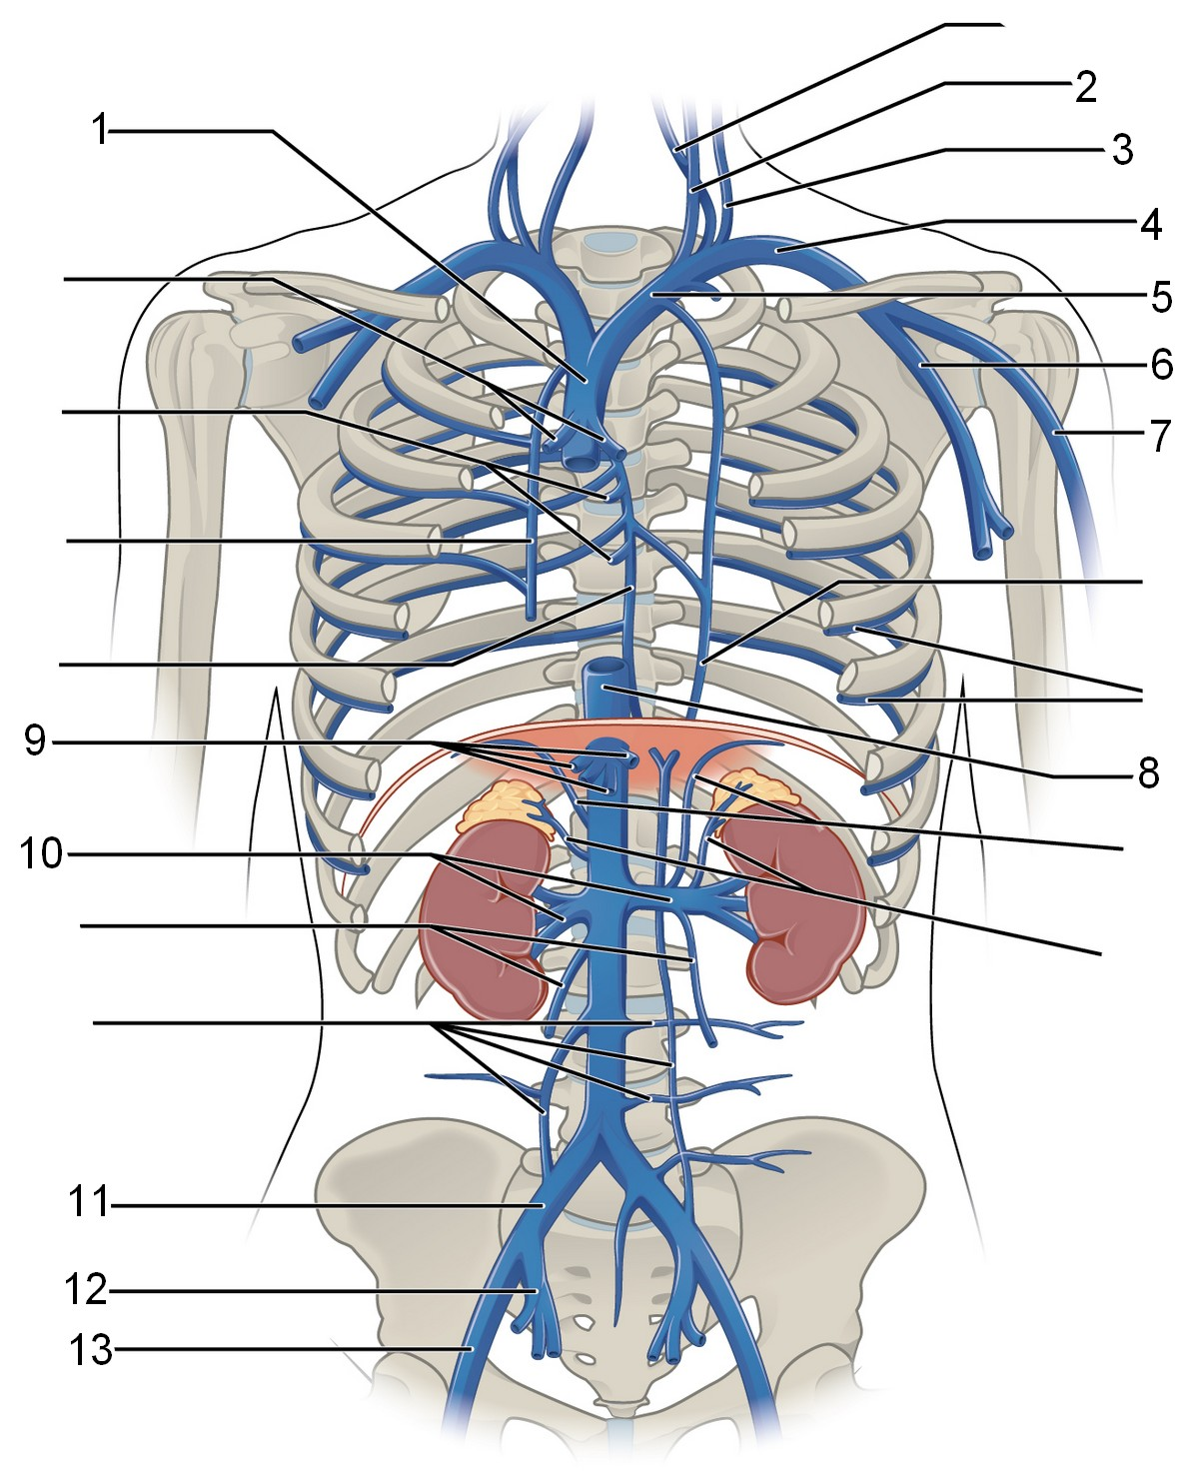
to liver

Slide 37
Vessels of the Legs

Slide 38
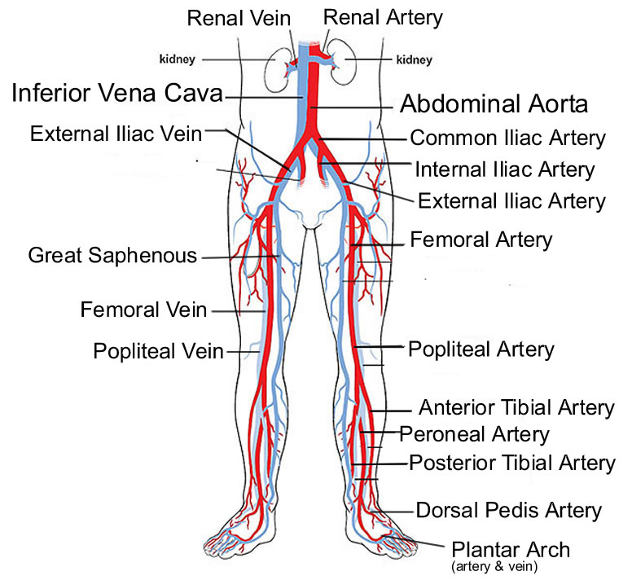
Small Saphenous

Slide 39
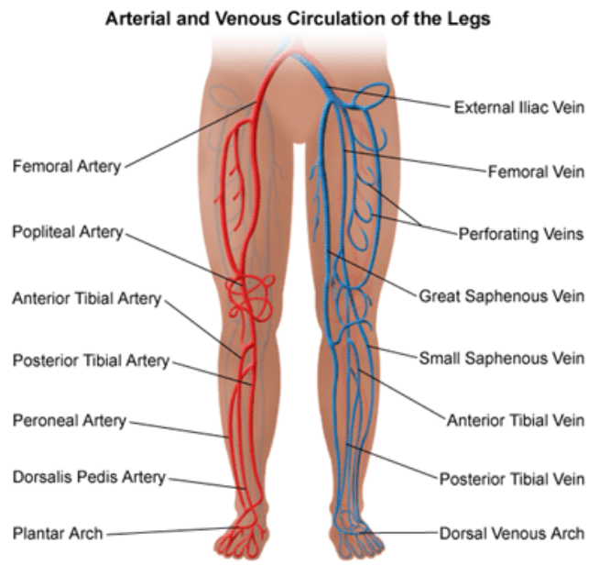

Slide 40
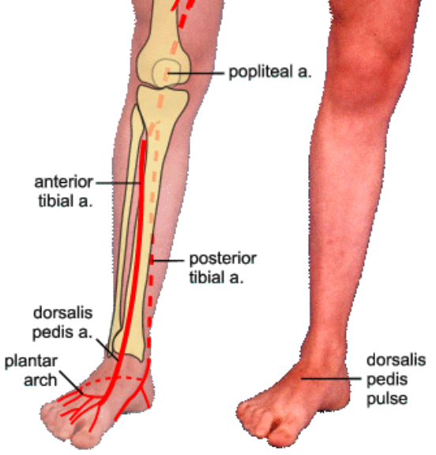

Slide 41
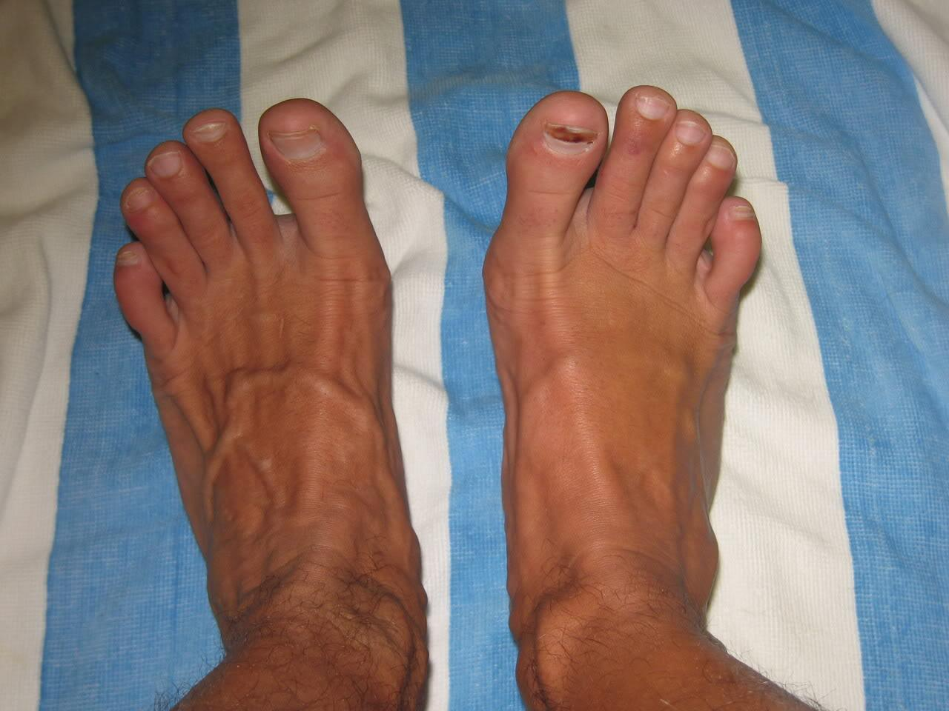

Slide 42
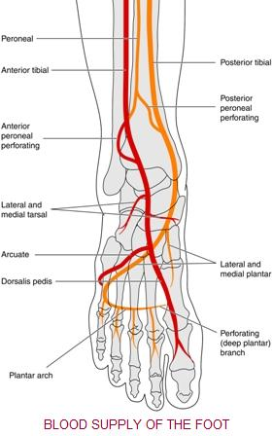

Slide 43
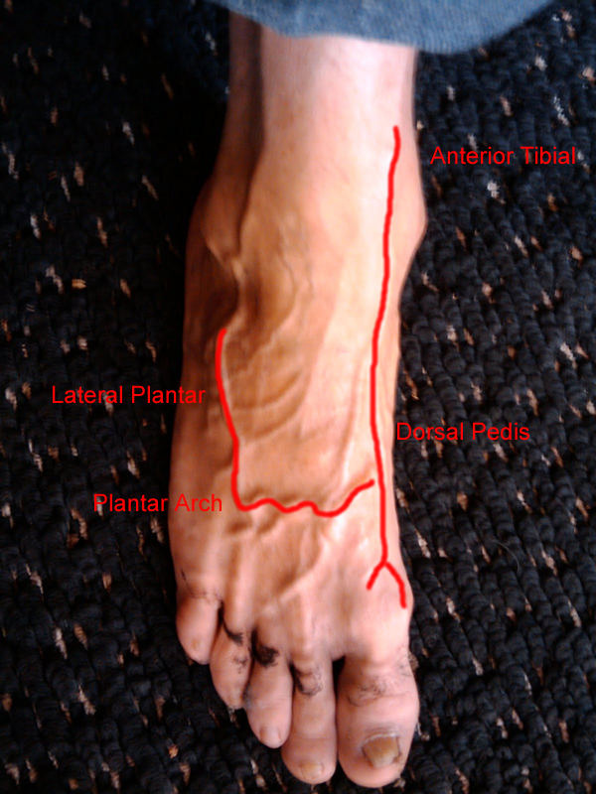
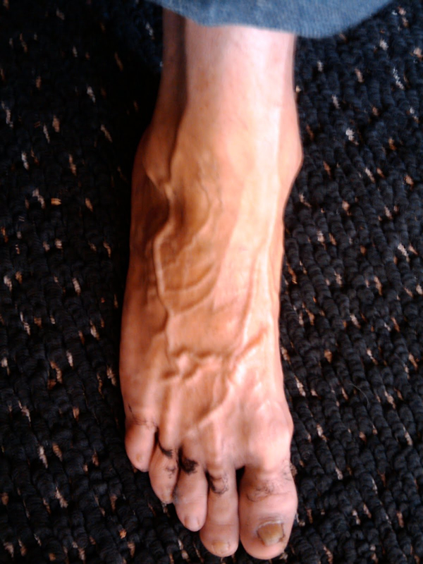

Slide 44
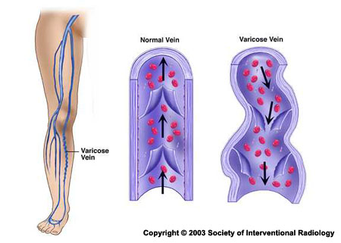
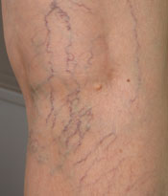

Slide 45
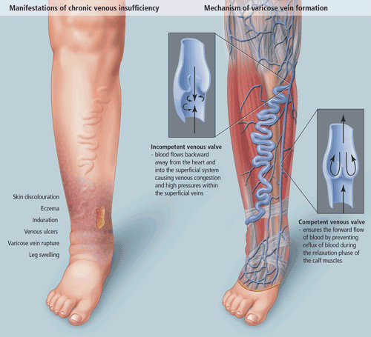

Slide 46
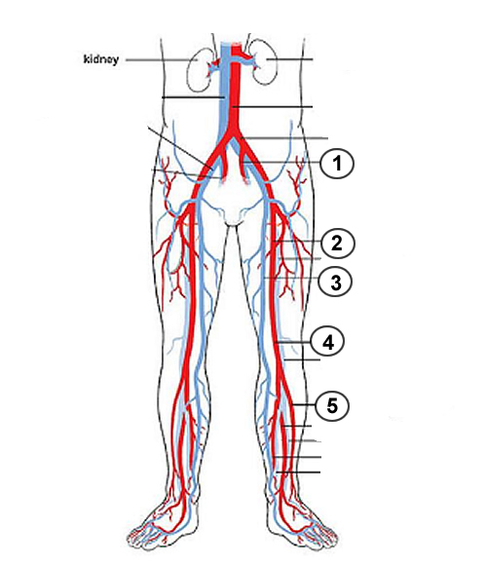

Slide 47
ENTIRE BODY IMAGES
FINAL TEST ON THE ARTERIES AND VEINS WILL BE A SLIDE TEST, SOME IMAGES MAY HAVE THE ENTIRE BODY, SOME WILL HAVE JUST PARTS

Slide 48
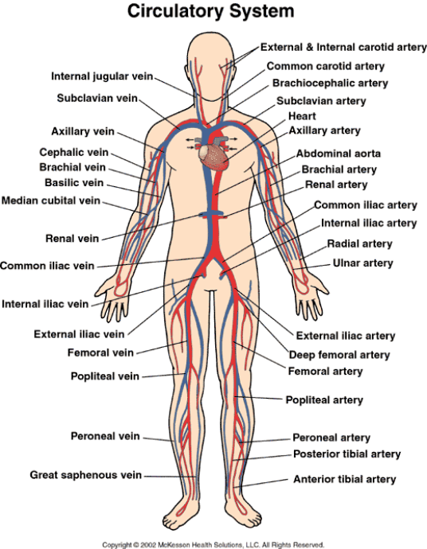

Slide 49
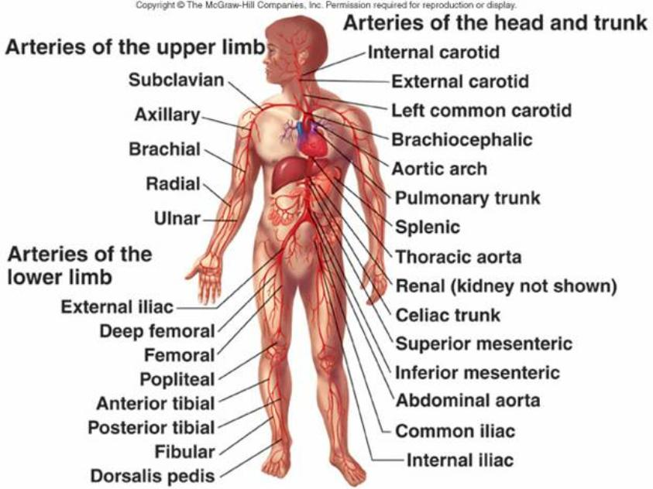

Slide 50
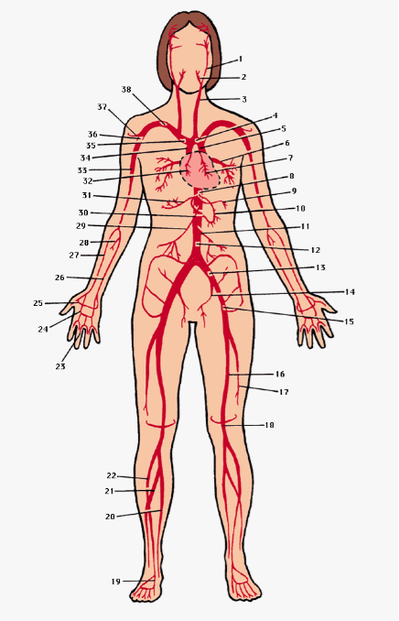
1 internal carotid artery, 2 external carotid artery, 3 common carotid artery, 4 arch of the aorta, 5 descending aorta, 6 pulmonary vein, 7 left coronary artery, 8 celiac artery, 9 splenic artery, 10 left gastric artery, 11 inferior mesenteric artery, 12 abdominal aorta, 13 common iliac artery, 14 internal iliac artery, 15 external iliac artery, 16 femoral artery, 17 deep femoral artery, 18 popliteal artery, 19 dorsalis pedis, 20 posterior tibial artery, 21 peroneal artery, 22 anterior tibial artery, 23 digital artery, 24 superficial palmar arch, 25 deep palmar arch, 26 ulnar artery, 27 radial artery, 28 common interosseous artery, 29 superior mesenteric artery, 30 right gastric artery, 31 hepatic artery, 32 right coronary artery, 33 brachial artery, 34 ascending aorta, 35 brachiocephalic artery, 36 axillary artery, 37 anterior humeral circumflex artery, 38 subclavian artery

