Slide 1
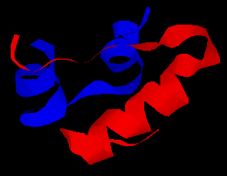
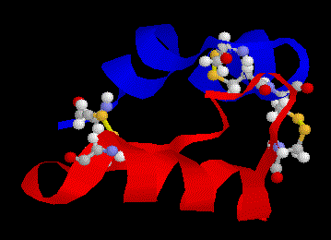
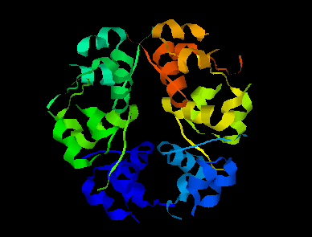
2.4 Proteins
Essential idea: Proteins have a very wide range of functions in living organisms.
One of the central ideas in Biology is that structure dictates function. Above you can see insulin in its secondary, tertiary and quaternary structures. Polypeptides vary hugely in the combination and number of amino acids that they are composed from. Even if we consider a single polypeptide it's properties, and hence it's function, would vary greatly depending on it's level of structure. Insulin can exist in all these forms, but the active form, which controls blood glucose levels, is a the tertiary structure.
http://www.biotopics.co.uk/as/insulinproteinstructure.html

Slide 2
Understandings, Applications and Skills
 | Statement | Guidance
2.4.U1 | Amino acids are linked together by condensation to form polypeptides.
2.4.U2 | There are 20 different amino acids in polypeptides synthesized on ribosomes. | Students should know that most organisms use the same 20 amino acids in the same genetic code although there are some exceptions. Specific examples could be used for illustration.
2.4.U3 | Amino acids can be linked together in any sequence giving a huge range of possible polypeptides.
2.4.U4 | The amino acid sequence of polypeptides is coded for by genes.
2.4.U5 | A protein may consist of a single polypeptide or more than one polypeptide linked together.
2.4.U6 | The amino acid sequence determines the three-dimensional conformation of a protein.
2.4.U7 | Living organisms synthesize many different proteins with a wide range of functions.
2.4.U8 | Every individual has a unique proteome.
2.4.A1 | Rubisco, insulin, immunoglobulins, rhodopsin, collagen and spider silk as examples of the range of protein functions. | The detailed structure of the six proteins selected to illustrate the functions of proteins is not needed.
2.4.A2 | Denaturation of proteins by heat or by deviation of pH from the optimum. | Egg white or albumin solutions can be used in denaturation experiments.
2.4.S1 | Drawing molecular diagrams to show the formation of a peptide bond.

Slide 3
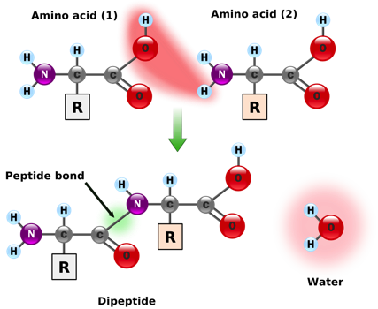
2.1.U5 Anabolism is the synthesis of complex molecules from simpler molecules including the formation of macromolecules from monomers by condensation reactions.
Example of anabolism by condensation
A ribosome condenses two amino acids into a dipeptide forming a peptide bond
The bonds formed are types of covalent bonds.
Bonding monomers together creates a polymer (mono = one, poly = many)
This is also key to understanding:
2.4.U1 Amino acids are linked together by condensation to form polypeptides.
2.4.S1 Drawing molecular diagrams to show the formation of a peptide bond.
http://commons.wikimedia.org/wiki/File:Peptidformationball.svg

Slide 4
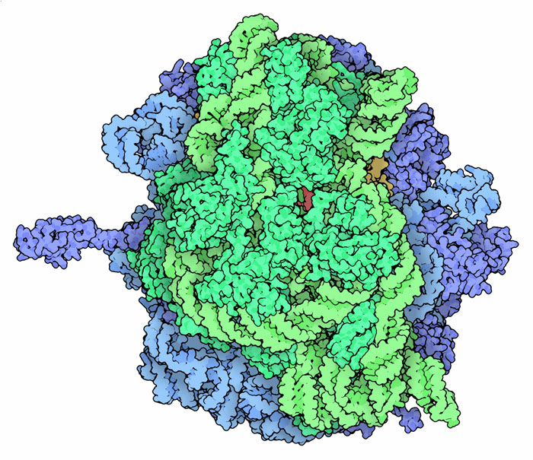
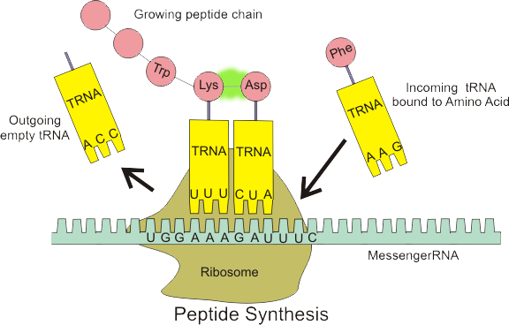
2.4.U2 There are 20 different amino acids in polypeptides synthesized on ribosomes.
Ribosomes are the molecules within cells that facilitate the formation of peptide bonds and hence where polypeptides are synthesized
peptide bond
https://en.wikipedia.org/wiki/File:Peptide_syn.png
http://www.rcsb.org/pdb/education_discussion/molecule_of_the_month/images/2wdk_2wdl_front.jpg

Slide 5
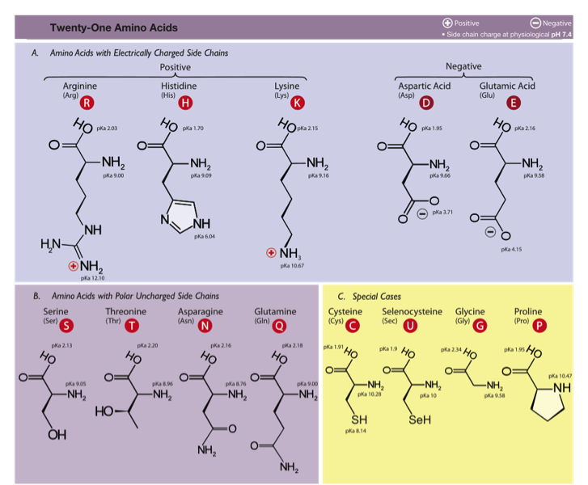
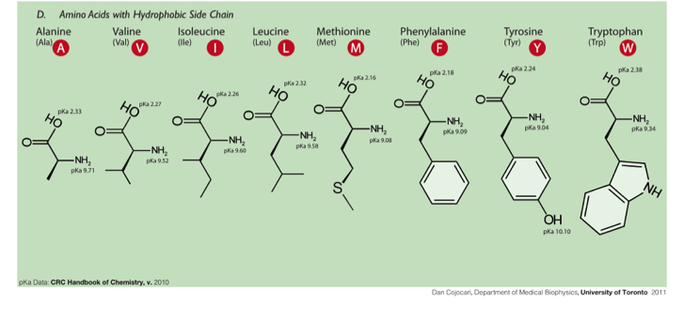
2.4.U2 There are 20 different amino acids in polypeptides synthesized on ribosomes.
n.b. there are 22 amino acids, but only 20 amino acids are encoded by the universal genetic code.
http://commons.wikimedia.org/wiki/File:Amino_Acids.svg

Slide 6
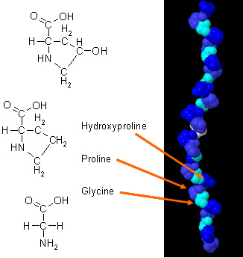
2.4.U2 There are 20 different amino acids in polypeptides synthesized on ribosomes.
Hydroxyproline is an example of an amino acid created not by the genetic code, but modification, after polypeptide formation, of proline (by the enzyme prolyl hydroxylase).
prolyl hydroxylase
This modification of proline increases the stability of the collagen triple helix.
Collagen is a a structural protein used to provide tensile strength in tendons, ligaments, skin and blood vessel walls.
http://chempolymerproject.wikispaces.com/file/view/collagen_%28alpha_chain%29.jpg/34235269/collagen_%28alpha_chain%29.jpg

Slide 7
2.4.U2 There are 20 different amino acids in polypeptides synthesized on ribosomes.
“OMG I HAVE TO LEARN THE NAMES OF ALL 20 !?!?”
“Relax, no you don’t, you just need an awareness of the concepts as outlined.”
http://commons.wikimedia.org/wiki/File:Amino_Acids.svg

Slide 8
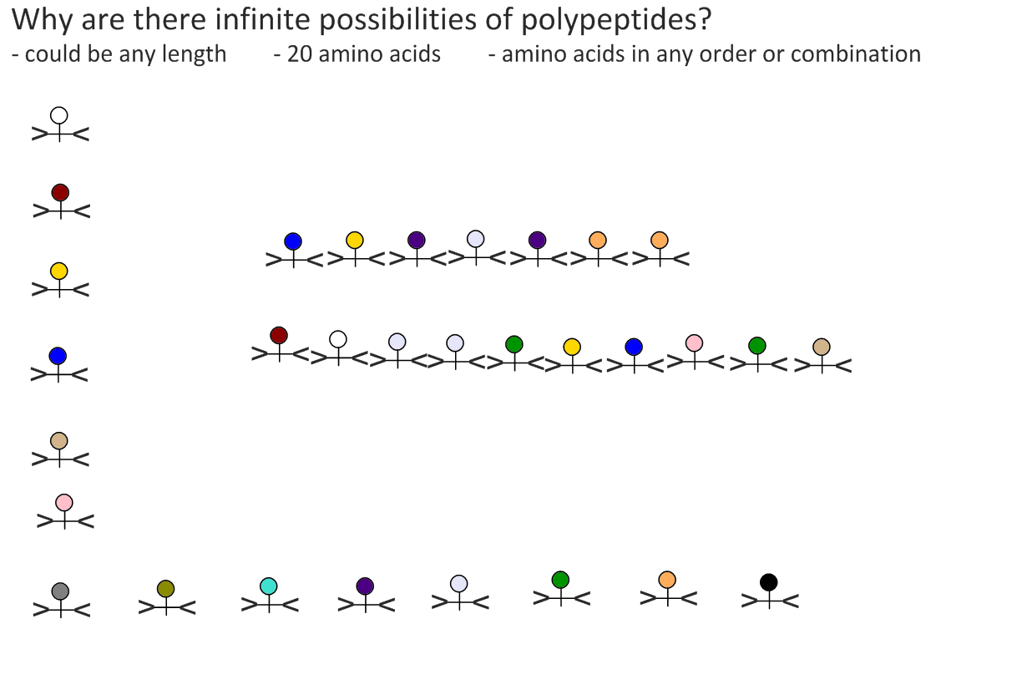
2.4.U3 Amino acids can be linked together in any sequence giving a huge range of possible polypeptides.

Slide 9
2.4.U3 Amino acids can be linked together in any sequence giving a huge range of possible polypeptides.
If a polypeptide contains just 7 amino acids there can be 20⁷ = 1,280,000,000 possible polypeptides generated.
Given that polypeptides can contain up to 30,000 amino acids (e.g. Titin) the different possible combinations of polypeptides are effectively infinite.

Slide 10
2.4.U4 The amino acid sequence of polypeptides is coded for by genes.
peptide bond
Ribosomes are the site of polypeptide synthesis, but ribosomes need a template – the messenger RNA, which, in turn, is translated by transfer RNA molecules which, in turn, carry specific amino acids.
Q – Where does the messenger RNA come from?
https://en.wikipedia.org/wiki/File:Peptide_syn.png

Slide 11
2.4.U4 The amino acid sequence of polypeptides is coded for by genes.

Slide 12
2.4.U6 The amino acid sequence determines the three-dimensional conformation of a protein.

Slide 13
2.4.U6 The amino acid sequence determines the three-dimensional conformation of a protein.
There are four levels of protein structure. Which level a protein conforms to is determined by it’s amino acid sequence.
(Polypeptide)
The order / sequence of the amino acids of which the protein is composed
Formed by covalent peptide bonds between adjacent amino acids
Controls all subsequent levels of structure
The chains of amino acids fold or turn upon themselves
Held together by hydrogen bonds between (non-adjacent) amine (N-H) and carboxylic (C-O) groups
H-bonds provide a level of structural stability
Fibrous proteins
The polypeptide folds and coils to form a complex 3D shape
Caused by interactions between R groups (H-bonds, disulphide bridges, ionic bonds and hydrophilic / hydrophobic interactions)
Tertiary structure may be important for the function (e.g. specificity of active site in enzymes)
Globular proteins
The interaction between multiple polypeptides or prosthetic groups
A prosthetic group is an inorganic compound involved in a protein (e.g. the heme group in haemoglobin)
Fibrous and Globular proteins
n.b. although you don’t need to be able to outline the different levels of structure knowing of them helps to understand the difference between globular and fibrous proteins.

