Slide 1
2.4.U6 The amino acid sequence determines the three-dimensional conformation of a protein.
Proteins are commonly described as either being fibrous or globular in nature. Fibrous proteins have structural roles whereas globular proteins are functional (active in a cell’s metabolism).
In globular proteins the hydrophobic R groups are folded into the core of the molecule, away from the surrounding water molecules, this makes them soluble. In fibrous proteins the hydrophobic R groups are exposed and therefore the molecule is insoluble.

Slide 2
2.4.U7 Living organisms synthesize many different proteins with a wide range of functions.
Nothing can compare with the versatility of proteins. Their functionality and usage in organisms is unrivalled.
Function | Description | Key examples
Catalysis | There are thousands of different enzymes to catalyse specific chemical reactions within the cell or outside it. | Rubisco
Muscle contraction | Actin and myosin together cause the muscle contractions used in locomotion and transport around the body.
Cytoskeletons | Tubulin is the subunit of microtubules that give animals cells their shape and pull on chromosomes during mitosis.
Tensile strengthening | Fibrous proteins give tensile strength needed in skin, tendons, ligaments and blood vessel walls. | collagen
Blood clotting | Plasma proteins act as clotting factors that cause blood to turn from a liquid to a gel in wounds.
Transport of nutrients and gases | Proteins in blood help transport oxygen, carbon dioxide, iron and lipids.
Key examples are outlined in more detail.
Although a key example spider silk is not mentioned above as the table refers to uses within the organism

Slide 3
2.4.U7 Living organisms synthesize many different proteins with a wide range of functions.
Function | Description | Key examples
Cell adhesion | Membrane proteins cause adjacent animal cells to stick to each other within tissues.
Membrane transport | Membrane proteins are used for facilitated diffusion and active transport, and also for electron transport during cell respiration and photosynthesis.
Hormones | Some such as insulin, FSH and LH are proteins, but hormones are chemically very diverse. | Insulin
Receptors | Binding sites in membranes and cytoplasm for hormones, neurotransmitters, tastes and smells, and also receptors for light in the eye and in plants. | rhodopsin
Packing of DNA | Histones are associated with DNA in eukaryotes and help chromosomes to condense during mitosis.
Immunity | This is the most diverse group of proteins, as cells can make huge numbers of different antibodies. | immunoglobulins
Biotechnologically has allowed us to use proteins in industry examples are:
enzymes for removing stains in clothing detergent
monoclonal antibodies for pregnancy tests
insulin for treating diabetics
Disease treatments
Genetically modified organisms are often used as to produce proteins. This however is still a technically difficult and expensive process.

Slide 4
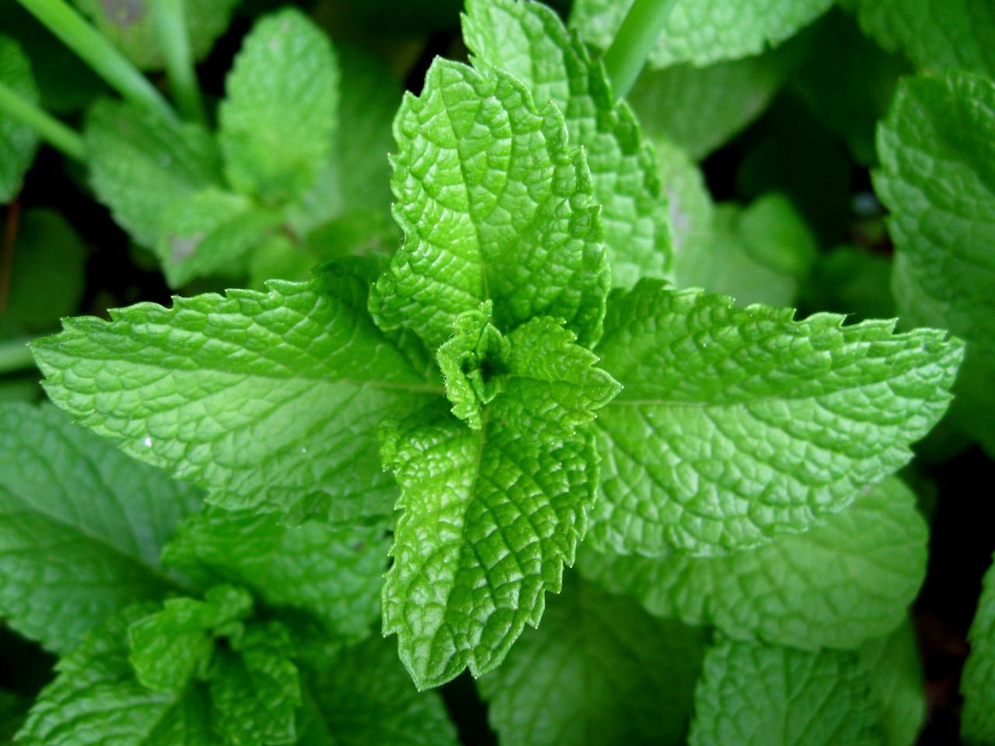
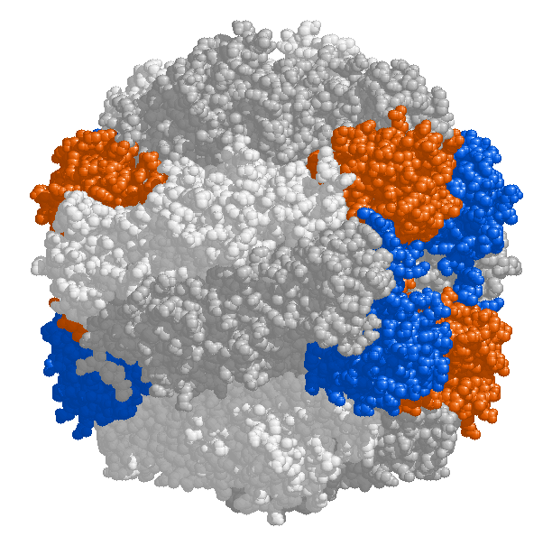
2.4.A1 Rubisco, insulin, immunoglobulins, rhodopsin, collagen and spider silk as examples of the range of protein functions.
Rubisco
Full name ribulose bisphosphate carboxylase
Enzyme - catalyses the reaction that fixes carbon dioxide from the atmosphere
Provides the source of carbon from which all carbon compounds, required by living organisms, are produced.
Found in high concentrations in leaves and algal cells
http://upload.wikimedia.org/wikipedia/commons/b/b0/Mint-leaves-2007.jpg
http://upload.wikimedia.org/wikipedia/commons/thumb/7/74/Rubisco.png/220px-Rubisco.png

Slide 5
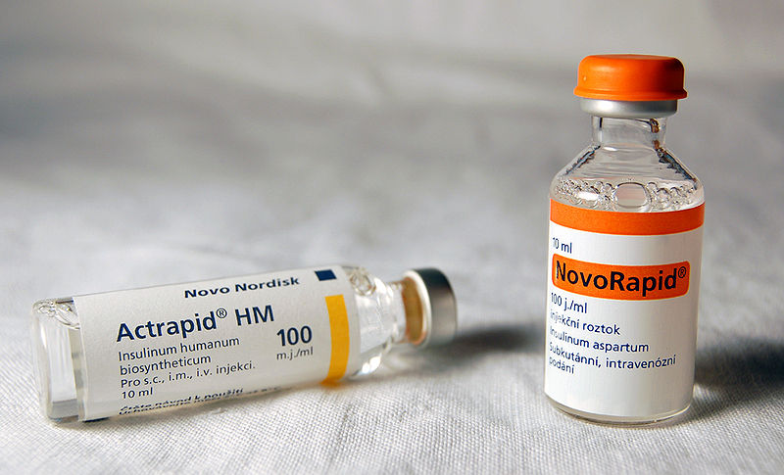
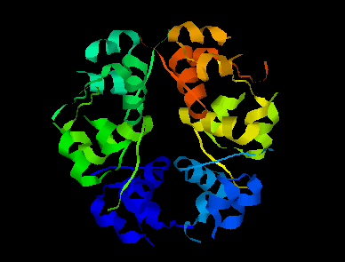
2.4.A1 Rubisco, insulin, immunoglobulins, rhodopsin, collagen and spider silk as examples of the range of protein functions.
Insulin
A hormone – signals many cells (e.g. liver cells) to absorb glucose and help reduce the glucose concentration of the blood.
Affected cells have receptor (proteins) on their surface to which insulin can (reversibly) bind to.
Secreted by β cells in the pancreas and transported by the blood.
The pancreas of type I diabetics don’t produce sufficient insulin therefore they must periodically inject synthetically produced insulin to correct their blood sugar concentration.
https://en.wikipedia.org/wiki/File:Inzul%C3%ADn.jpg
http://www.biotopics.co.uk/as/insulinproteinstructure.html

Slide 6
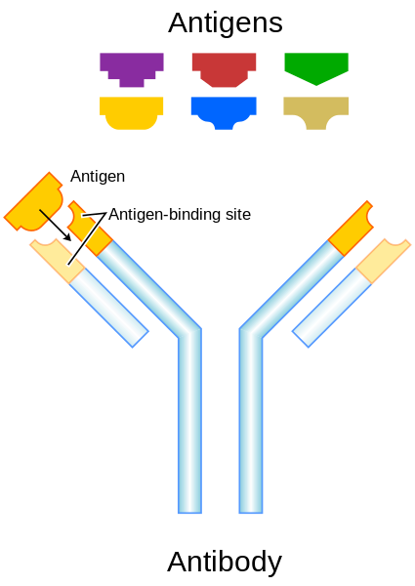
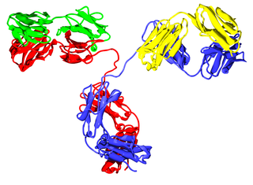
2.4.A1 Rubisco, insulin, immunoglobulins, rhodopsin, collagen and spider silk as examples of the range of protein functions.
immunoglobulins
Also known as antibodies.
Two antigen (a molecule on the pathogen which provokes an immune response) binding sites - one on each ‘arm’
Binding sites vary greatly between immunoglobulins (hypervariable) to enable them to respond a huge range of pathogens.
Other parts of the immunoglobulin molecule cause a response, e.g. acting as a marker to phagocytes (which engulf the pathogen)
https://upload.wikimedia.org/wikipedia/commons/thumb/a/a9/Antibody_IgG2.png/320px-Antibody_IgG2.png

Slide 7
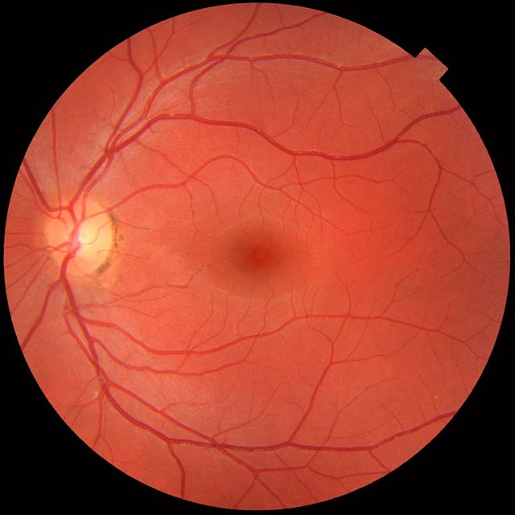
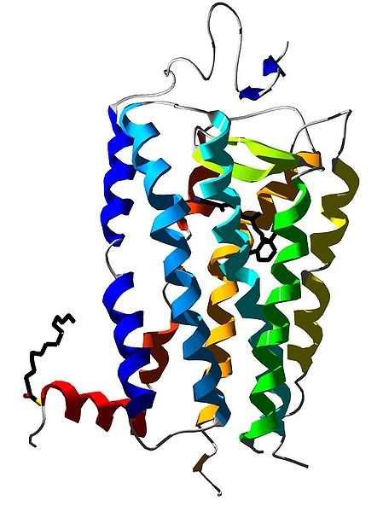
2.4.A1 Rubisco, insulin, immunoglobulins, rhodopsin, collagen and spider silk as examples of the range of protein functions.
rhodopsin
A pigment that absorbs light
Membrane protein of rod cells of the retina (light sensitive region at the back of the eye)
Rhodopsin consists the opsin polypeptide surrounding a retinal prosthetic group
retinal molecule absorbs a single photon of light -> changes shape -> change to the opsin -> the rod cell sends a nerve impulse to the brain
Even very low light intensities can be detected.
http://commons.wikimedia.org/wiki/File:Rhodopsin.jpg
https://en.wikipedia.org/wiki/Retina#mediaviewer/File:Fundus_photograph_of_normal_left_eye.jpg

Slide 8
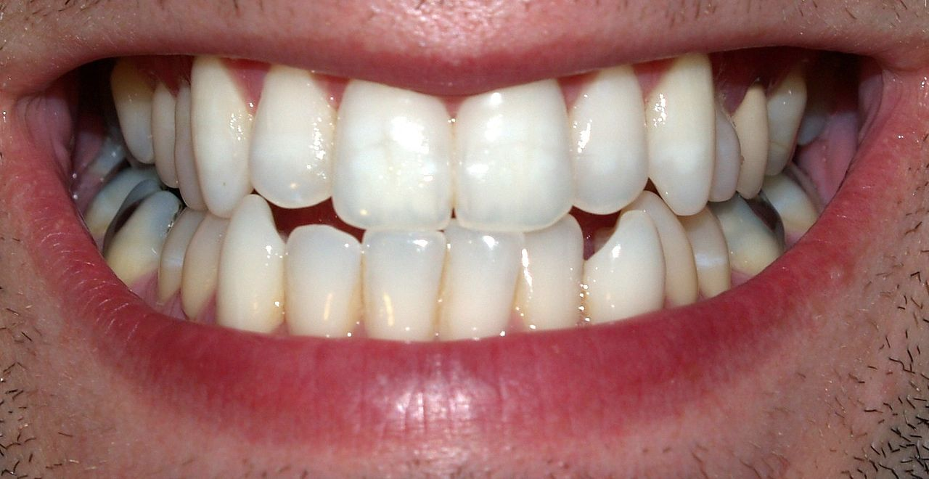
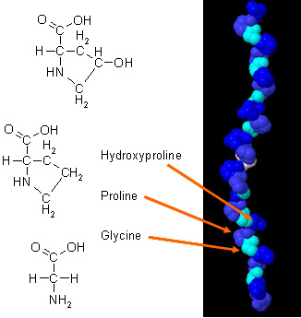
2.4.A1 Rubisco, insulin, immunoglobulins, rhodopsin, collagen and spider silk as examples of the range of protein functions.
collagen
A number of different forms
All are rope-like proteins made of three polypeptides wound together.
About a quarter of all protein in the human body is collagen
Forms a mesh of fibres in skin and in blood vessel walls that resists tearing.
Gives strength to tendons, ligaments, skin and blood vessel walls.
Forms part of teeth and bones, helps to prevent cracks and fractures to bones and teeth
https://en.wikipedia.org/wiki/Tooth_(human)#mediaviewer/File:Teeth_by_David_Shankbone.jpg
http://chempolymerproject.wikispaces.com/file/view/collagen_%28alpha_chain%29.jpg/34235269/collagen_%28alpha_chain%29.jpg

Slide 9
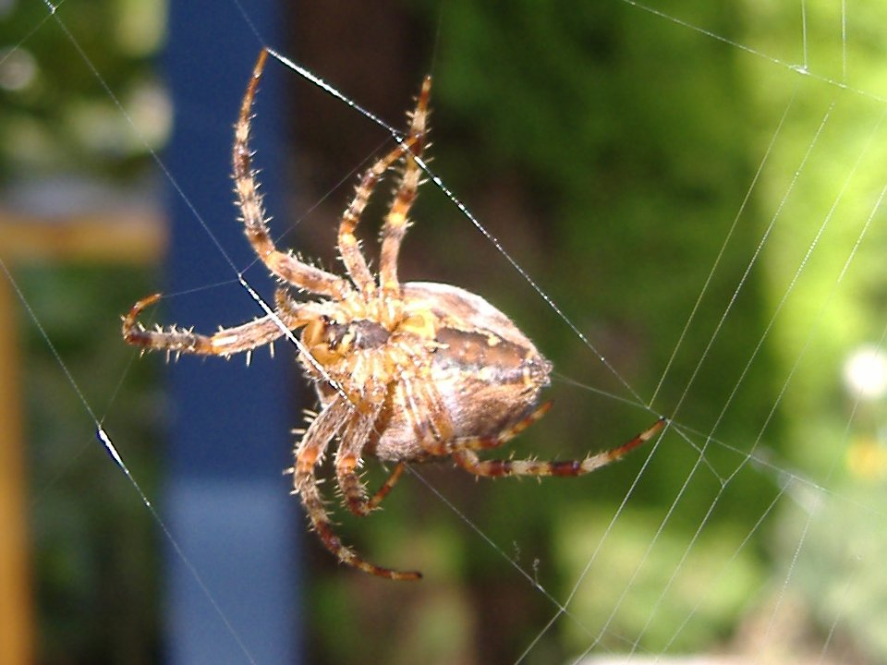
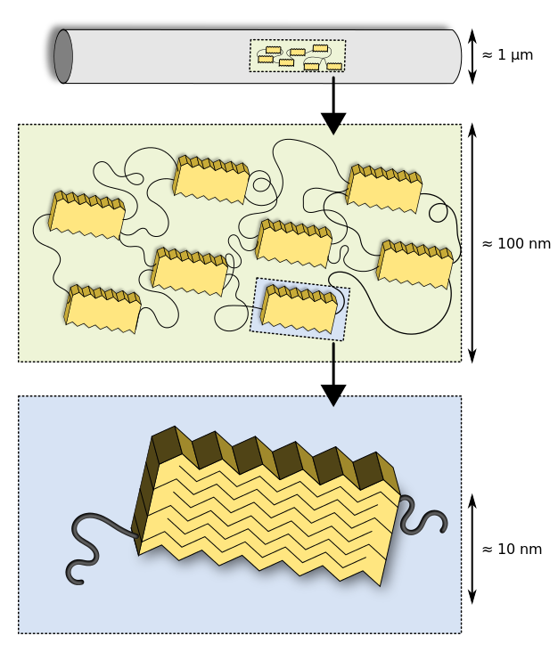
2.4.A1 Rubisco, insulin, immunoglobulins, rhodopsin, collagen and spider silk as examples of the range of protein functions.
spider silk
Different types of silk with different functions
Dragline silk is stronger than steel and tougher than Kevlar
When first made it contains regions where the polypeptide forms parallel arrays (bottom)
Some regions seem like a disordered tangle (middle)
When the stretched the polypeptide gradually extends, making the silk extensible and very resistant to breaking.
https://en.wikipedia.org/wiki/Spider_silk#mediaviewer/File:Araneus_diadematus_underside_1.jpg
https://en.wikipedia.org/wiki/Spider_silk#mediaviewer/File:Structure_of_spider_silk_thread_Modified.svg

Slide 10
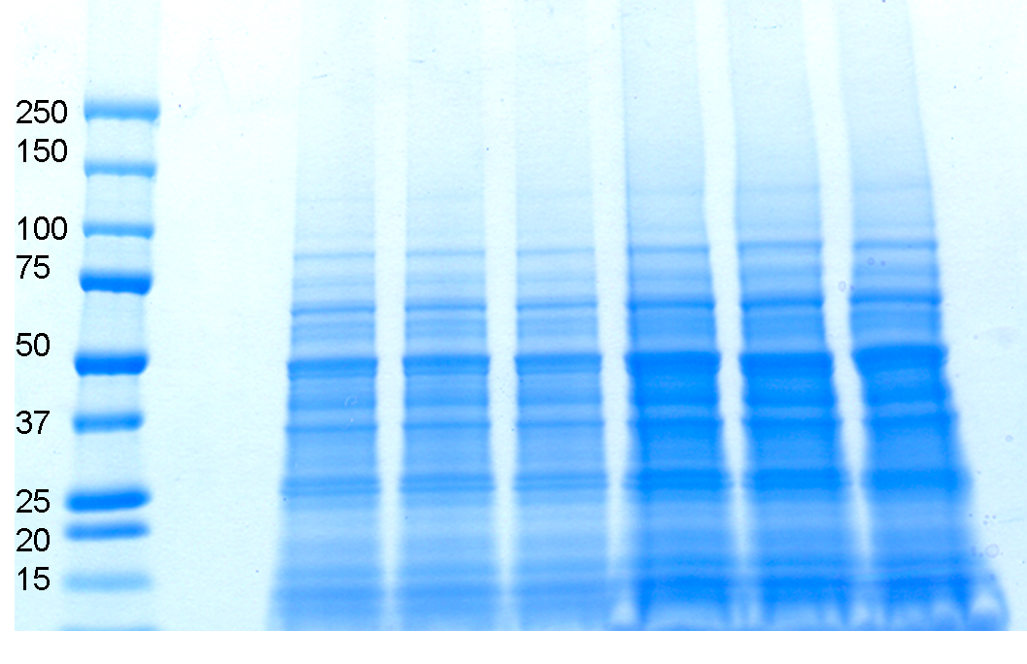
2.4.U8 Every individual has a unique proteome.
Genome: all of the genes of a cell, a tissue or an organism
The genome determines what proteins an organism can possibly produce. A genome is unique to most individuals (identical twins and clones share a genome)
Environmental factors
The environment influences what proteins an organism needs to produce and in what quantity. Example factors would be nutrition, temperature, activity levels and anything else that affects a cell’s activities.
Proteome: all of the proteins produced by a cell, a tissue or an organism.
Being a function of both the genome and the environment to which the organism is exposed the proteome is both variable (over time) and unique to every individual (including identical twins and clones).
It reveals what is happening in an organism at a particular time
Q – Genome or proteome, which is larger? Explain the reasons for your answer.
To analyze a proteome mixtures of proteins are extracted from a sample and are then separated by gel electrophoresis. The background shows a stained example of gel electrophoresis.
http://proteomics.arizona.edu/sites/proteomics.arizona.edu/files/1D_Gel_CD_4.png

Slide 11
2.4.U8 Every individual has a unique proteome.
Q – Genome or proteome, which is larger? Explain the reasons for your answer.
A – Proteome:
Not all genes produce polypeptides
Multiple polypeptides and prosthetic groups can interact
Amino acids can be modified (e.g. Collagen)
A polypeptide can fold into different levels of structure (e.g. insulin)
To analyze a proteome mixtures of proteins are extracted from a sample and are then separated by gel electrophoresis. The background shows a stained example of gel electrophoresis.
http://proteomics.arizona.edu/sites/proteomics.arizona.edu/files/1D_Gel_CD_4.png

Slide 12
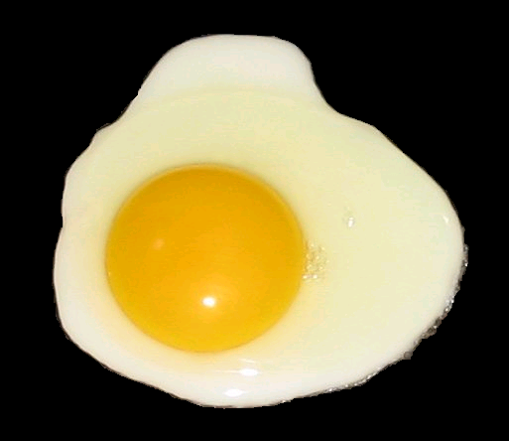
2.4.A2 Denaturation of proteins by heat or by deviation of pH from the optimum.
The three-dimensional conformation of proteins is stabilized by bonds or interactions between R groups of amino acids within the molecule. Most of these bonds and interactions are relatively weak and they can be disrupted or broken. This results in a change to the conformation of the protein, which is called denaturation.
A denatured protein does not normally return to its former structure – the denaturation is permanent. Soluble proteins often become insoluble and form a precipitate.
Heat can cause denaturation: vibrations within the molecule breaks intermolecular bonds or interactions.
Extremes of pH can cause denaturation: charges on R groups are changed, breaking ionic bonds within the protein or causing new ionic bonds to form.
http://upload.wikimedia.org/wikipedia/commons/2/22/Fried_egg%2C_sunny_side_up_%28black_background%29.PNG

Slide 13
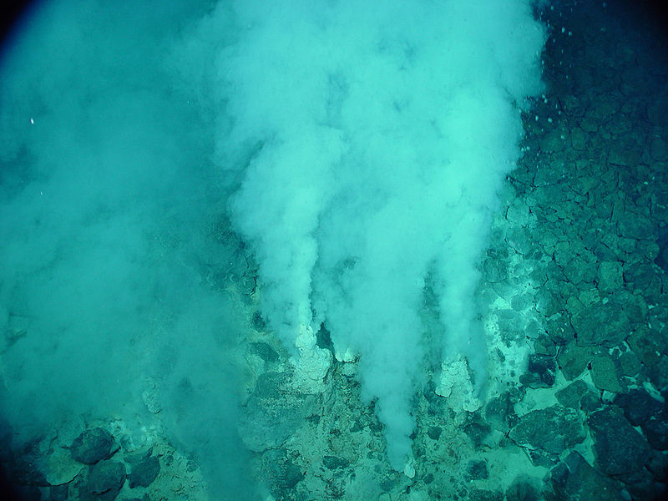
2.4.A2 Denaturation of proteins by heat or by deviation of pH from the optimum.
The background image shows white smokers, a particular kind of hydrothermal vent which produces very hot carbon dioxide gas. These vents can be found deep in oceans and produce temperatures in excess of 100 °C, but life can still be found around them.
Thermophiles are organisms (often archea or eubacteria) that live in relatively hot conditions (45 to122 °C). In order that they can survive their proteins are stable at the higher than normal temperatures they experience.
https://en.wikipedia.org/wiki/File:Champagne_vent_white_smokers.jpg

Slide 14
2.4.A2 Denaturation of proteins by heat or by deviation of pH from the optimum.
Available equipment:
Waterbaths
Albumen otherwise known as egg white
Thermometers
Colorimeters (optional)
Your task: determine the temperature stability of albumen
http://upload.wikimedia.org/wikipedia/commons/2/22/Fried_egg%2C_sunny_side_up_%28black_background%29.PNG

