Slide 1
2.2 Water
Essential idea: Water is the medium of life.
The cohesive nature of nature gives it surface tension. The surface tension in turn allows organisms such as pond skaters (above) to move across the surface. For pond skaters the surface of water is their habitat. The surface tension transmits vibrations from fallen invertebrates - this allows pond skaters to detect and locate their prey.

Slide 2
Understandings, Applications and Skills
 | Statement | Guidance
2.2.U1 | Water molecules are polar and hydrogen bonds form between them.
2.2.U2 | Hydrogen bonding and dipolarity explain the cohesive, adhesive, thermal and solvent properties of water. | Students should know at least one example of a benefit to living organisms of each property of water. Transparency of water and maximum density at 4°C do not need to be included.
2.2.U3 | Substances can be hydrophilic or hydrophobic.
2.2.A1 | Comparison of the thermal properties of water with those of methane. | Comparison of the thermal properties of water and methane assists in the understanding of the significance of hydrogen bonding in water.
2.2.A2 | Use of water as a coolant in sweat.
2.2.A3 | Modes of transport of glucose, amino acids, cholesterol, fats, oxygen and sodium chloride in blood in relation to their solubility in water.

Slide 3
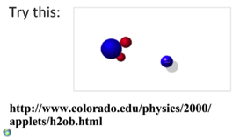
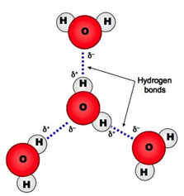
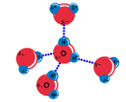
2.2.U1 Water molecules are polar and hydrogen bonds form between them.
Water (H₂O) is made up of two hydrogen atoms covalently bound to an oxygen atom
While this bonding involves the sharing of electrons, they are not shared equally
The number of protons in each atom is different; oxygen atoms have 8 whilst hydrogen atoms have just 1
having more protons the oxygen atoms attract the electrons more strongly
Thus the oxygen atom becomes slightly negative and the hydrogen atoms become slightly positive
(i.e. the oxygen has a higher electronegativity)
Covalently bonded molecules that have a slight potential charge are said to be polar
The slightly charged regions of the water molecule can attract other polar or charged compounds
Water molecules can associate via weak hydrogen bonds
Hydrogen bonds are transitory in nature – they constantly form, break and re-form
Animated tutorial on hydrogen bonding
http://programs.northlandcollege.edu/biology/biology1111/animations/hydrogenbonds.html

Slide 4
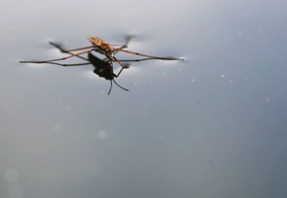
2.2.U2 Hydrogen bonding and dipolarity explain the cohesive, adhesive, thermal and solvent properties of water.
Nature of science:
Use theories to explain natural phenomena—the theory that hydrogen bonds form between water molecules explains the properties of water. (2.2)
Cohesion:
This property occurs as a result of the polarity of a water molecule and its ability to form hydrogen bonds
Although hydrogen bonds are weak the large number of bonds present (each water molecule bonds to four others in a tetrahedral arrangement) gives cohesive forces great strength
Water molecules are strongly cohesive (they tend to stick to one another)
Water droplets form because the cohesive forces are trying to pull the water into the smallest possible volume, a sphere.
Surface tension is caused by the cohesive hydrogen bonding resisting an object trying to penetrate the surface.
n.b. capillary action is to cohesion and adhesion and so dealt with under adhesion.
http://ib.bioninja.com.au/standard-level/topic-3-chemicals-of-life/31-chemical-elements-and.html

Slide 5
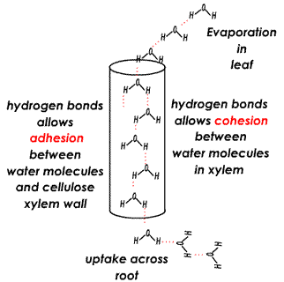
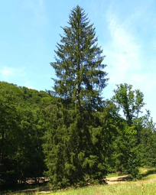
2.2.U2 Hydrogen bonding and dipolarity explain the cohesive, adhesive, thermal and solvent properties of water.
Nature of science:
Use theories to explain natural phenomena—the theory that hydrogen bonds form between water molecules explains the properties of water. (2.2)
Water droplets stick to surface and seem to defy gravity because of form because the adhesive forces that bond them to the surface of the grass blade.
Adhesion:
This property occurs as a result of the polarity of a water molecule and its ability to form hydrogen bonds
Water molecules tend to stick to other molecules that are charged or polar for similar reasons that they stick to each other
Again similarly individual hydrogen bonds are weak, but large number of bonds gives adhesive forces great strength
Capillary action is caused by the combination of adhesive forces causing water to bond to a surface, e.g. the sides of a xylem vessel and the cohesive forces bonding water molecules together. Capillary action is helpful in the movement of water during transpiration and also when you drink using a straw.
http://click4biology.info/c4b/9/plant9.2.htm
http://commons.wikimedia.org/wiki/File:GemeineFichte.jpg

Slide 6
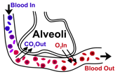
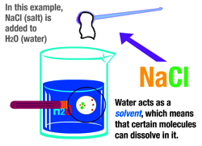
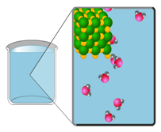
2.2.U2 Hydrogen bonding and dipolarity explain the cohesive, adhesive, thermal and solvent properties of water.
Nature of science:
Use theories to explain natural phenomena—the theory that hydrogen bonds form between water molecules explains the properties of water. (2.2)
Solvent:
Water can dissolve many organic and inorganic substances that have charged or polar regions.
The polar attraction of large quantities of water molecules can interrupt intramolecular forces (such as ionic bonds) and resulting in the dissociation of the atoms
Positive atoms, e.g. Na+ end up being surrounded by the negative oxygen regions of water molecules and the Cl- being surrounded by the positive hydrogen region of water molecules
Because of this water is often (wrongly) referred to as being the ‘universal solvent’, it is however a very good solvent for many substances.
Metabolic reactions happen most readily in solutions of water – water in cells dissolves the reactants /substrates
Cells are mostly water therefore diffusion into and out of them happens most easily if the substance concerned is in solution, e.g. before oxygen diffuses from the alveoli to the blood it dissolves into the moist layer lining the alveoli.
http://upload.wikimedia.org/wikipedia/commons/8/8b/Alveoli.svg
Soluble substances such as sucrose can be easily transported around the plant in the phloem. Once dissolved in the water of the phloem the sucrose can be moved to where it is needed by mass flow.
http://www.northland.cc.mn.us/biology/Biology1111/animations/dissolve.swf
http://www.sumanasinc.com/webcontent/animations/content/propertiesofwater/water.html

Slide 7
What kind of bears dissolve in water?

Slide 8
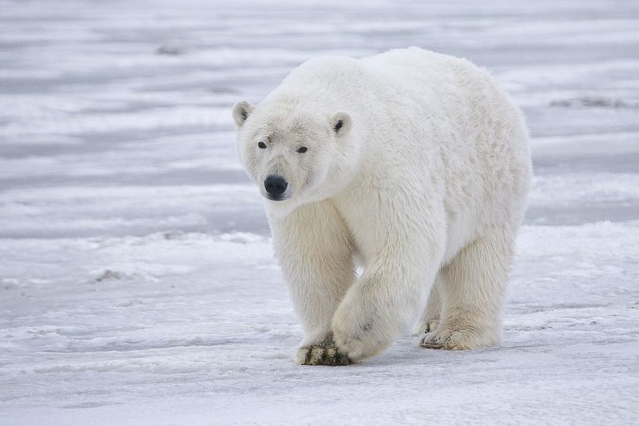
Polar Bears!
https://upload.wikimedia.org/wikipedia/commons/0/09/Polar_Bear_-_Alaska.jpg

Slide 9
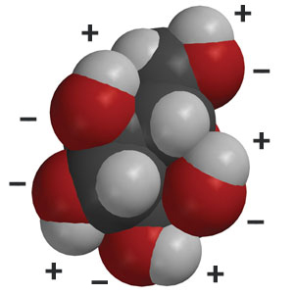
2.2.U3 Substances can be hydrophilic or hydrophobic.
hydrophilic
This term is used to describe substances that are chemically attracted to water.
( water loving )
All substances that dissolve in water are hydrophilic, including polar molecules such as glucose, and particles with positive or negative charges such as sodium and chloride ions.
Substances that water adheres to, cellulose for example, are also hydrophilic.
A space filling molecular diagram of glucose showing the positive and negative charges
http://www.middleschoolchemistry.com/img/content/multimedia/chapter_5/lesson_7/glucose.jpg

Slide 10
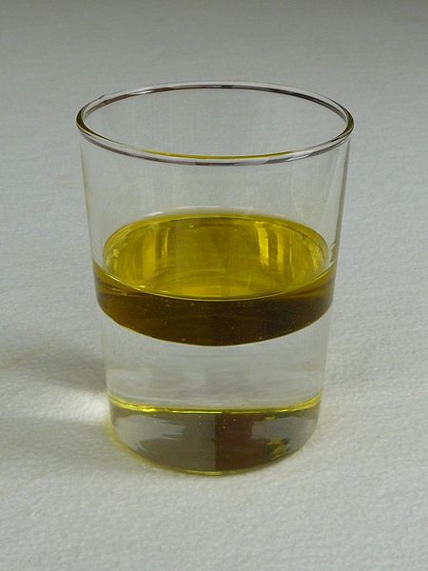
2.2.U3 Substances can be hydrophilic or hydrophobic.
hydrophobic
This term is used to describe substances that are insoluble in water
( water fearing )
Molecules are hydrophobic if they do not have negative or positive charges and are nonpolar
All lipids are hydrophobic, including fats and oils
Hydrophobic molecules dissolve in other solvents such as propanone (acetone)
http://upload.wikimedia.org/wikipedia/commons/thumb/f/f1/Water_and_oil.jpg/450px-Water_and_oil.jpg

Slide 11
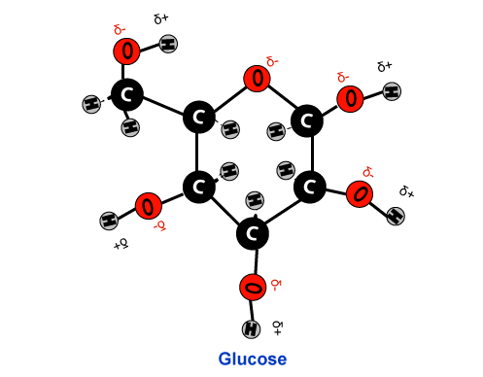
2.2.A3 Modes of transport of glucose, amino acids, cholesterol, fats, oxygen and sodium chloride in blood in relation to their solubility in water.
Blood plasma consists of mainly of water (95%) plus dissolved substances which it transports.
Glucose
polar molecule hence freely soluble
carried by the blood plasma
http://4.bp.blogspot.com/-71TuXJIWv8o/UChT59p73fI/AAAAAAAAAFY/B1zkMgT-dlA/s1600/Glucose.png

Slide 12
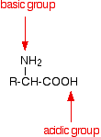
2.2.A3 Modes of transport of glucose, amino acids, cholesterol, fats, oxygen and sodium chloride in blood in relation to their solubility in water.
Amino acids
Positive and negative charges (due to the amine and acid groups) therefore soluble in water
R group varies, can be polar, non-polar or charged
R group determines the degree of solubility
carried by the blood plasma
There is an internal transfer of a hydrogen ion from the -COOH group to the -NH2 group to leave an ion with both a negative charge and a positive charge.
n.b. the bullet points summarise what you need to know the chemistry gives a more complete understanding for those who want to know why
http://chemwiki.ucdavis.edu/Under_Construction/Chemguide_(Jim_Clark)/Properties_of_Organic_Compounds/XIII._Amino_Acids_and_Other_Biochemistry/A._Amino_Acids/2._Acid-Base_Reactions_of_Amino_Acids

Slide 13
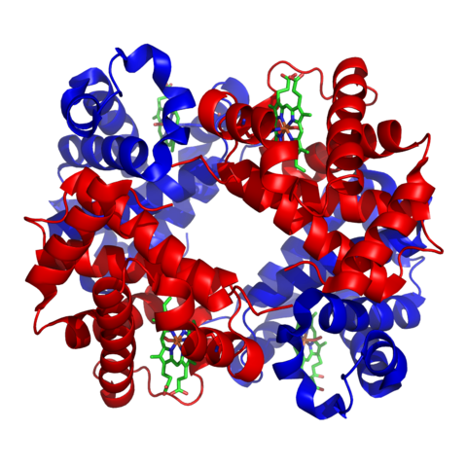
2.2.A3 Modes of transport of glucose, amino acids, cholesterol, fats, oxygen and sodium chloride in blood in relation to their solubility in water.
O = O
Oxygen
Non-polar molecule
Due to the small size of an oxygen molecule it is soluble in water, but only just
water becomes saturated with oxygen at relatively low concentrations
As temperature increases the solubility of oxygen decreases
At body temperature (37 °C) very little oxygen can be carried by the plasma, too little to support aerobic respiration
hemoglobin in red blood cells carry the majority of oxygen
Hemoglobin has (4) binding sites for oxygen
Hemoglobin
https://upload.wikimedia.org/wikipedia/commons/thumb/3/3d/1GZX_Haemoglobin.png/480px-1GZX_Haemoglobin.png

Slide 14
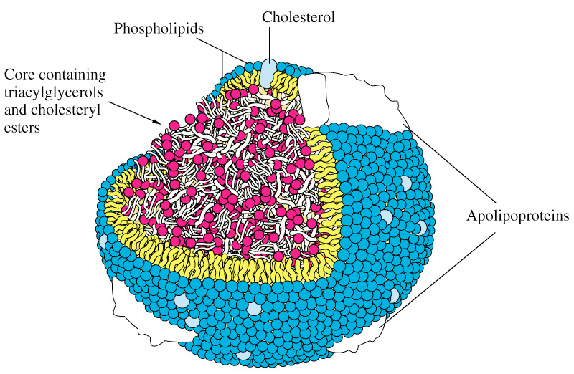
2.2.A3 Modes of transport of glucose, amino acids, cholesterol, fats, oxygen and sodium chloride in blood in relation to their solubility in water.
Fats
Large, non-polar molecules
insoluble in water
They are carried in blood inside lipoprotein complexes (in the plasma)
Lipoprotein complex
Outer layer consists of single layer of phospholipid molecules
hydrophilic phosphate heads of the phospholipids face outwards and are in contact with water
The hydrophobic hydrocarbon tails face inwards and are in contact with the fats
cholesterol molecules are positioned in the phospholipid monolayer - hydrophilic region facing outwards
Proteins are also embedded in the phospholipid layer (hence the name)
Cholesterol
molecules are hydrophobic, apart
from a small hydrophilic region at one end
This is not enough to make cholesterol dissolve in water
They are carried in blood in lipoprotein complexes (in the plasma)
http://chienlab.wikispaces.com/file/view/lipoprotein.jpg/45882185/lipoprotein.jpg

Slide 15
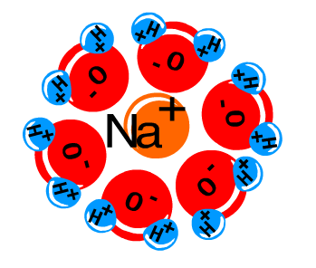
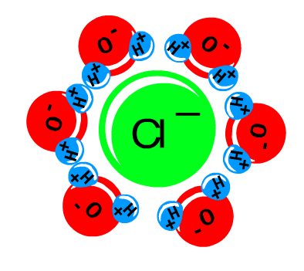
2.2.A3 Modes of transport of glucose, amino acids, cholesterol, fats, oxygen and sodium chloride in blood in relation to their solubility in water.
Sodium Chloride
ionic compound
freely soluble in water
dissolving to form sodium ions (Na+) and chloride ions (Cl-)
carried in the blood plasma
http://www.northland.cc.mn.us/biology/Biology1111/animations/dissolve.swf

Slide 16
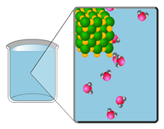
2.2.U2 Hydrogen bonding and dipolarity explain the cohesive, adhesive, thermal and solvent properties of water.
Nature of science:
Use theories to explain natural phenomena—the theory that hydrogen bonds form between water molecules explains the properties of water. (2.2)
Thermal:
Water has a high specific heat capacity (4.2 Joules is required to raise the temperature of 1 g of water by 1°C)
Water has a high heat of vaporisation (amount of energy needed to change from a liquid to a gas or vapour)
Water has a high heat of fusion (amount of energy needed to be lost to change liquid water to ice)
These properties are due to many hydrogen bonds that need to be formed or broken to change the temperature or state of water
Therefore the temperature of water remains relatively stable
http://www.sumanasinc.com/webcontent/animations/content/propertiesofwater/water.html
Water is used by Leaves as a coolant. The heat lost from leaves for evaporation prevents them over-heating. If the leaves get too hot enzymes in their cells will start to denature.
http://www.flickr.com/photos/jaxxon/37559138/

Slide 17
2.2.A2 Use of water as a coolant in sweat.

Slide 18
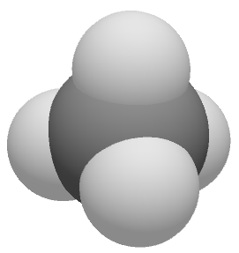
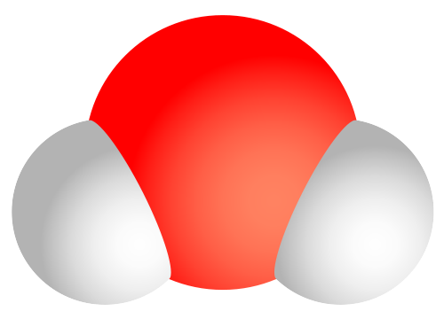
2.2.A1 Comparison of the thermal properties of water with those of methane.
 | Methane | Water
Formula | CH₄ | H₂O
Molecular mass | 16 | 18
Bonding | Single covalent
Polarity | Polar | nonpolar
Density (g cm⁻³) | 0.46 | 1
Specific Heat Capacity (J g⁻¹ ºc⁻¹) | 2.2 | 4.2
Latent heat of vapourisation (J g⁻¹) | 760 | 2257
Melting point (ºC) | -182 | 0
Boiling point (ºC) | -160 | 100
Methane
waste product of anaerobic respiration in certain prokaryotes living in anaerobic conditions
Methane can be used as a fuel
If present in the atmosphere it contributes to the greenhouse effect.
Key chemical property that causes the major differences seen in the physical properties.
Methanogenic prokaryotes
can be found in swamps, wetlands, the guts of animals (including cattle and sheep)
can also be found in waste dumps
https://commons.wikimedia.org/wiki/Water_molecule#mediaviewer/File:Water_molecule.svg
https://upload.wikimedia.org/wikipedia/commons/5/55/3D_methane.PNG

Slide 19
Bibliography / Acknowledgments
Jason de Nys

